Slide 1
BIB 114 Unit #1 Sessions 3 & 4
#3. Historical Background
#4. The Jewish Religious System

Slide 2
Unit # 1 Session #3

Slide 3
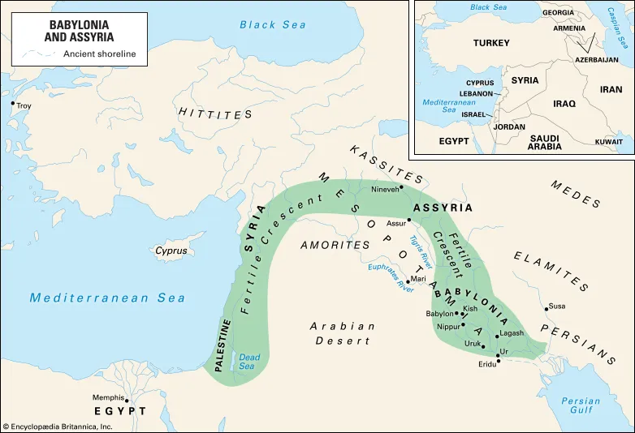
OT History
Assyria conquers N. Kingdom (Israel) 722 bc
Babylon conquers S. Kingdom (Judah) 586 bc King Nebuchadnezzar
Medes & Persians conquer Babylon 539 bc Cyrus the Great

Slide 4
Assyrian captivity (722bc)= cruel, forced interracial marriages to destroy ethnic lines – creating the Samaritans, remember Goyim (Gentiles) meaning “subhuman”
Babylonian captivity (586bc)= Prophesied during Moses’ leadership, prophesied as the 70-year captivity
Medes and Persian captivity (539bc)= Cyrus’ name mentioned in the book of Isaiah over 125 years before his rule. This led him to allow and pay for Jews to return home and rebuild their wall, city, and the Temple.

Slide 5
Significant and transitional history
Intertestamental Period = years between Malachi and Matthew, approximately 400 years
331bc = Alexander the Great conquers Babylon and gains control of Palestine, etc
Greeks rule favored: education (math, philosophy, language, politics, art, literature, and culture). Greek became the predominate ‘world language’ making it easier to preach the gospel later. Hellenists/Hellenistic rooted in culture.
Antiochus Epiphanes – Grk Emperor in 168bc (Daniel 12:11’s prophesy seen in Mark) cause the ‘Abomination of Desolation’ killing over 8,000 Jews in three days and sacrificed a huge pig on the Temple altar causing the Maccabean Revolt
Maccabean Revolt = (167-160 bc) Hasmoneans (the Hammar) Maccabees and his priestly family revolted and won independence from Greek rule.

Slide 6
Roman Empire in Israel
74-73bc = Masada Revolt/Roman Siege – 960 Jews killed themselves to ‘live free’
70bc = Romans conquer Israel
63bc = Pompey conquers Jerusalem
47bc = Antipater (an Edomite) schemed with the Romans to help take control of Jerusalem. He is the father of Herod the Great. (Edomites – Esau’s family line - making him ‘kind of Jewish’)
Roman Influences: Roads, Administration, legal and political systems still linger

Slide 8
Session #3
Worksheet #5

Slide 9
Visual 8 & 9

Slide 10
Unit #1
Session #4

Slide 11
The Jewish religious system – Synagogues, Pharisees, and Sadducees
Pharisees = ‘R’ Sadducees = ‘D’
Synagogues – synagogues were the local churches. They were responsible for providing education, spiritual and social support – a place to ‘safeguard’ their teachings and faith. Any Jewish Community with 10 or more men, could establish a synagogue, smaller communities would combine their communities to have a shared local synagogue.
The Temple – located in Jerusalem, the main place/center of worship for the Jewish Nation

Slide 12
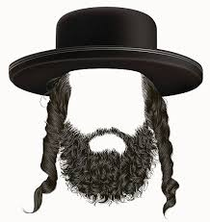
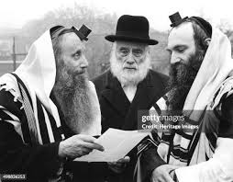
The Pharisees – ‘The separated ones’
Intertestamental Time – Hellenism started to mix in with Judaism; becoming very offensive to the orthodox (strict) Jews in Palestine. The extreme Orthodox Jews were often a part of the group Hasidic/Hasidim (‘pious ones’) Jews
Their goal was to preserve the true and pure Judaism, to protect and maintain the purity of the Law of God… ‘Pharisee’ often used to infer ‘self-righteous hypocrite’

Slide 13
Nicodemus and Paul were Pharisees

Slide 15
Sadducees cared mostly about their own wealth – making them less popular than the Pharisees
Joseph of Arimathea was a Sadducee
Jesus’ rebuke to the Pharisee were mostly about their attitudes – not their theology! They knew the truth but often did not practice the truth…

Slide 16
Essenes, zealots and scribes:
Essenes = Extreme Pharisees who separated themselves from society, lived in isolated communities, John the Baptist had Essene tendencies
Zealots = Israel’s ‘patriots’ – followed the tradition of Phinehas (Num. 25: 1-13) a grandson of Aaron who dealt with sin in honor of the Lord. Zealots, however, used violence to achieve their political goals. Matt 22:15-22; and 26: 50-54. Simon the Zealot was a Disciple (Matt 10:4)
Scribes = OT – more like secretaries or clerks. (Ezra 7:11) NT – like lawyers, copying, preserving, and interpreting the Law – very respected

Slide 18
The sanhedrin
The highest governing council and local judicial council dealing with Jewish religious and civil matters
‘Sanhedrin’ not found in the NT, however called ‘Council’ or ‘Court’ – Mark 14:55 is an example
Mostlikely from Num 11: 16-24 = established in the days of Moses with 71 members

Slide 19
Nicodemus and Joseph of Arimathea both served on the Great Sanhedrin or Supreme Court
John 3:1; Mark 15: 42-46; Luke 23: 50-54; & John 19: 38 - 42

