Slide 1
Unit 3 Chapter 8
Lesson 8.1 Salvation Under the Old Covenant and the New
Lesson 8.2 Three Types of Old Testament Laws

Slide 2
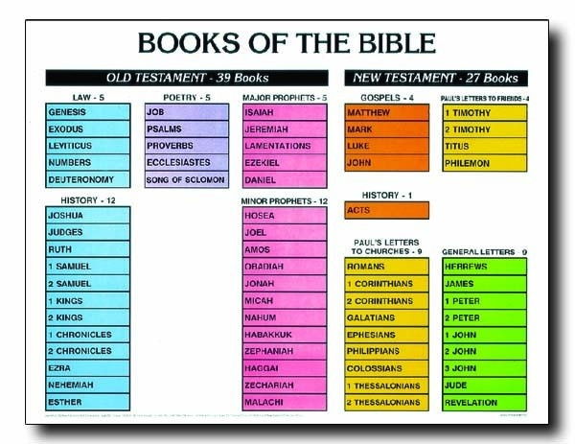
Salvation Under the Old Covenant and the New
8.1
Also called the Pentateuch
The “Laws” were Genesis,
Exodus, Leviticus, Numbers,
and Deuteronomy
Revelation is called Apocalyptic Literature

Slide 3
The Covenant
Gen 12 God’s covenant with Abraham
The Covenant renewed/passed on to Isaac and Jacob
400 years later – it was renewed and passed on to the Jews through Moses
Like a road map: stay on the road and be blessed; off the road – face consequences
Remember that (between Ex 20 – Deuteronomy 33) it is about a covenant between God and the Jews, based on the Law of Moses.

Slide 4
The New Covenant explained in Hebrews:
“By calling this covenant “new,” He has made the first one obsolete; and what is obsolete (not work) and aging will soon disappear. (Hebrews 8:7–13; compare Jeremiah 31:31–34) Christians are not under the old covenant based on Law.”
Christians are not under the old covenant based on Law:
For sin shall not be your master, because you are not under law, but under grace. (Romans 6:14)
Clearly no one is justified before God by the law, because, “The righteous will live by faith.” (Galatians 3:11)

Slide 5
Salvation by Faith in God, through the Sacrifice He Accepts
Always thru blood
Adam and Eve: Gen 2 – 3
Cain and Abel: Gen 4
Noah (after the flood): Gen 8
Abraham: Gen 12 – 22
Job: Job 1
Moses and the Law: Ex 12+
“For the life of a creature is in the blood, and I have given it to you to make atonement for yourselves on the altar; it is the blood that makes atonement for one’s life” (Leviticus 17:11)

Slide 6
Saving Faith Through Good Works and the Spirit of the Law
Faith without works is as dead as the body without the spirit (James 2:14–26).
Balance needed
For it is by grace you have been saved, through faith, and this is not from yourselves, it is the gift of God. Ephesians 2: 8

Slide 7
How do Christians fulfill the OT Law?
In the Old Testament, there are 248 positive (you shall) laws and 365 negative (you shall not) laws (Ryken and Longman 1993, 130). Jesus said that we keep all of His moral laws if we live by one: the law of love.
“Teacher, which is the greatest commandment in the Law?” Jesus replied: “Love the Lord your God with all your heart and with all your soul and with all your mind.” This is the first and greatest commandment. And the second is like it; ‘Love your neighbor as yourself.’ All the Law and the Prophets hang on these two commandments.” (Matthew 22:36–40)

Slide 8
Matthew 5: 17 - 20
“Do not think that I have come to abolish the Law or the Prophets; I have not come to abolish them but to fulfill them. I tell you the truth, until heaven and earth disappear, not the smallest letter, not the least stroke of a pen, will by any means disappear from the Law until everything is accomplished. Anyone who breaks one of the least of these commandments and teaches others to do the same will be called least in the kingdom of heaven, but whoever practices and teaches these commands will be called great in the kingdom of heaven. For I tell you that unless your righteousness surpasses that of the Pharisees and the teachers of the law, you will certainly not enter the kingdom of heaven.”

Slide 9
Jesus taught that both the fruit (actions we see) and the root of sin (in the heart) are wrong.
Matthew 5 | Fruit of Sin | Root of sin
5: 21 – 22 | Murder | Anger
5: 27 – 28 | Adultery | Lust
5: 31 – 32 | Divorce | Selfishness
5: 33 – 34 & 37 | Breaking oaths | Being dishonest
5: 38 – 39 | Revenge | Unforgiveness
5: 43 – 48 | Hating enemies | Lack of love
Jesus emphasized the principles, the spirit of the Law, rather than the commandments, the letter of the law.

Slide 10
Three Types of Laws in the Old Testament: Ceremonial, Civil, and Moral
8.2
Type of Law | Examples | Length of Time | Purpose
1. Ceremonial Laws about religious rites (vertical in nature) | Laws about sacrifices, priests, the tabernacle, holy days, feasts, fasts, cleansing, and circumcision | Temporary | To prepare people for Christ’s coming To give us illustrations of spiritual truths
2. Civil A. Laws against practices of unholy, pagan neighbors: Canaanites B. Laws about relating to holy, Jewish neighbors (horizontal nature) | Laws about food and Farming Laws about penalties, slavery, marriage, war, judges, and courts | Temporary | To keep God’s people separate from pagan worship and customs To explain what God said was just and fair. These illustrate moral truths

Slide 11
Type of Law | Examples | Length of Time | Purpose
3. Moral (Ethical) Laws about right and wrong (vertical in nature) | Ten Commandments; Love your neighbor; Do not seek revenge | Eternal | To give us eternal, moral laws that do not change. The NT repeats moral laws of the OT
Look beneath the OT principle to find | current application:
“If a man borrows an animal from his neighbor and it is injured or dies while the owner is not present, he must make restitution.” (Exodus 22:14) | If you borrow something and it breaks – you are responsible to replace it at the same value
When you build a new house, make a parapet around your roof so that you may not bring the guilt of bloodshed on your house if someone falls from the roof. (Deuteronomy 22:8) | A parapet = railing Principle of doing everything you can to keep your home as safe as possible

