Slide 1
THEO 211 Chapters 8 - 11

Slide 2
#9 . Sanctification
Sanctification is an act of separation from that which is evil, and of dedication unto God (Rom 12:1–2; 1 Thess 5:23; Heb 13:12). Scriptures teach a life of “holiness without which no man shall see the Lord” (Heb 12:14). By the power of the Holy Spirit we are able to obey the command: “Be ye holy, for I am holy” (1 Peter 1:15–16). Sanctification is realized in the believer by recognizing his identification with Christ in His death and resurrection, and by faith reckoning daily upon the fact of that union, and by offering every faculty continually to the dominion of the Holy Spirit (Rom 6:1–11,13; 8:1–2,13; Gal 2:20; Philip 2:12–13; 1 Peter 1:5).

Slide 3
Hebrews 12:14 reads, “Make every effort to live in peace with all men and to be holy; without holiness no one will see the Lord.”
Sanctification targets character. The most important key to success in ministry is one’s character.
Sanctification Defined:
The central idea of sanctification is separation—being separated from evil and set apart or separated (devoted) to God. Another word for sanctify is consecrate.

Slide 4
Holiness, Righteousness & Sanctification:
Holiness is conformity to divine nature,
Righteousness is conformity to divine law.
Sanctification is the process by which God makes people holy and righteous.

Slide 5
Instant and Progressive Sanctification
Actual holiness is having God’s holiness visible in our lives to those around us.
Positional holiness is how God sees us: made holy by the blood of Jesus, our sins covered by grace.
Sanctification is a cooperative effort between God and us. We cannot be made holy without God’s work in our lives, but we must also do our part.

Slide 6
#10. The Church and Its Mission
The Church is the body of Christ, the habitation of God through the Spirit, with divine appointments for the fulfillment of her Great Commission. Each believer, born of the Spirit, is an integral part of the general assembly and church of the firstborn, which are written in heaven (Ephesians 1:22–23; 2:22; Hebrews 12:23). Since God’s purpose concerning man is to seek and to save that which is lost, to be worshipped by man, to build a body of believers in the image of His Son, and to demonstrate His love and compassion for all the world,

Slide 7
The priority reason for being of the Assemblies of God as part of the Church is: a. To be an agency of God for evangelizing the world (Acts 1:8; Matt 28:19–20; Mark 16:15–16). b. To be a corporate body in which man may worship God (1 Cor 12:13). c. To be a channel of God’s purpose to build a body of saints being perfected in the image of His Son (Eph 4:11–16; 1 Cor 12:28; 14:12). d. To be a people who demonstrate God’s love and compassion for all the world (Ps 112:9; Gal 2:10; 6:10; James 1:27).

Slide 8
The Assemblies of God exists expressly to give continuing emphasis to this reason for being in the New Testament apostolic pattern by teaching and encouraging believers to be baptized in the Holy Spirit. This experience: a. Enables them to evangelize in the power of the Spirit with accompanying supernatural signs (Mark 16:15–20; Acts 4:29–31;
Heb 2:3–4). b. Adds a necessary dimension to a worshipful relationship with God (1 Cor 2:10–16; 1 Cor 12–14). c. Enables them to respond to the full working of the Holy Spirit in expression of fruit and gifts and ministries as in New Testament times for the edifying of the body of Christ and care for the poor and needy of the world (Gal 5:22–26; Matt 25:37–40; Gal 6:10; 1 Cor 14:12; Eph 4:11–12; 1 Cor 12:28; Col 1:29).

Slide 9
The Church was birthed on the Day of Pentecost!
Origins of the Term Church
The origins of the term church can be traced back to two sources:
Kuriokosi (Greek) means “belonging to the Lord.” This term was eventually used for the places where people met to worship, since those sites were dedicated to the Lord.
Eccklesia (Greek) means “called out of.” Originally, it referred to a group of men who were called out of their homes or places of work to meet and solve community problems.

Slide 11
The New Testament Church:
The New Testament church is described using three phrases:
1. Bride of Christ
2. Temple of God
3. Body of Christ

Slide 12
The Mission of the Church: {WIFE}
Jesus formed the church with a mission. If the church forgets its mission, it loses its value and becomes little more than a social gathering. The Holy Spirit helps the church fulfill four main objectives.
1. Evangelize—to preach or announce the good news
2. Worship—to express reverence and adoration for God
3. Edify—to build up
4. Show compassion—to help those in need

Slide 13

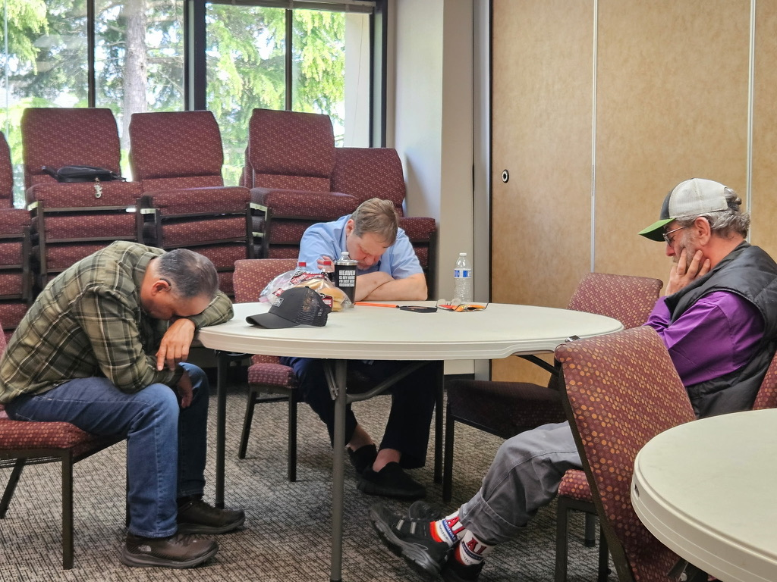
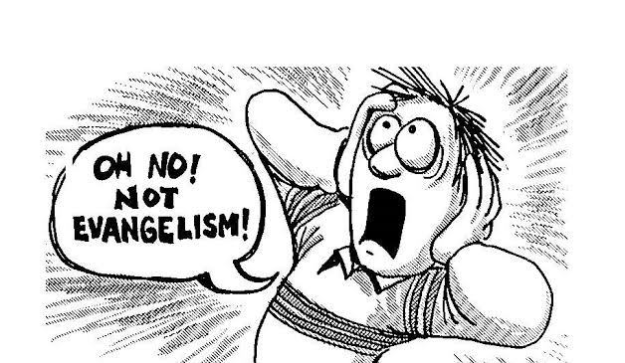
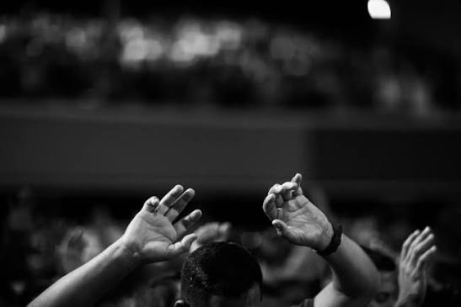
WIFE
W
I
F
E
Worship
Instruction
Fellowship
Evangelism

Slide 14
Edification
“Christ himself gave the apostles, the prophets, the evangelists, the pastors and teachers, to equip his people for works of service, so that the body of Christ may be built up until we all reach unity in the faith and in the knowledge of the Son of God and become mature, attaining to the whole measure of the fullness of Christ” (Ephesians 4:11–13).
God wants believers to build each other up into mature saints.

Slide 15
Eph 4
Apostles: sent one
Prophets: one who speaks to God for the people and one who speaks to the people for God
Evangelists: one with the gift of winning lost souls
Pastors: one who feeds His sheep
Teacher: one anointed to unfold and share His Word

Slide 16
#11. The Ministry
A divinely called and scripturally ordained ministry has been provided by our Lord for the fourfold purpose of leading the Church in: (1) evangelization of the world (Mark 16:15–20),
(2) worship of God (John 4:23–24),
(3) building a Body of saints being perfected in the image of His Son (Ephesians 4:11,16), and
(4) meeting human need with ministries of love and compassion (Psalm 112:9; Galatians 2:10; 6:10; James 1:27).

Slide 17
Minister—The Greek word for minister (diakonos) means “a servant” or “one who serves.”
Priesthood—In the Old Testament, ministry was led by the priests. They served as mediators between God and people. The priesthood was reserved for a chosen few. In the New Testament, that changed. Jesus became the eternal High Priest, allowing us access to God directly. First Peter 2:5 maintains that God’s people are priests as well (so does verse 9).
This means that (1) all Christians can come into God’s presence, and (2) all Christians can be God’s representatives and accomplish His purposes through various ministries. Christian service and a calling

Slide 18
#12 Divine Healing
Divine healing is an integral part of the gospel. Deliverance from sickness is provided for in the Atonement, and is the privilege of all believers (Is 53:4–5; Matt 8:16–17; James 5:14–16).
Through the sin of Adam and Eve sickness and all the difficulties of our lives, go back to that incident.

Slide 19
Causes of Sickness
▪ Personal sin (1 Corinthians 11:29-32)
▪ Demonic attack (Luke 13:11)
▪ The curse on humankind
▪ Malnutrition / poverty
▪ The aging process (Hebrews 9:27)
* Psalms 103: 3, “He Who forgives all your sins and heals all your diseases”

Slide 20
Matthew 10: 8
⁸ Heal the sick, raise the dead, cleanse those who have leprosy, drive out demons. Freely you have received; freely give.

