Slide 1
Ephesians 4:11-16

Slide 2
Ephesians 4:11-16 (NLT)
11 Now these are the gifts Christ gave to the church: the apostles, the prophets, the evangelists, and the pastors and teachers.
12 Their responsibility is to equip God’s people to do his work and build up the church, the body of Christ.
13 This will continue until we all come to such unity in our faith and knowledge of God’s Son that we will be mature in the Lord, measuring up to the full and complete standard of Christ.

Slide 3
Ephesians 4:11-16 (NLT)
14 Then we will no longer be immature like children. We won’t be tossed and blown about by every wind of new teaching. We will not be influenced when people try to trick us with lies so clever they sound like the truth.
15 Instead, we will speak the truth in love, growing in every way more and more like Christ, who is the head of his body, the church.
16 He makes the whole body fit together perfectly. As each part does its own special work, it helps the other parts grow, so that the whole body is healthy and growing and full of love.

Slide 4
Acts 4:11 (NLT)
11 For Jesus is the one referred to in the Scriptures, where it says, 'The stone that you builders rejected has now become the cornerstone.'
Jesus

Slide 5
Ephesians 2:20 (NLT)
20 Together, we are his house, built on the foundation of the apostles and the prophets. And the cornerstone is Christ Jesus himself.
Apostles
Prophets
Jesus

Slide 6
Ephesians 4:11-12 (NLT)
11 Now these are the gifts Christ gave to the church: the apostles, the prophets, the evangelists, and the pastors and teachers.
12 Their responsibility is to equip God’s people to do his work and build up the church, the body of Christ.
Evangelists
Pastors
Teachers
Apostles
Prophets
Jesus

Slide 7
The apostle lives with leaders
The prophet lives with God
The evangelist lives with the lost
The pastor lives with the people
The teacher lives with the word
Evangelists
Pastors
Teachers
Apostles
Prophets
Jesus

Slide 8
Scott
Ron
Daniel
Helen
Talia
Trisha
Earl
Patti
Karen
Daisy
Melvin
Kevin
Dianne
Jon
Beth
Karla
Jennifer
Michael
Nancy
Jay
Linda
Greg
Joanna
Forrest
Jiovanni
Evangelists
Pastors
Teachers
Apostles
Prophets
Jesus

Slide 9
Ephesians 4:11-16 (NLT)
11 Now these are the gifts Christ gave to the church: the apostles, the prophets, the evangelists, and the pastors and teachers.
12 Their responsibility is to equip God’s people to do his work and build up the church, the body of Christ.
13 This will continue until we all come to such unity in our faith and knowledge of God’s Son that we will be mature in the Lord, measuring up to the full and complete standard of Christ.

Slide 10
Ephesians 4:11-16 (NLT)
11 Now these are the gifts Christ gave to the church: the apostles, the prophets, the evangelists, and the pastors and teachers.
12 Their responsibility is to equip God’s people to do his work and build up the church, the body of Christ.
13 This will continue until we all come to such unity in our faith and knowledge of God’s Son that we will be mature in the Lord, measuring up to the full and complete standard of Christ.
Who? body of Christ = You and Your Fellow Believers
What? do his work = Walk with the Lord, Prayer, becoming more and more like Jesus
Why? build up the church = Mature Believers, Growth

Slide 11
Ephesians 4:11-16 (NLT)
11 Now these are the gifts Christ gave to the church: the apostles, the prophets, the evangelists, and the pastors and teachers.
12 Their responsibility is to equip God’s people to do his work and build up the church, the body of Christ.
13 This will continue until we all come to such unity in our faith and knowledge of God’s Son that we will be mature in the Lord, measuring up to the full and complete standard of Christ.
How? unity in our faith = The Whole Gospel

Slide 12
Ephesians 4:11-16 (NLT)
11 Now these are the gifts Christ gave to the church: the apostles, the prophets, the evangelists, and the pastors and teachers.
12 Their responsibility is to equip God’s people to do his work and build up the church, the body of Christ.
13 This will continue until we all come to such unity in our faith and knowledge of God’s Son that we will be mature in the Lord, measuring up to the full and complete standard of Christ.
How? knowledge of God’s Son = Who is Jesus? How would you describe Him? Why did He die for you? Why does He love you?

Slide 13
Ephesians 4:11-16 (NLT)
11 Now these are the gifts Christ gave to the church: the apostles, the prophets, the evangelists, and the pastors and teachers.
12 Their responsibility is to equip God’s people to do his work and build up the church, the body of Christ.
13 This will continue until we all come to such unity in our faith and knowledge of God’s Son that we will be mature in the Lord, measuring up to the full and complete standard of Christ.
How? mature in the Lord = Maturity in all things

Slide 14
Ephesians 4:11-16 (NLT)
11 Now these are the gifts Christ gave to the church: the apostles, the prophets, the evangelists, and the pastors and teachers.
12 Their responsibility is to equip God’s people to do his work and build up the church, the body of Christ.
13 This will continue until we all come to such unity in our faith and knowledge of God’s Son that we will be mature in the Lord, measuring up to the full and complete standard of Christ.
How? full and complete standard of Christ = Full of Christ!
Full of Love, Compassion, Mercy, Obedience, Unity, Wisdom, Peace, Prayer, Service, Worship, Joy, Power, Testimony, etc.

Slide 15
Noun, Oikodomé
Verb, Oikodomeo
oikos + demo = "a home" + "to build" = "to build a house"
(a) the act of "building"; this is used in the New Testament, in the sense of edification, the promotion of spiritual growth, "the things of building up"
(b) "a building" of the future body of the believer, or of a local church, or the whole church, "the body of Christ“
(c) promoting the spiritual growth and development of character of believers, by teaching or by example, for spiritual progress.

Slide 16
Edify – Edification - Oikodomé
Edification is Personal
Edify Each Other
Edify the Church

Slide 17
Edification is Personal
Galatians 5:22-23
22 But the Holy Spirit produces this kind of fruit in our lives: love, joy, peace, patience, kindness, goodness, faithfulness,
23 gentleness, and self-control.
Start with Yourself
You are a building block

Slide 18
Edify Each Other
Romans 14:19 (NKJV)
19 Therefore let us pursue the things which make for peace and the things by which one may edify another.
Romans 14:19 (NLT)
19 So then, let us aim for harmony in the church and try to build each other up.

Slide 19
Edify Each Other
Romans 15:2 (NKJV)
2 Let each of us please his neighbor for his good, leading to edification.
Romans 15:2 (NLT)
2 We should help others do what is right and build them up in the Lord.

Slide 20
Edify Each Other
1 Thessalonians 5:11 (NKJV)
11 Therefore comfort each other and edify one another, just as you also are doing.
1 Thessalonians 5:11 (NLT)
11 So encourage each other and build each other up, just as you are already doing.

Slide 21
Edify the Church
1 Corinthians 14:26 (NKJV)
26 How is it then, brethren? Whenever you come together, each of you has a psalm, has a teaching, has a tongue, has a revelation, has an interpretation. Let all things be done for edification.
1 Corinthians 14:26 (NLT)
26 Well, my brothers and sisters, let’s summarize. When you meet together, one will sing, another will teach, another will tell some special revelation God has given, one will speak in tongues, and another will interpret what is said. But everything that is done must strengthen all of you.

Slide 22
Edify the Church
1 Corinthians 3:9 (NKJV)
9 For we are God’s fellow workers; you are God’s field, you are God’s building.
1 Corinthians 3:9 (NLT)
9 For we are both God’s workers. And you are God’s field. You are God’s building.

Slide 23
Edify the Church
Acts 9:31 (NKJV)
31 Then the churches throughout all Judea, Galilee, and Samaria had peace and were edified. And walking in the fear of the Lord and in the comfort of the Holy Spirit, they were multiplied.
Acts 9:31 (NLT)
31 The church then had peace throughout Judea, Galilee, and Samaria, and it became stronger as the believers lived in the fear of the Lord. And with the encouragement of the Holy Spirit, it also grew in numbers.

Slide 24
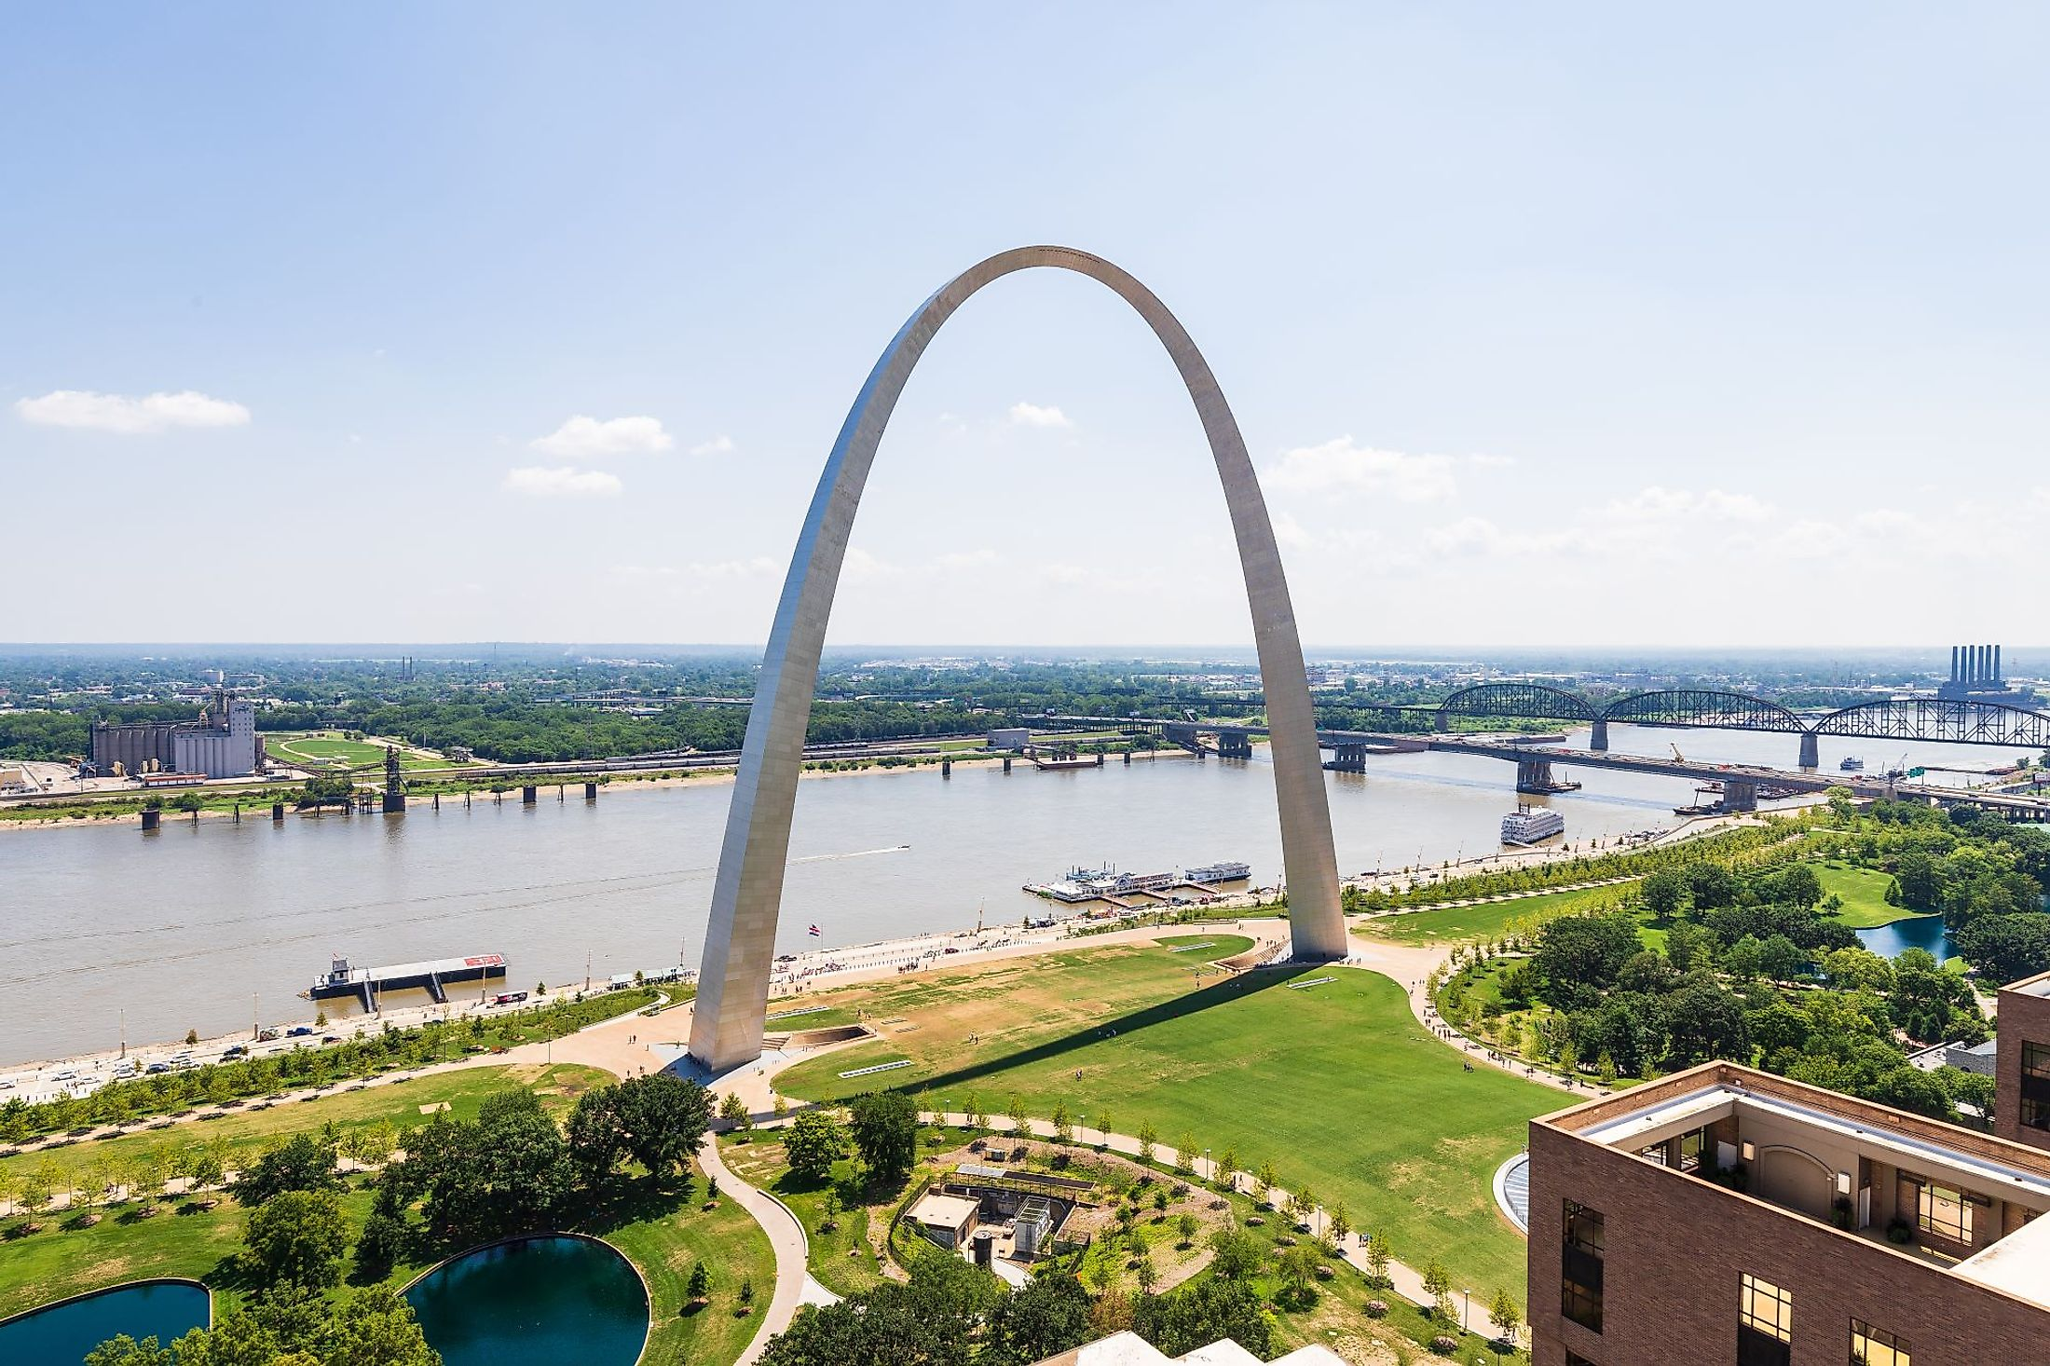

Slide 25
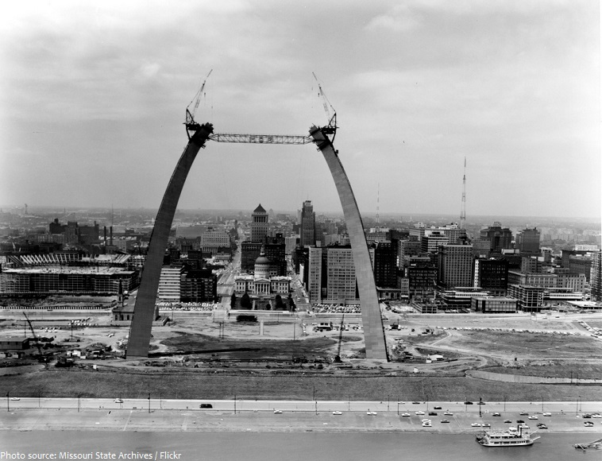

Slide 26
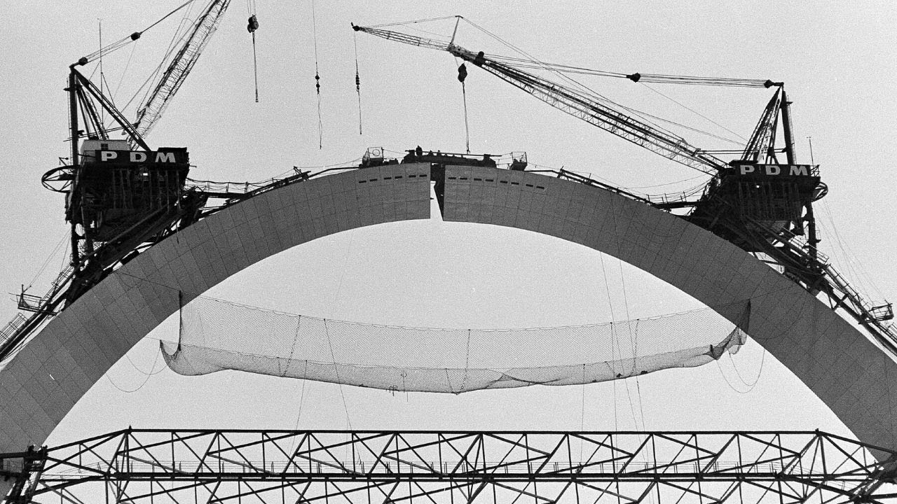

Slide 27
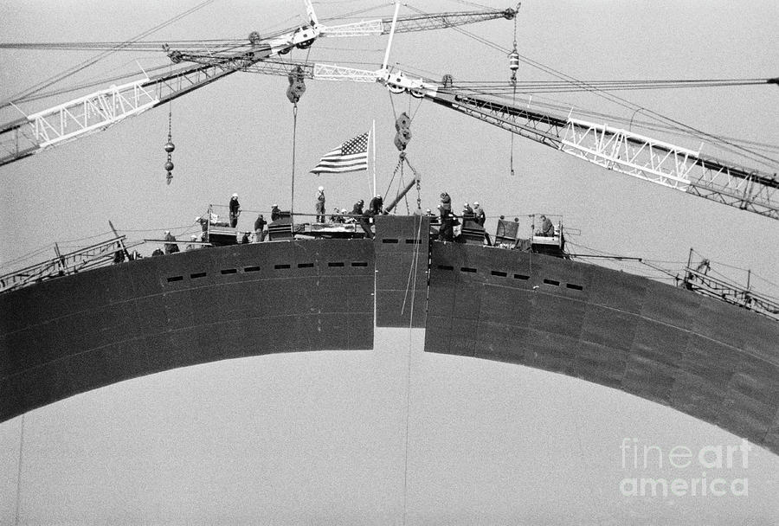

Slide 28
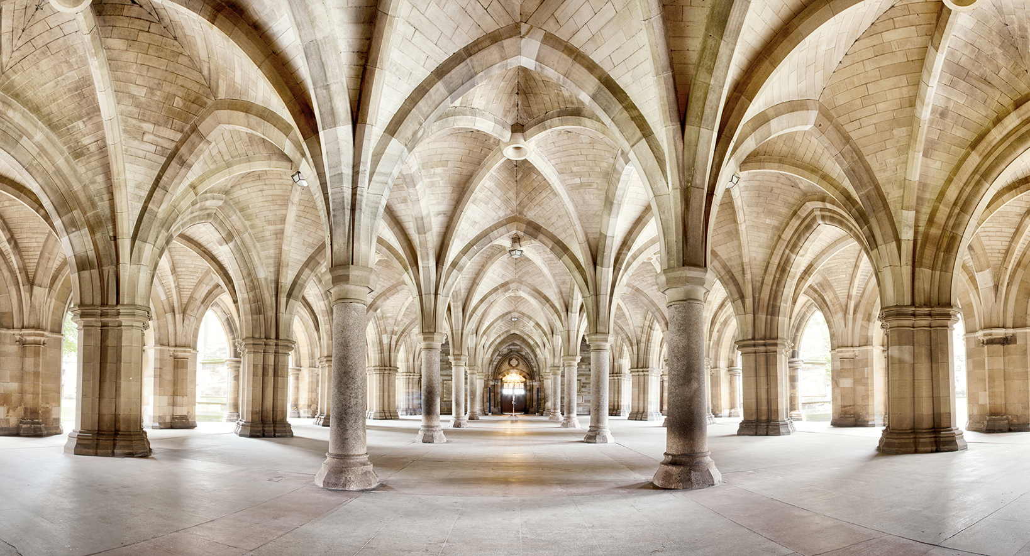

Slide 29
Scott
Ron
Daniel
Helen
Talia
Trisha
Earl
Patti
Karen
Daisy
Melvin
Kevin
Dianne
Jon
Beth
Karla
Jennifer
Michael
Nancy
Jay
Linda
Greg
Joanna
Forrest
Jiovanni
Evangelists
Pastors
Teachers
Apostles
Prophets
Jesus

