Slide 1
BUT … God!
II Kings 4: 8 - 37

Slide 2
Elisha’s Story: I Kings 19
The Nation of Israel divided into 2 separate Nations – King Solomon’s son – Rehoboam – arrogance!
900 bc: Nation of Judah = “State” of Benjamin and “State” of Judah…the other 10 became the Nation of Israel.
I & II Kings – historical perspective
I & II Chronicles – priestly perspective
Same time period, same stories, different purpose for telling

Slide 3
Confusing!!! YES!
The OT big rocks: Adam to Noah to Abraham, Isaac, and Jacob (Patriarchs) to Moses’ time to Joshua (conquering Promise Land) to 14 different Judges to Country ruled by Kings (King Saul 1st)
David (2nd King) to Solomon to Rehoboam to a big big mess!!! Babylonian captivity and Assyrian captivity and Medes and Persian captivity.
God sends the prophets to bring Israel back. 4 Major prophets = Isaiah, Jeremiah, Ezekiel and Daniel. 12 Minor… look them up!

Slide 4
That takes us back to Elisha’s Story:
At each point of Israel’s history – God intervened!
BUT … God!!!

Slide 5
Elisha’s Story begins in I Kings 19: 16 - 21
Elijah’s low after the victory over the 400 prophets of Baal
V. 16 … “anoint Elisha…to succeed you as prophet…”
Vv. 19 – 21 Elijah searched and found Elisha
Elisha was working! (MYOBing) Plowing the family fields
Elijah places his mantel (cloak or coat) on Elisha and leaves
Elisha wants to say goodbye
Elijah responds, “What have I done to you?”
Elisha breaks the yoke, kills the 24 oxen, feeds everyone then says goodbye to his family and follows Elijah

Slide 6
Elijah’s God becomes Elisha’s God…
II Kings 2 – Elijah asks Elisha “What do you want”… Elisha responds a double blessing (Elijah = 14 miracles; Elisha – 28 miracles)
Elijah and the chariots of fire
Elijah’s mantel falls…Elisha picks it up … now, time to cross over the Jordan again…
V14 “where now is the God of Elijah?” Struck the water and it parted
Group of Elijah’s students saw and stated Elijah’s anointing is now on Elisha…

Slide 7
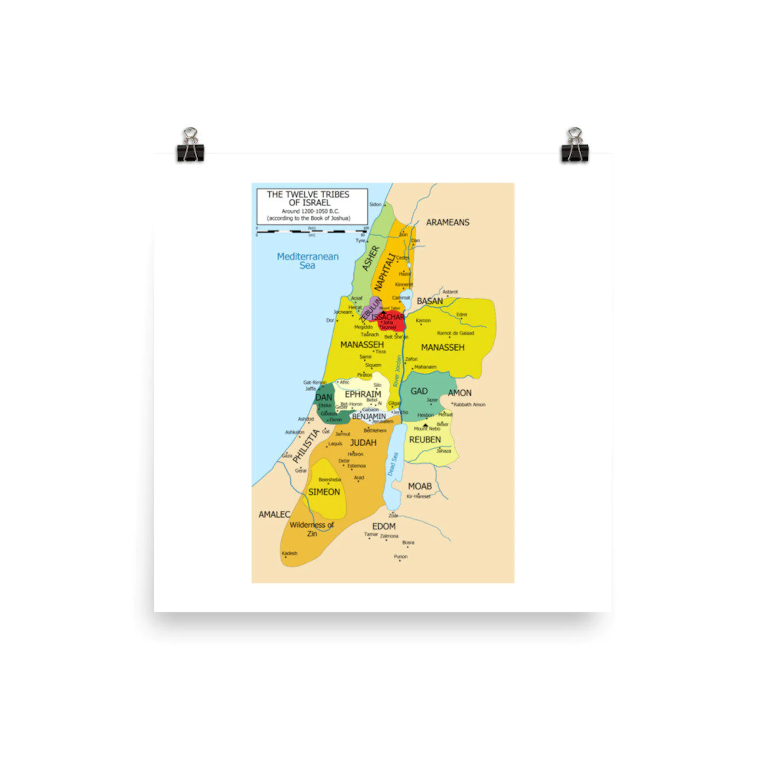
One of the 28 = the Shunammite’s Son
II Kings 4: 8 – 37 and 8: 1- 6
Shunem– a little town in Israel
Shunem means “she knows” or
“to rest”
A wealthy woman or a wealthy
Shunammite woman…

Slide 8
II Kings 4: 8 - 37
Loved the Lord and the prophet, built a special room for Elisha
Granted her the desire of her heart – a child ( a son)
Years later (approximately 10 – 12 years) the son died… she put the boy on Elisha’s bed.
Donkeyed a long distance to find Elisha, fell at his feet…

Slide 9
“I told you not to tease my heart…I did not ask you for a child… and now he is dead…”
Elisha sent his servant to run and place his staff on the boy’s body
Then he and the mother followed, the boy still did not move
Elisha sent everyone out and began to pray, again and again…laid down on top of the boy…twice…then GOD… the boy sneezed and lived again…

Slide 10
Off point! Apply to us HOW???
I didn’t ask for this! You God gave this to me!
Finish, don’t tease me, Lord!
We’re left with confusion and broken hearts!
Remember, You promised!

Slide 11
But God!
Is He the same yesterday, today and forever?
Did Jesus die and rise again to forgive my/your sins?
Can He heal your heart and forgive our sins?
But God!

