Slide 1
Attributes of God continued
Exodus 3: 1 - 15

Slide 2
Definitions: Attributes; Character; & Personality
Attribute: a core/internal quality that defines his/her existence or actions
Characteristics: distinguishing trait that identifies the person coming from attributes
Personality: reflection of one’s character thru thinking, feelings, and behavior
Attribute
Character
Personality

Slide 3
Deaf Community
Attribute = values visibility
Characteristic = attention getting waving hands, etc.
Personality = Americans stomp feet, wave hands, shout, etc.

Slide 4
Attributes of God: (sharing only 6)
God is holy
God is love
God is omniscient = all knowing
God is omnipresent = everywhere, all the time, multi-dimensional
God is omnipotent = all powerful
God is immutable = never changing

Slide 5
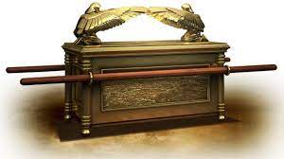
God is holy
Psalms 99: 1- 5, “The Lord reigns, let the nations tremble; He sits enthroned between the cherubim, let the earth shake. Great is the Lord in Zion; He is exalted over all the nations. Let them praise your great and awesome name – He is holy.”
I Chronicles 13, 15, 16
13 - Bringing the Ark of the Covenant back – Uzzah
15 – Bringing the Ark back as commanded
16 – The worship and praise by the people

Slide 6
The sacred…
Became profane…

Slide 7
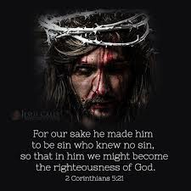
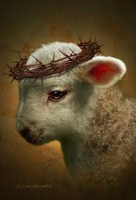
He Who knew no sin – became sin God could not look upon sin – Mark 15

Slide 8
Holiness is a process!
I Peter 1: 15 & 16, “But just as he (Jesus) who called you is holy, so be holy in all you do; for it is written: ‘Be holy, because I am holy.’”

Slide 9
Remember:
He is the same (immutable) yesterday, today, and forever…
He is still holy
How is your progress?

