Slide 1
4-fold or 5-fold Positional Gifts
Ephesians 4: 11 - 13

Slide 2
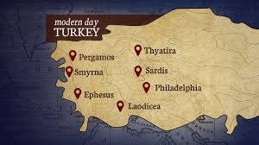
An Introduction to the Book of Ephesians
City like SF
300,000+ ppl
Paul’s 2nd Trip
60 AD Acts 19
3rd largest Roman city
John & Mary’s last home
Temple of Diana/Artemis
262 AD Goths destroyed the city completely
7 Wonders of the World

Slide 3
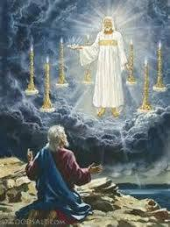
Revelation 2: 1 – 7 Jesus said, “To the angel of the church in Ephesus write: These are the words of Him who holds the 7 stars in His right hand and walks among the 7 golden lampstands
The angel – pastor =
Timothy
7 stars = the 7 pastors
7 golden lampstands = 7 Churches

Slide 4
I know your deeds, your hard work, and your perseverance.
I know you cannot tolerate wicked people, that you test those who claim to be apostles, but are not and have found them false.
You have persevered and have endured hardships for My Name (Jesus), and you have not grown weary.

Slide 5
Yet I hold this against you: You have forsaken the love you had at first.
Consider how far you have fallen!
Repent and do the things you did at first.
If you do not repent, I will come to you and remove your lampstand from its place.

Slide 6
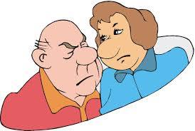
Yet I hold this against you: You have forsaken the love you had at first. – Think of your true love!
Consider how far you have fallen!
Love = duty; sacred becomes profane
Timothy lost his energy, doctrine was fine - heart problem
Repent and do the things you did at first.
A command! Turn around! Change!
If you do not repent, I will come to you and remove your lampstand from its place. Seems they did repent for a while – but by 262 ad … Ephesus is nothing…destroyed completely (Goths)

Slide 7
According to the Expositors’ Greek Testament…
Paul is the author; written between 58 – 64 AD from a Roman prison (wrote Colossians the same time)
To the “saints at Ephesus” – this phrase meant more than separated for believing; it meant those who practiced their faith relationally with Jesus Christ and their fellow believers
Paul visited Ephesus 3 times: 1st Missionary journey (3 months); 2nd Missionary journey (3 years); and on his way to Jerusalem (he called their leaders to Miletus as his final farewell)

Slide 8
Paul’s tone = very excited and joyful … no problem to correct!
Outline:
Greetings (1:1&2)
Divine Purpose Teach the Glory and Headship of Christ (1:3-14)
Prayers that Christians would realize God’s purpose (1:15-23)
Steps towards the fulfillment of God’s purpose (Chpt 2 -3)
Salvation by grace through faith (2:1-10)
Reconciliation of Jew & Gentiles through the Cross (2:11-18)

Slide 9
4) c) Unity of Jew & Gentile in One Household (2:19 – 22)
d) Revelation of God’s wisdom through the Church (3:1-13)
e) Prayer for deeper experience of God’s fullness (3:14-21)
Practical Ways to Fulfill God’s Purpose (Chpt 4:1-6:20)
Unity (4:1-6)
Maturity (4:7-16)
Renewal of personal life (4:17-5:20)
Deference (Others before self) in personal relationships (5:21- 6:9)
Principle (5:21)
Husbands and wives (5:22-33)
Children and parents (6:1-4)
Slaves and masters (6:5-9)
e) Strengthen for Spiritual Conflicts (6:10-20)
6) Conclusion, final greetings and benediction (6:21-24)

Slide 10
Focusing on: #5 b = Maturity Ephesians 4: 7 - 17
“So Christ Himself gave the apostles, the prophets, the evangelists, the pastors and teachers to equip His people for works of service, so that the body of Christ may be built up until we all reach unity in faith and in the knowledge of the Son of God and become mature, attaining to the whole measure of the fullness of Christ.”

