Slide 1
I Am the Light of the world!
John 8: 12 & John 9: 5

Slide 2
Context:
John 7
V1 – 13 Jesus is in the region of Galilee and His brothers are taunting him: you want to be popular – go to the Feast of Tabernacles where everyone is and get the recognition you want! He waits.
V14 He slips into Jerusalem for the Feast and teaches in the Temple half-way through the 7-day festival. Conflict arises between Jesus and the religious leaders (Pharisees and Sadducees).
V34-39 On the last day of the Feast, Jesus says, “if you are thirsty, come and drink…you will never thirst again. Rivers of living water shall flow from within – speaking of the infilling of the Holy Spirit.

Slide 3
Chapter 8
V1-11 Woman caught in adultery, Jesus says, “… Go and leave your life of sin.”
V12ff When He spoke again, He stated, “I am the light of the world, whoever follows Me will never walk in darkness, but will have the light of life.”
A great debate happened again… 8:13 – 59 “Who are you and who do you think you are, Jesus?”

Slide 4
Chapter 9
V1-12 Jesus heals a man who was born blind – His disciples asks, “Who’s fault caused the man’s blindness?”
V5 Jesus heals the man and again states, “I am the Light of the world.”
All this, remember, happened right after the Feast of Tabernacles was celebrated…

Slide 5
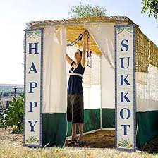
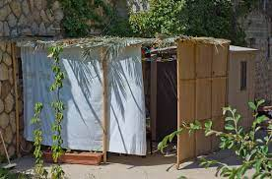
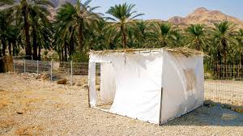
The Feast of Tabernacles (Sukkot)
Established to commemorate Israel’s escape from Egypt
One of 3 Festivals the Israelites were required to return to Jerusalem
They were required to build a dwelling to live in for 7 days – no leaven allowed…

Slide 6
Exodus 13 & 14
Remember the 10 plagues and Pharoah finally letting the Israelites leave after the angel passed over Egypt killing every first-born from homes that did not have the blood of the lamb on their doorposts.
While the Israelites were leaving, Pharoah changed his mind… the Israelites shouted and saw themselves as “ready for battle”
But God led them “out of the way” then towards the Red Sea. V17 because “if they face war, they may run back to Egypt…”
By day the Lord went ahead of them in a pillar of cloud to guide them … and a pillar of fire by night to give them light, so they could travel by day or by night.

Slide 7
Exodus 13: 23 “Neither the pillar of cloud nor the pillar of fire left its place in front of the people
Chapter 14
V8 The Egyptians “marched boldly”
V10 The Israelites were terrified! Remember earlier?
V13-14 Moses said, “Do not be afraid. Stand firm and you will see the deliverance the Lord will bring you today! The Lord will fight for you; you need to be still.”

Slide 8
Exodus 14: 15 - 31
The angel of the Lord with both the pillar of cloud and fire moved to behind the Israelites causing darkness on the Egyptian soldiers and the pillar of fire gave the people light all night.

Slide 9
V21 Moses stretched his hand over the Sea and the Lord drove the water back all night creating a path of dry ground for the Israelites to walk through
V24 And the Lord looked down from the pillar of light…
As long as they were covered by the cloud and followed the light they were saved…
Feast of Tabernacles establish to commemorate that day…

Slide 10
It was with this background that Jesus declare Himself the Light of the World…
As the pillar of light protected and led the Israelites, Jesus is here as the Pillar of Light for our daily lives…

