Slide 1
I Am the Gate
John 10: 1 – 10

Slide 2
John 10: 1 - 10
“Verily, verily, I tell you Pharisees, anyone who does not enter the sheep pen by the gate, but climbs in by some other way, is a thief and a robber.
The one who enters by the gate is the shepherd of the sheep.
The gatekeeper opens the gate for him (shepherd), and the sheep listen to his voice. He calls his sheep by name and they listen to Him.
When he has brought out all of his own, he goes ahead of them, and his sheep follow him because they know his voice.

Slide 3
But they will never follow a stranger; in fact, they will run away from him (the stranger) because they do not recognize a stranger’s voice.
…the Pharisees did not understand…
Jesus said again, “ …I am the gate for the sheep… I am the gate, whoever enters through Me will be saved. They will come in and go out and find pasture. The thief comes only to steal and kill and destroy; I have come that they may have life and have it more fully.”

Slide 4
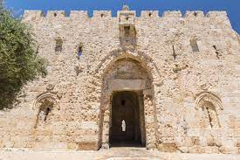
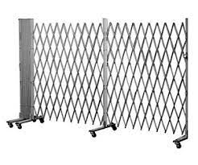
Gate: (grk) Defined as where you enter or exit, can be a movable structure or a permanent attachment on a wall.
Movable gates in the Temple used today
The Golden Gate – gate into old Jerusalem

Slide 5
Biblical uses for their gates:
City leaders would gather together on “bleachers” to:
Complete Financial Transactions = Gen 23 Abraham & Mt. Hebron
Arrange Marriages = Ruth 4
King’s Public Appeal to Israelis = II Samuel 18
Settle Arguments = Amos 5

Slide 6
Solomon’s Temple: only 3 gates were mentioned and Babylon destroyed the Temple in 586 bc. The most detailed record of Jerusalem gates is in Nehemiah 3 – rebuilding of the wall - 10 gates.
V1 Sheep gate = at the NE corner of the wall, used to bring the animal sacrifices to the priests to prepare them for the sacrifices also near the Pool of Bethseda (John 5:2)
V3 & 32 Fish gate = a main entrance to Jerusalem and to the coasts. Today it is known as the Damascus gate. Called Fish gate because this is where the fishermen brought their catch from both Galilee and Tyre.
V6 Old gate = at the NW corner, the oldest gate leading into Jerusalem or “the City of Salem”

Slide 7
V13 Valley gate = Western section where Nehemiah started his tour around the city wall (Nehemiah 2 & 3) and met with the city leaders.
V14 Dung gate = Southern section, this was the “city dump”
V15 Fountain gate = NE of the Dung gate, near the pool of Siloam, by the King’s garden, watered from Gihon Springs, Jesus healing the blind man and sent him to the pool of Siloam (John 9: 7).
V26 Water gate = part of the palace and Temple complex, led to Jerusalem’s water supply (Gihon Springs), also the place where Nehemiah and Ezra read the Laws after over 70 years of captivity

Slide 8
V28 Horse gate = Eastern side overlooking the Kidron Valley. Horses entered and exited Jerusalem here, possibly the gate Jesus entered on the Triumphal Entry, stables were located at the gate.
V29 East gate = Located below today’s Golden gate, this is where people entered to go to the Temple for worship. This is the place of Jesus’ return.
V31 Muster or Inspection (Miphkhad) = Northern most gate, the numbering of tribes done here, the elders sat at this gate judging disputes, the appointed place where sin offerings were burnt, the next gate brings you back to the Sheep gate where assignments to build started.

Slide 9
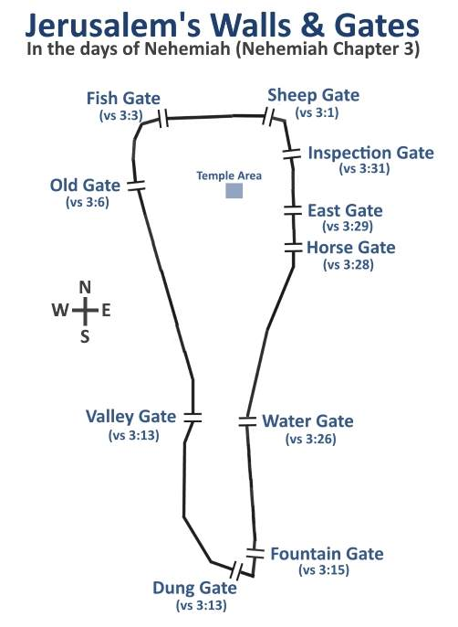

Slide 10
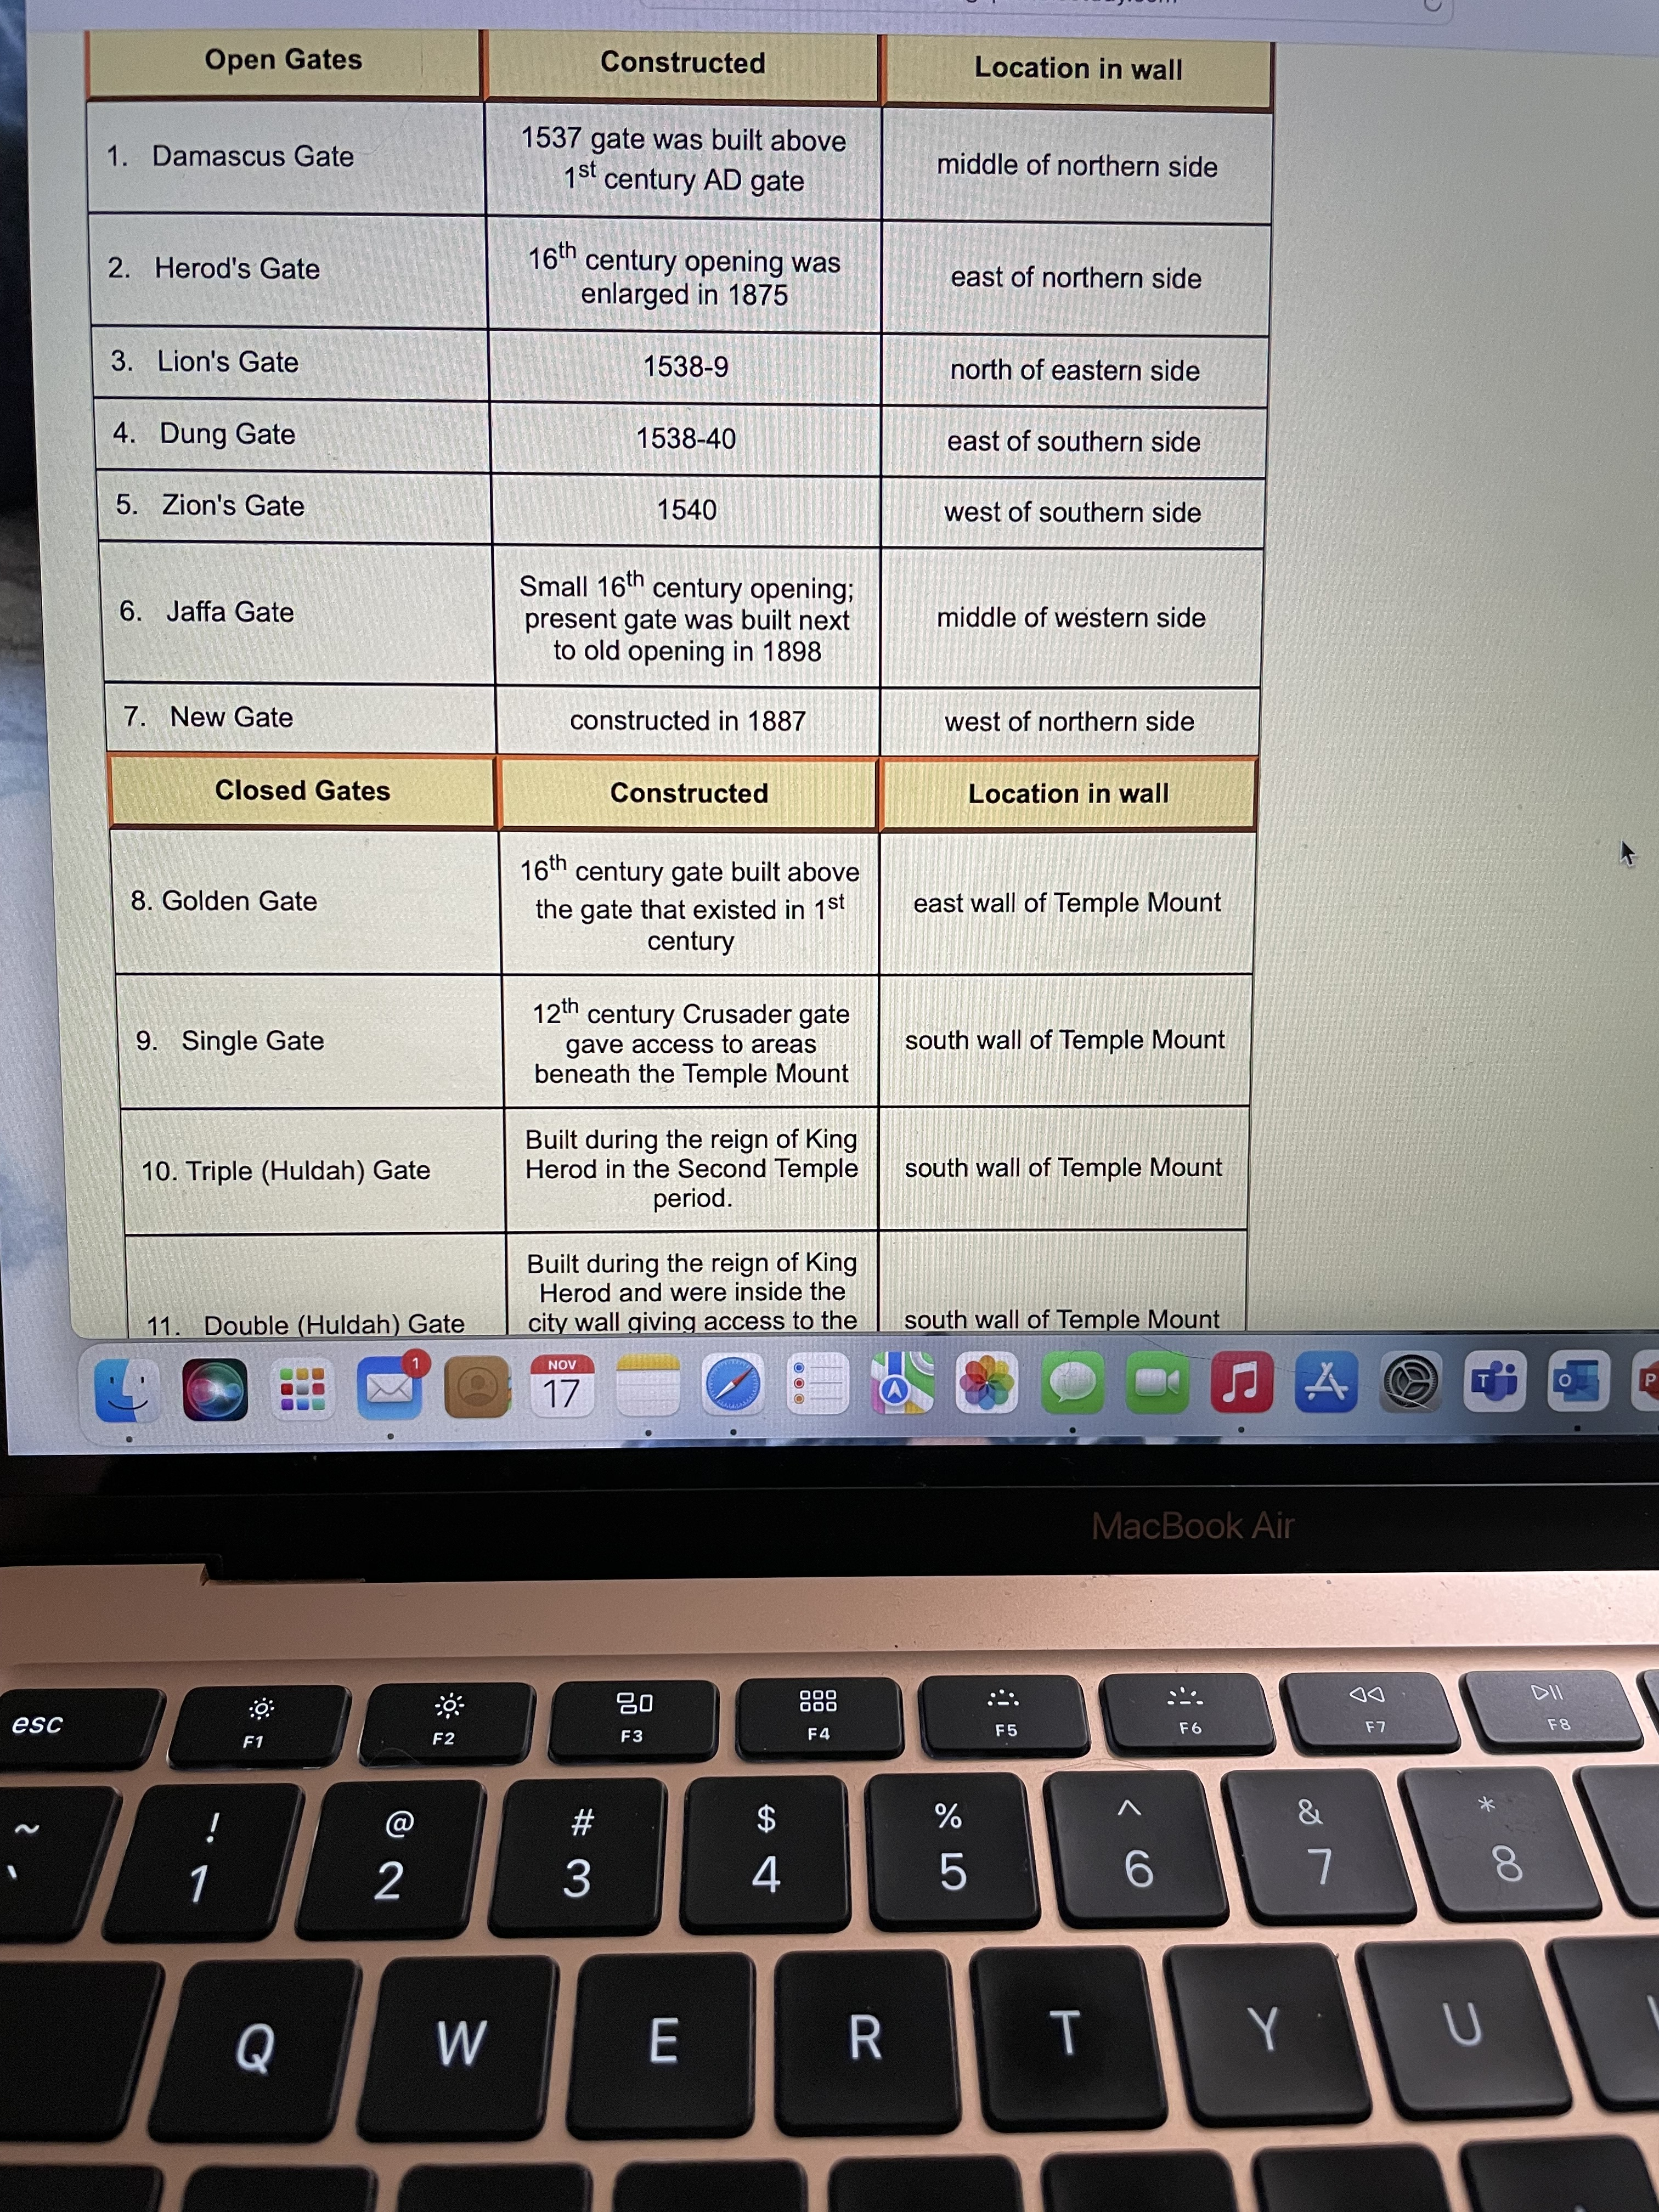
Today:

Slide 11
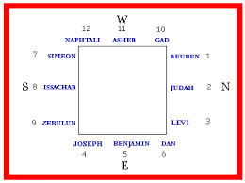
12 Gates of the Book of Revelation:

Slide 12
And Jesus said, “I am the gate” (John 10)
And Jesus said, “I am the way (gate) and the truth and the life. No one comes to the Father except through Me.” (John 14: 6)
He calls you by name…

