Slide 1
I Am the good shepherd
John 10: 11 - 18

Slide 2
The good shepherd lays down his life for the sheep
The hired worker is not the shepherd and does not own the sheep
When the wolf comes, the hired worker runs to save himself and abandons the sheep. The hired worker cares nothing for the sheep…
Jesus said, “I am the good shepherd; I know My sheep and My sheep know Me – and I know the Father – and I lay down My life for the sheep…

Slide 3
I have other sheep that are not in this pen. I must bring them in (Jesus spoke about the Gentiles…you and me, too)
These other sheep will listen to My (Jesus’) voice and there shall be one flock and one shepherd. (Eph 2)
This reason My Father loves me: I lay down My life (the cross) – only to take it up again (resurrection).
No one can take My life from Me – I give it willingly
I have the authority to lay it down and take it up again.
This is the command I received from My Father.

Slide 4
The Unfaithful Shepherd
The Good Shepherd
Ezekiel 34: 1 – 10
They take care of themselves
Sheep starve, weak, sick, hurt without bandage, stray and the shepherd does not go to look for them to bring them back.
I will take My sheep from them
Sacrifices His life for the sheep
He knows each sheep
The sheep know the Shepherd

Slide 5
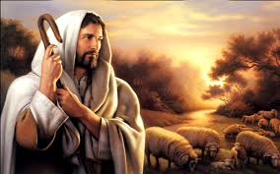
The Lord is my shepherd, I lack nothing.
David declared, “…my shepherd” (personal)
  Song of Solomon 2, “I am my beloved’s and He is mine.” (a mutual ownership)
  John 10 identifies Jesus as our Shepherd.
  I Peter 5:7, ”Cast your cares on Him (Jesus) because He cares for you.”

Slide 6
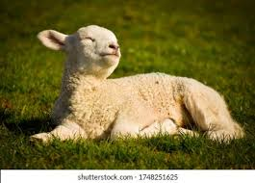
He makes me lie down in green pastures, He leads me besides quiet waters, He refreshes my soul. He guides me along the right paths for His name sake.
Content and securely resting
Quiet waters – did you know sheep can drown in only 2” of water?
My soul is made new
Right paths – conforming to His moral values/will
Gives us the honor of His name (story of oldest son)

Slide 7
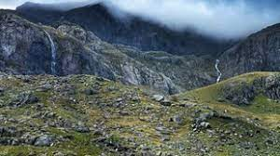
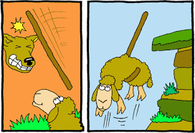
Even though I walk through the darkest valley, I will fear no evil for You are with me; Your rod and your staff, they comfort me.
The darkest valley – you tell me…
I will fear no evil/harm …
Your rod = instrument of authority and justice
Your staff = guidance, support and discipline
Comforts and reassures me – I am alright!

Slide 8
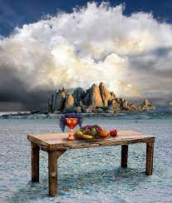
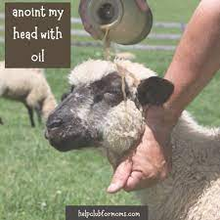
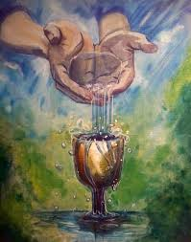
You prepare a table before me in the presence of my enemies.
You anoint my head with oil; my cup overflows.
He identifies your position in His Kingdom - one who eats at His table
Gnats get in their eyes, ears, & noses, these little bugs could actually kill them – the oil protects & heals.
The Spirit of the Living God continues to pour into our lives – overflowing grace

Slide 9
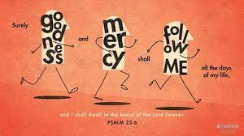
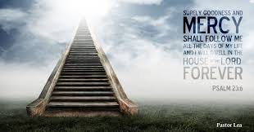
Surely Your goodness and mercy will follow me all the days of my life and I will dwell in the house of the Lord forever.”

Slide 10
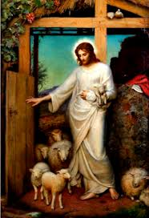
Jesus said,
“I am the Good Shepherd”
Do you know His heart?
He knows you!

