Slide 1

“I Am the Resurrection and Life” & “The Truth, Way and the Life”
John 11 and John 14

Slide 2
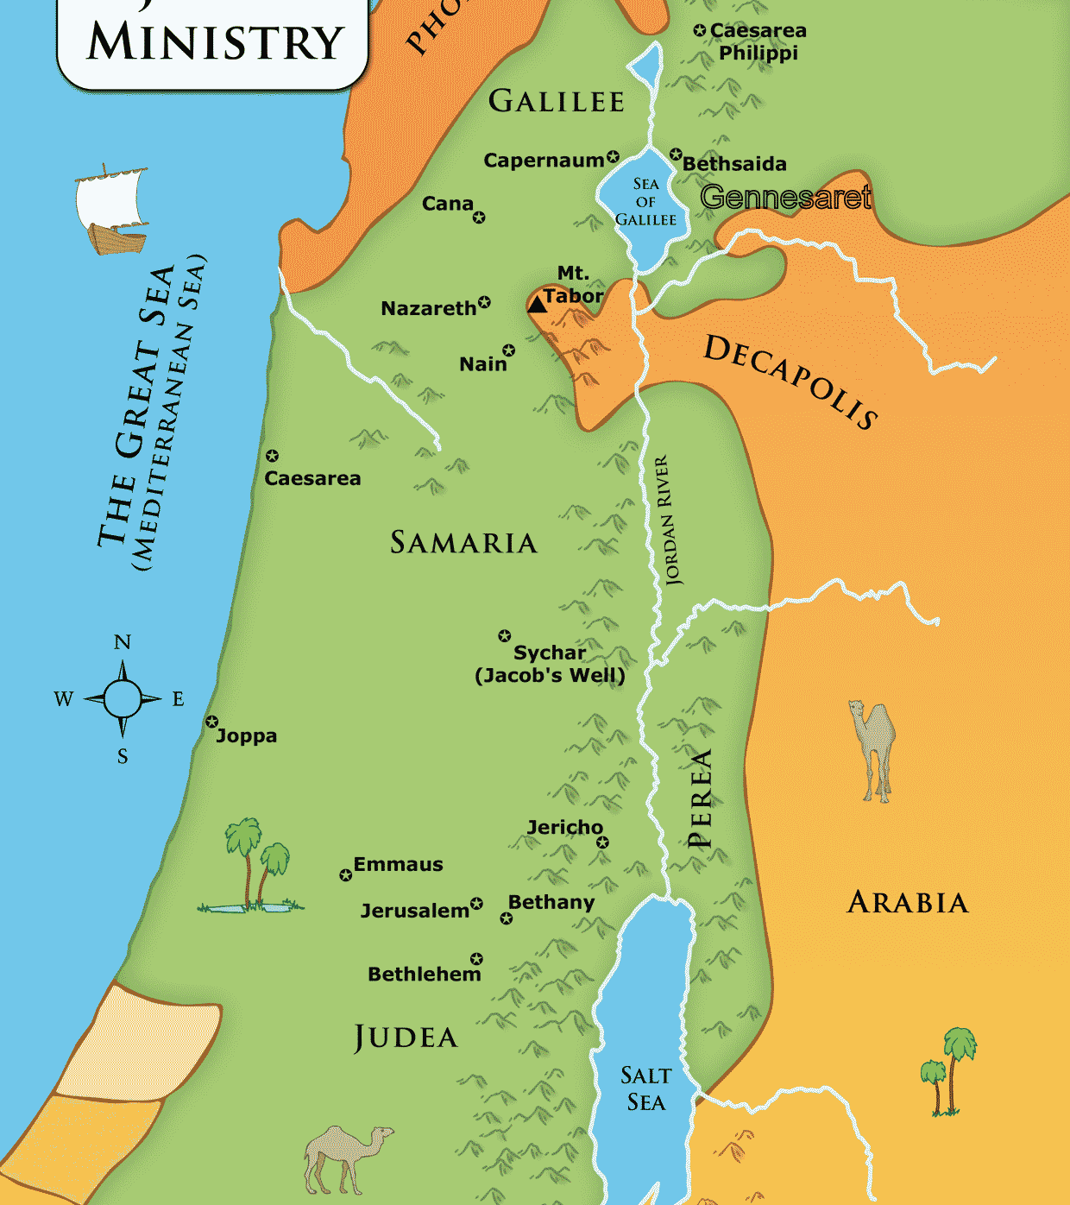
Background:
Chapter 10 – Pharisees’ and Sadducees’ aggression increase
Jesus crossed the Jordan (east) where He was baptized
Chapter 11 – Martha and Mary sent for Jesus telling Him Lazarus is sick
V6: Jesus stayed 2 more days – huh?

Slide 3
The Story:
v4 Jesus tells His disciples, “This sickness will not end in death. No, it is for God’s glory so that God’s Son may be glorified through it.”
V7 After staying the 2-days, He told His disciples, “Let’s go back to Judea…”
V8 The disciples respond, “Didn’t we leave because they wanted to kill you - and you still want to go back to Judea?”

Slide 4
V11 Jesus tells them Lazarus is sleeping – the disciples say, “isn’t it better to let him sleep?”
V14 Jesus told them, “Lazarus is dead, and for your sake I am glad I was not there, so that you may believe. But let us go to him.”
V16 Thomas (a twin) – warrior’s cry…let’s go and die with Him
V17 Lazarus already in the tomb four (4) days (In Bethany – less than 2 miles from Jerusalem)
V21 Martha – “if only You were here earlier, but God will do whatever you ask…”

Slide 5
Jesus stated, “Your brother will live again.”
Martha, “I know he will be resurrected in the last day.”
Jesus responded, “I am the resurrection and the life. Anyone who believes in Me will live, even though they die; and whoever lives by believing in Me will never die.” … Physical death is not the end of your soul…
Jesus asks, “Do you believe?”

Slide 6
V24 Martha’s response, “Yes, Lord,…I believe You are the Messiah, the Son of God, Who was to come into the world.”
V28 – 31 Martha returns to their home and tells Mary that Jesus is asking for her. Mary quickly leaves the home… the professional mourners follow her…
V32 Mary fell at Jesus’ feet and said (same thing Martha said), “If only you were here, he would not have died.”

Slide 7
V33 – 38 Mary was crying, the mourners were crying, Jesus wept…
Because He missed Lazarus, because He was overwhelmed by the sorrow and tears He confronted? Nope!
He wept because of the hopelessness He saw – they did not understand their HOPE … He is the Resurrection and the Life!
Jesus said, “Take away the stone!”
Martha stated, “After 4 days, he stinks!”

Slide 8
V40 “(Remember?), I told you that you, if you believe, you will see the glory of God.”
V41 – 42 Jesus prayed, “Father, I thank You that You have heard Me. I knew that You always hear Me, but I said this for the benefit of the people standing here, that they may believe that You sent Me.” (we call this a “horizontal prayer”)
V43 Then Jesus called loudly, “Lazarus come out!”…

Slide 9
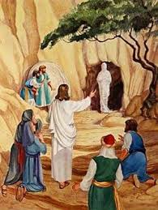
V44 Lazarus came out!
His hands and feet were wrapped with strips of linen, and a cloth around his face
Jesus said to them, “Take off the grave clothes and let him go.”

Slide 10
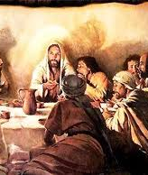
Less than 2 weeks later, the Last Supper happens…
Chapter 14: 6, “Jesus answered, ‘I am the way, the truth, and the life. No one comes to the Father except through Me (Jesus).’”
The Way – only way to eternal life – to the Father
The Truth – He fulfills ALL that has been written (Laws and Prophecies)

Slide 11
The Life – He is the Resurrection – the very spark (source) that creates life now and eternally
John 1: 3, “Through Him (Jesus) all things were made; without Him nothing was made….”
“Do you believe?” – Jesus is still asking…

