Slide 1
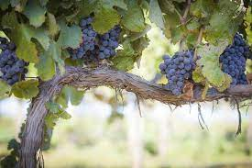
I Am the True Vine
John 15

Slide 2
Last Sunday’s to now…
John 11: “I Am the Resurrection and the Life…” (Lazarus’ resurrection)
John 12: Mary anoints Jesus’ feet – uses her hair to wash them
John 13: The Triumphal Entry; predicts His death, Judas’ betrayal and Peter’s denial
John 14: The Last Supper – He comforts the disciples (I Am the Way, Truth and Life) and promises sending the Holy Spirit
  Vv27&28: “Peace I leave with you; My peace I give you…Do not let your hearts be troubled and do not be afraid. You heard Me say, ‘I am going away and I am coming back to you’…”

Slide 3
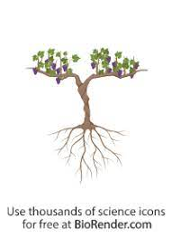
John 15: 1, “I Am the true vine and My Father is the Gardener (Husbandman [KJV])
Context seems “out of nowhere”:
Perhaps already on their way to Gethsemane
Perhaps a decorative vine caught Jesus’ attention
How did this good vineyard become a wild vineyard? Ps. 80; Isaiah 5:3-7; and Jer. 2:21

Slide 4
The True Vine…
Ps. 80: 3-19,
“Restore us, O God, make Your face to shine on us, that we may be saved…You transplanted a vine from Egypt; You drove out nations and planted it. You cleared ground for it, and it took root and filled the land…why have You broken down its walls and all who pass pick its grapes?...wild animals feed on it…return to us , God Almighty! Look down from heaven and see! Watch over this vine, the root Your right hand has planted, the son You have raised up for Yourself. Your vine is cut down, it is burnt with fire…Restore us, Lord God Almighty…”

Slide 5
Isaiah 5: 1 - 7
“I will sing for the one I love a song about His vineyard: My loved one had a vineyard on a fertile hillside. He dug it up and cleared it of stones and planted it with the choicest of vines. He built a watchtower in it and cut out a winepress as well. The He looked for a crop of good grapes, but it yielded only bad fruit…What more could I have done for my vineyard that I have not already done?...I will make it a wasteland…the vineyard of the Lord Almighty is the house of Israel; and the people of Judah are the vines He delights in. And He looked for justice, but saw bloodshed, for righteousness but heard cries of distress…”

Slide 6
Jeremiah 2: 21
“I have planted you like a choice vine of sound and reliable stock. How then did you turn against Me into a corrupt, wild vine?”
Let’s not be too quick to judge…Adam and Eve were created perfect… given a will to choose… hence the struggle defined in Romans 7…

Slide 7
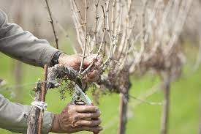
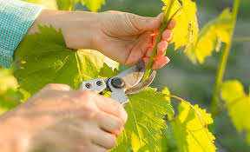
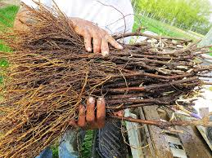
Before we go in depth on the Vine, let’s take a minute looking at the “Husbandman”
Some translations: the Gardener
Husbandman is an old English term = Owner, Cultivator and Trainer, Nurturer, Defends the vineyards growth with “merciless pruning”

Slide 8
Then Jesus states, “I am the True Vine…”
A classic/typical message of John 15 would look at the whole chapter like this:
  The Father – Husbandman;
  Jesus = the True Vine
  Believers = the branches being given life through remaining connected – through obedience to His Word – believers abide (have life) in Him.
  He prunes us through spiritual discipline…

Slide 9
Today’s Focus: Jesus is the True Vine – what mean “vine”? Where does that term come from?
God’s promise to Abraham through the Tribe/family of Judah (Jacob’s 4th son) through David (Judah is David’s great, great, great, etc. Grandpa)…

Slide 10
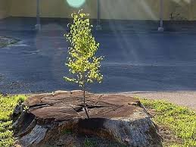
Isaiah 11: 1&2, “A shoot will come up from the stump of Jesse (David’s dad); from his roots a Branch will bear fruit. The Spirit of the Lord will rest on Him – the Spirit of wisdom and understanding, of counsel and might, of knowledge and the fear of the Lord.”

Slide 11
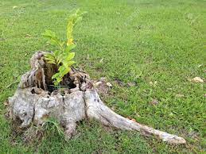
Jer 23: 5 & 6, “The days are coming, declares the Lord, when I will raise up for David, a righteous Branch, a King who will reign wisely and do what is just and right in the land. In His days, Judah will be saved and Israel will live in safety. This is the name by which He is called: The Lord, our Righteous Savior.”

Slide 12
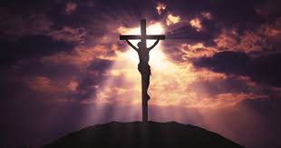
Isaiah 53: 8, “…for He was cut off from the land of the living; for the transgressions of My people He was punished.”

Slide 13
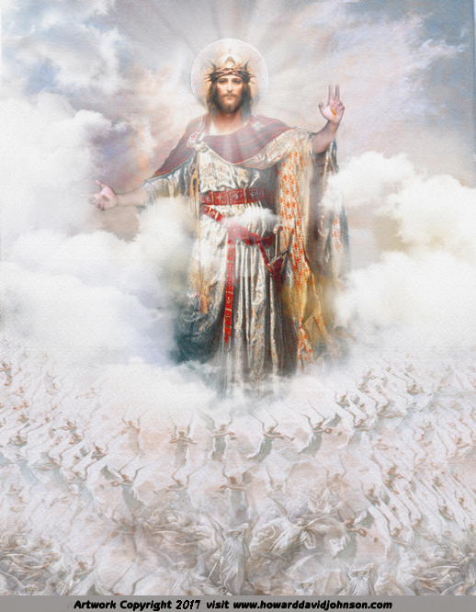
Rev 22:16, “I, Jesus, Am the root and offspring of David and the Bright Morning Star.”

Slide 14
Jesus told us (John 15) to abide in Him
When we do, He no longer calls us His servants – He calls us His friends…intimate relationship
As we receive life from Jesus, we will grow, be pruned, and be fruitful…
Abide in the Vine and have life eternal!

