Slide 1
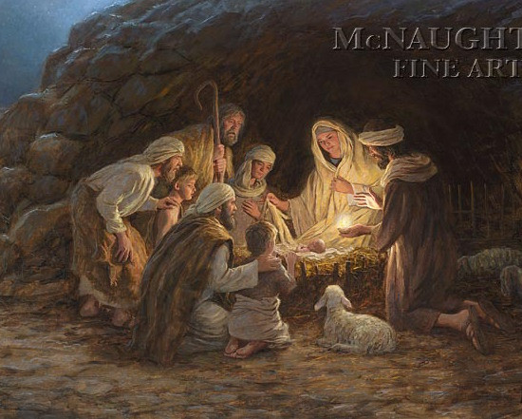
Merry Christmas!

Slide 2
Intro:
Gospel of Mark – starts with Jesus’ water baptism. Mark wrote on behalf of Peter…to the Romans – “the doers”
Gospel of John – starts with, “In the beginning was the Word, with God and was God, all things made by Him, became flesh and lived among us, Jesus Christ…(Jn 1:1-18)
John establishes Jesus’ deity: Jesus it the Word of God that became human

Slide 3
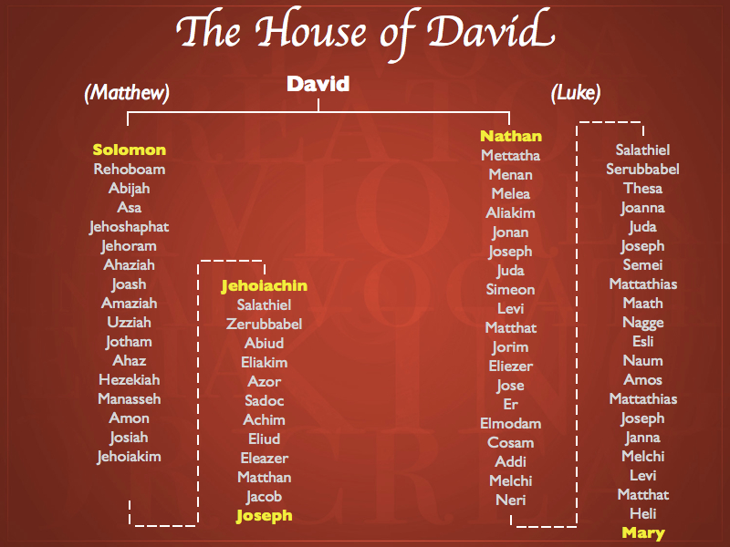
Matthew 1:1-18 Traces Jesus’ birth line (lineage) from Joseph to Abraham
Joseph through Solomon
Luke 3:23-38 Traces Jesus’ lineage from Mary to Adam
Mary through Nathan (another son of David)

Slide 4
Observe:
Matthew writes to a Jewish reader
Traces Jesus back to David, Judah, and Abraham – fulfilling the promise of God to Abraham
Uses the male line: Joseph – emphasizes he is the husband of Mary not the father of Jesus
Luke is Greek, saved through Paul’s ministry, and is a medical doctor.
Luke traces Jesus through Nathan (son of David). Commentaries identify both Solomon and Nathan are sons birth by Bathsheba.
Luke traces Jesus’ lineage back to Adam – the Father of all of humanity.

Slide 5
Prep for Jesus’ conception and birth
Luke 1: 1-25 John the baptizer’s birth, Elizabeth (Jn’s mom) is Mary’s older cousin.
Vv26-38 Gabriel and Mary’s conversation
Vv39-56 Mary goes to Jerusalem – visits Elizabeth and Zechariah’s home. Elizabeth is 6 mos pregnant. Jn jumps within Elizabeth and the Holy Spirit comes upon her and she prophesies.
After 3 mos, Mary returns to Nazareth
Matthew and Luke

Slide 6
Matthew 1:18-25 An angel visits Joseph
Luke 2: 1-20 Caesar’s census, Joseph & Mary travel to Bethlehem, town full of people because of the census.
Mary gives birth in a “barn” and laid Jesus in a manger
An angel appeared to the shepherds living in the fields (Spring months)
Then a “host” of angels appear singing
The shepherd find Joseph, Mary, and Jesus and goes back to Bethlehem telling everyone they could about what they saw
Matthew and Luke
Prep for Jesus’ conception and birth

Slide 7
“Do not be afraid, I bring you good news! Today in the town of David a Savior has been born to you; He is the Messiah, the Lord.”
The angel said,

Slide 8
Jesus’ circumcision, The Magi visit, Trip to Egypt
Luke 2:22-39 Jesus taken to the Temple on the 8th day after birth to fulfill Law requirements. They bring 2 doves for sacrifice and meet Simeon and Anna
Approximately two years later, the Magi arrive bringing 3 gifts: gold, frankincense, and myrrh. (odd gifts!)
An angel appears to Joseph and tells him to take Mary and Jesus to Egypt…they stay there until Herod dies and returns to Nazareth where Jesus is raised…we hear nothing more about Jesus until He is 12 yrs old.
Luke 2:22-39 & Matt 2:1-23

