Slide 1
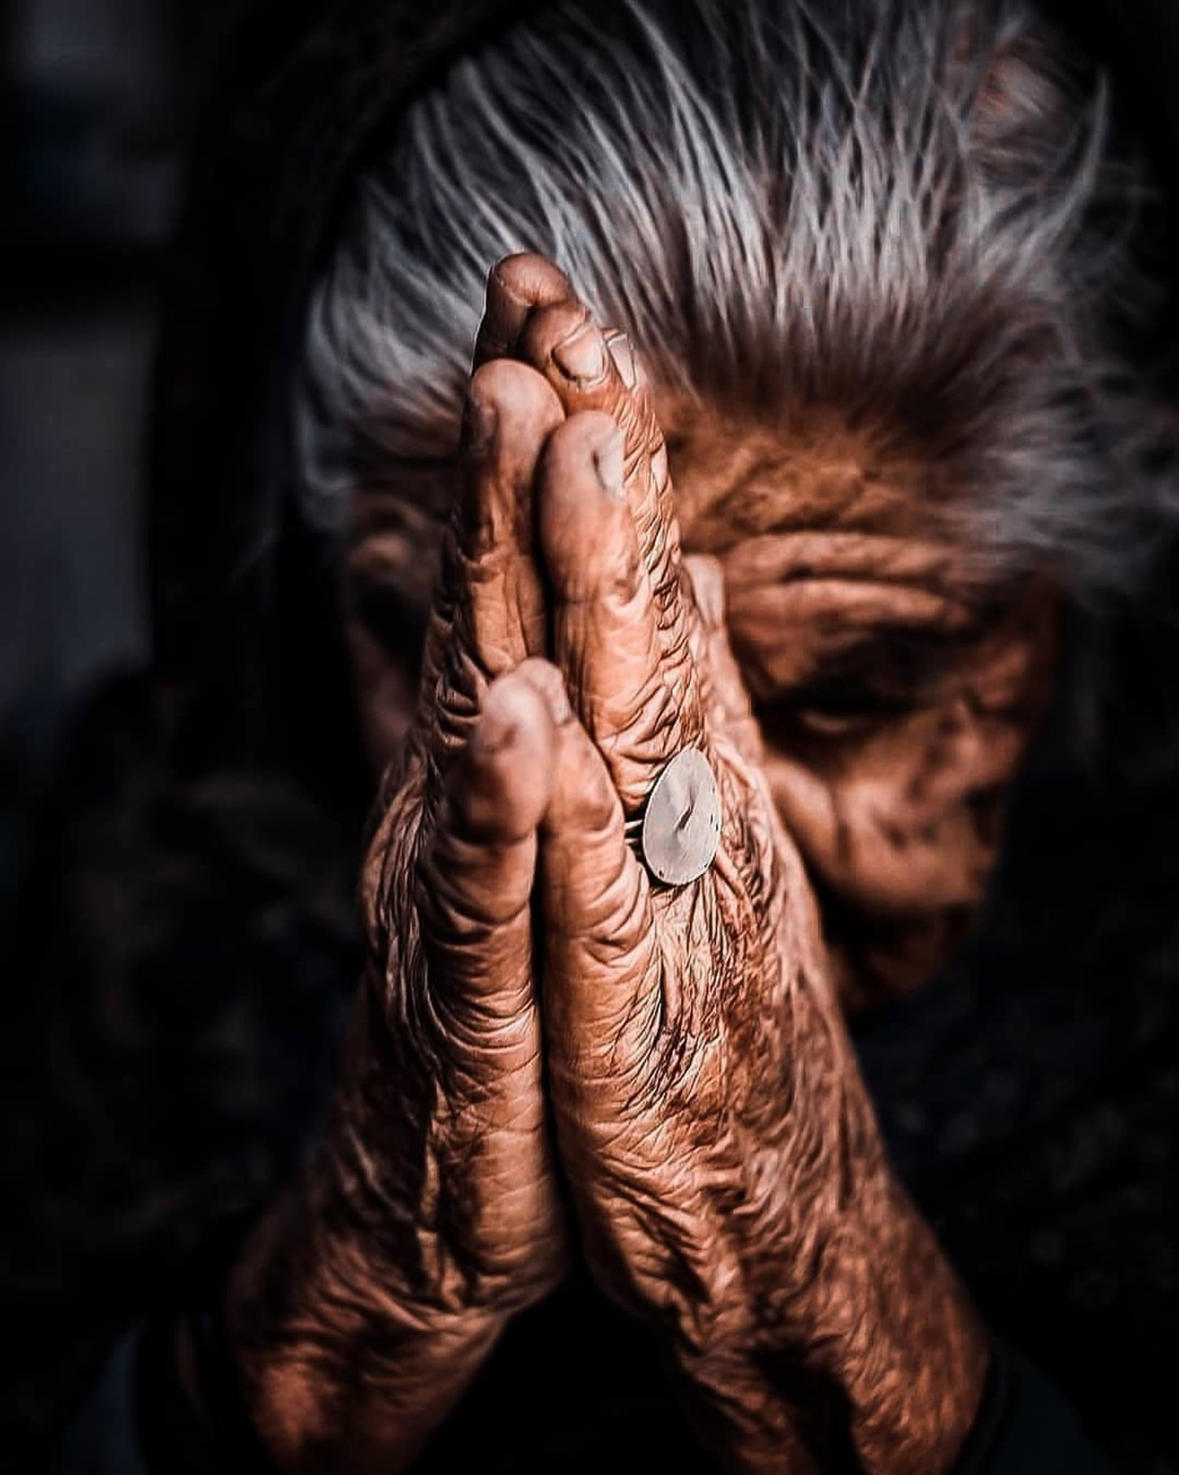
The
Lord’s
Prayer
Matthew 6:9-13
Luke 11:1-4

Slide 2
Matthew 6:9-15 NET (also Luke 11:1-4)
So pray this way:
Our Father in heaven
May your name be kept honored
May your kingdom come
May your will be done on earth as it is in heaven
Give us today our daily bread
And forgive us our debts, as we ourselves have forgiven our debtors.
And do not lead us into temptation, but deliver us from the evil one.

Slide 3
Matthew 6:9-15 NET (also Luke 11:1-4)
So pray this way:
Our Father in heaven
May your name be honored
May your kingdom come
May your will be done on earth as it is in heaven
Give us today our daily bread
And forgive us our debts, as we ourselves have forgiven our debtors.
And do not lead us into temptation, but deliver us from the evil one.
Notes:
Everyone had a different type of earth father: good, bad, lost your father, never knew him
Each of us has a different walk with Jesus
With Our Father, together we recognize that He is Our Father, and we are His children.
“If you then, who are evil, know how to give good gifts to your children, how much more will your Father in Heaven give good things to those who ask Him!” (Matthew 7:11)
God created heavens and earth.

Slide 4
Matthew 6:9-15 NET (also Luke 11:1-4)
So pray this way:
Our Father in heaven
May your name be honored
May your kingdom come
May your will be done on earth as it is in heaven
Give us today our daily bread
And forgive us our debts, as we ourselves have forgiven our debtors.
And do not lead us into temptation, but deliver us from the evil one.
Notes:
Hallowed, Holy, Honored
Every knee shall bow
God’s name is sacred
God is almighty, El Shaddai
He made us in His image

Slide 5
ἁγιασθήτω
1) to render or acknowledge, or to be venerable or hallow
2) to separate from profane things and dedicate to God
2a) consecrate things to God
2b) dedicate people to God
3) to purify
3a) to cleanse externally
3b) to purify by expiation: free from the guilt of sin
3c) to purify internally by renewing of the soul

Slide 6
Romans 14:11 NET
11 For it is written, “As I live, says the Lord, every knee will bow to me, and every tongue will give praise to God.”
Philippians 2:10-11 NET
10 so that at the name of Jesus every knee will bow – in heaven and on earth and under the earth –
11 and every tongue confess that Jesus Christ is Lord to the glory of God the Father.
Isaiah 45:23 NET
23 I solemnly make this oath – what I say is true and reliable: ‘Surely every knee will bow to me, every tongue will solemnly affirm;

Slide 7
Kaddish Prayer (short version)
Notice the common themes
May the great Name of God be exalted and sanctified, throughout the world, which he has created according to his will. May his Kingship be established in your lifetime and in your days, and in the lifetime of the entire household of Israel, swiftly and in the near future; and say, Amen.

Slide 8
Matthew 6:9-15 NET (also Luke 11:1-4)
So pray this way:
Our Father in heaven
May your name be honored
May your kingdom come
May your will be done on earth as it is in heaven
Give us today our daily bread
And forgive us our debts, as we ourselves have forgiven our debtors.
And do not lead us into temptation, but deliver us from the evil one.

Slide 9
Matthew 6:9-15 NET (also Luke 11:1-4)
So pray this way:
Our Father in heaven
May your name be honored
May your kingdom come
May your will be done on earth as it is in heaven
Give us today our daily bread
And forgive us our debts, as we ourselves have forgiven our debtors.
And do not lead us into temptation, but deliver us from the evil one.

Slide 10
Matthew 6:9-15 NET (also Luke 11:1-4)
So pray this way:
Our Father in heaven
May your name be honored
May your kingdom come
May your will be done on earth as it is in heaven
Give us today our daily bread
And forgive us our debts, as we ourselves have forgiven our debtors.
And do not lead us into temptation, but deliver us from the evil one.
Notes:
3 parts of sin
Our sins, forgive us
We forgive their sins

Slide 11
Matthew 6:9-15 NET (also Luke 11:1-4)
So pray this way:
Our Father in heaven
May your name be honored
May your kingdom come
May your will be done on earth as it is in heaven
Give us today our daily bread
And forgive us our debts, as we ourselves have forgiven our debtors.
And do not lead us into temptation, but deliver us from the evil one.

Slide 12
Matthew 6:9-15 NET (also Luke 11:1-4)
So pray this way:
Our Father in heaven
May your name be honored
May your kingdom come
May your will be done on earth as it is in heaven
Give us today our daily bread
And forgive us our debts, as we ourselves have forgiven our debtors.
And do not lead us into temptation, but deliver us from the evil one.

Slide 13
Matthew 6:9-15 NET (also Luke 11:1-4)
So pray this way:
Our Father in heaven
May your name be honored
May your kingdom come
May your will be done on earth as it is in heaven
Give us today our daily bread
And forgive us our debts, as we ourselves have forgiven our debtors.
And do not lead us into temptation, but deliver us from the evil one.

Slide 14
The
Lord’s
Prayer
Matthew 6:9-13
Luke 11:1-4

