Slide 1
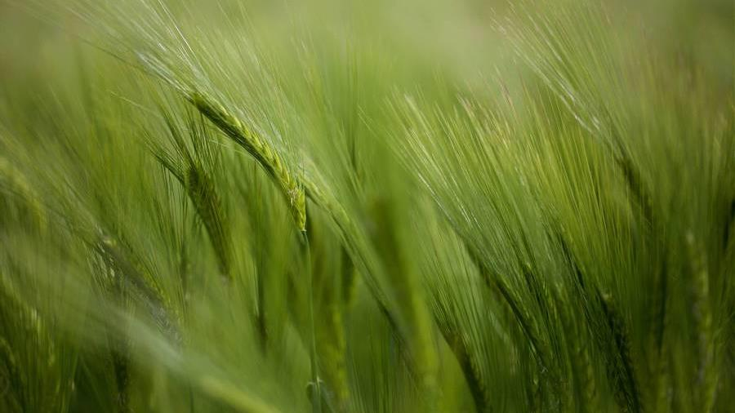
The Wind
The Holy Spirit

Slide 2
Ruach and Pneuma:
Wind
Breathe of God
Creative power
Nurtures
Force of strength
Life giving
Ruach (Hebrew)
Pneuma (Greek)

Slide 3
Genesis 1: 1 – 2: “In the beginning God created the heavens and earth. Now the earth was formless and empty, darkness was over the surface of the deep (earth), and the Spirit of God was hovering over the waters.”
Genesis 6: 3: “My Spirit will not always abide over mankind…”

Slide 4
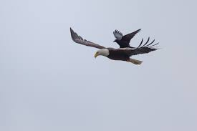
Deuteronomy 32: 11, - Like an eagle hovering over its young, nurturing, guiding, protecting – spreads its wings to catch them and carries them to safety.
Isaiah 31: 5, “Like the eagle hovering overhead, the Lord Almighty will shield Jerusalem. He will shield it and deliver it, He will pass over it and will rescue it.”

Slide 5
Breathe of life
Genesis 2: 7, “Then the Lord God formed a man from dust of the ground and breathed into his nostrils the breathe of life and the man became a living being.”
Job 33: 4, “The Spirit of God has made me; the breath of the Almighty gives me life.”
Psalms 104: 29 & 30, “…when You take away their breath, they die and return to dust. When You send Your Spirit, they are created…”

Slide 6
Power and Strength
Genesis 8: 1, “But God remembered Noah and all the wild animals and livestock that were with him in the ark, and He sent a wind over the earth, and the waters receded.”
Exodus 15: 10 (about the Red Sea), “You blew Your wind…and the seas parted…”
Pneuma:
John 20: 22, “and He breathed on them and said, ‘Receive the Holy Spirit’…”
Acts 2: 1 – 4, “…Suddenly a sound like the blowing of a mighty rushing wind (a violent wind) from heaven and filled the whole house…”

Slide 7
An Interesting Story… I Kings 19
Background in Chapter 18: Elijah and the 450 prophets of Baal… a tremendous victory!
Chapter 19: Jezebel, Queen of Israel and married to King Ahab, sends a message to Elijah that she will kill him for killing her prophets…Elijah fleas to the desert…found a tree and sat under it praying he would die! “I’ve had enough, take my life!” … slept …
An angel of the Lord woke him three times and fed him three times telling him to rest and eat and rest again…
Elijah was then sent to walk for 40 days and 40 nights to Mt. Horeb – the mountain Moses often met with God…

Slide 8
Found a cave and stayed in there…
V9. God asks Elijah, “What are you doing here?”
V10. Elijah responds: I have been faithful, I have obeyed everything You have asked of me, I am the only one left – they kill all the others!
V11. God responds by telling Elijah to go out and stand on the mountain, He will pass before Elijah…
A mighty wind came, breaking a part parts of Mt. Horeb – God not there…
An earthquake shook violently - God not there…
Fire from heaven came down - God not there…

Slide 9
A gentle whispering wind came – Elijah fell down and worshiped the Lord God Almighty because His Spirit was in the whispering wind
What do we see?
This mighty, life-giving breath of God, nurturer comes as a whispering wind as well… (by the way, there were 7,000 prophets alive-not only Elijah)
The book of Hebrews tells us that He is the same yesterday, today, and forever…how does and how will He speak to you through His Spirit today?
What do you need from Him today?
Healing – His power is here; Comfort and Strength – He is here; Life – let Him breath life back into your soul…

