Slide 1
Bethany Deaf Assembly
Jesus www.BDAChurch.com
Jesus
Sermons | Events | Calendar | Give
{clear browser cache if you have issues}

Slide 2
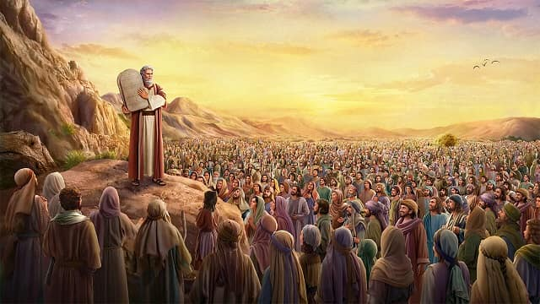
Old Covenant
Mt. Sinai
10 Commandments
613 Commandments
Decrees and Regulations
Instructions to build the Tabernacle (“Tent of Meeting”)

Slide 3
Summary of Old Covenant
Matthew 22:36:-40 NLT
36 "Teacher, which is the most important commandment in the law of Moses?"
37 Jesus replied, "'You must love the Lord your God with all your heart, all your soul, and all your mind.'
38 This is the first and greatest commandment.
39 A second is equally important: 'Love your neighbor as yourself.'
40 The entire law and all the demands of the prophets are based on these two commandments."
(See Deuteronomy 6:5 and Leviticus 19:18)

Slide 4
Prophecy for New Covenant
Jeremiah 31:31-33 NLT
31 "The day is coming," says the Lord, "when I will make a new covenant with the people of Israel and Judah.
32 This covenant will not be like the one I made with their ancestors when I took them by the hand and brought them out of the land of Egypt. They broke that covenant, though I loved them as a husband loves his wife," says the Lord.
33 "But this is the new covenant I will make with the people of Israel after those days," says the Lord. "I will put my instructions deep within them, and I will write them on their hearts. I will be their God, and they will be my people.

Slide 5
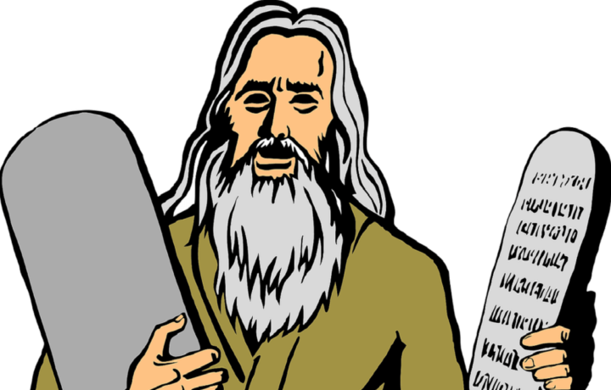

Old Covenant
613 Commandments
“Write the law on their hearts”
Jeremiah 31:31-33

Slide 6
Old Covenant
613 Commandments
“Write the law on their hearts”
Jeremiah 31:31

Slide 7
New Covenant
Luke 22:20 NLT
20 After supper he took another cup of wine and said, "This cup is the new covenant between God and his people—an agreement confirmed with my blood, which is poured out as a sacrifice for you.
Hebrews 8:13 NLT
8 But when God found fault with the people, he said: "The day is coming, says the Lord, when I will make a new covenant with the people of Israel and Judah.
13 When God speaks of a "new" covenant, it means he has made the first one obsolete. It is now out of date and will soon disappear.

Slide 8
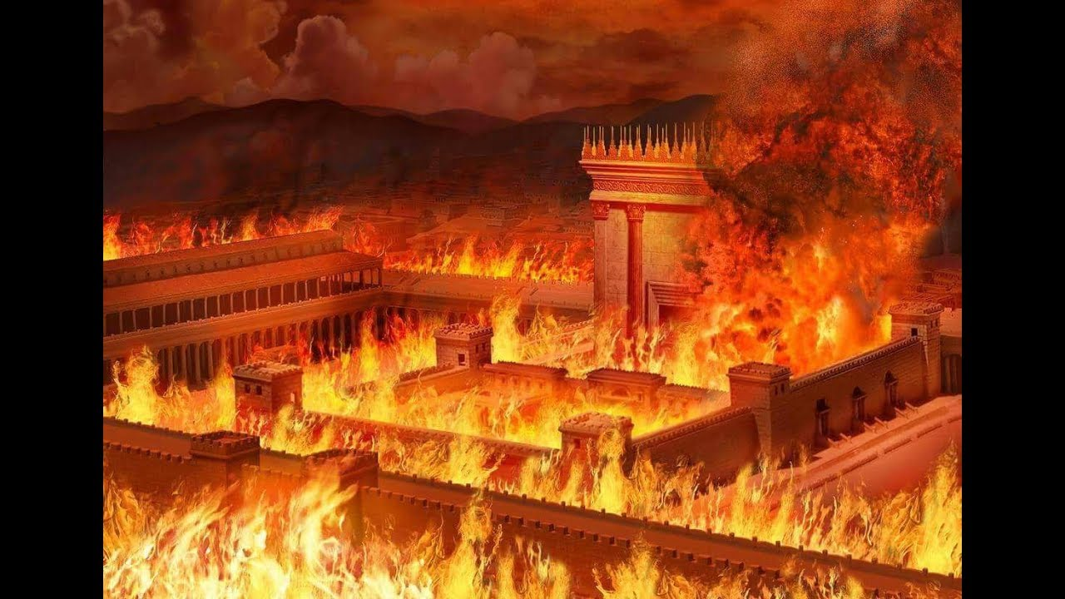

Old Covenant (temporary)
New Covenant (forever)

Slide 9
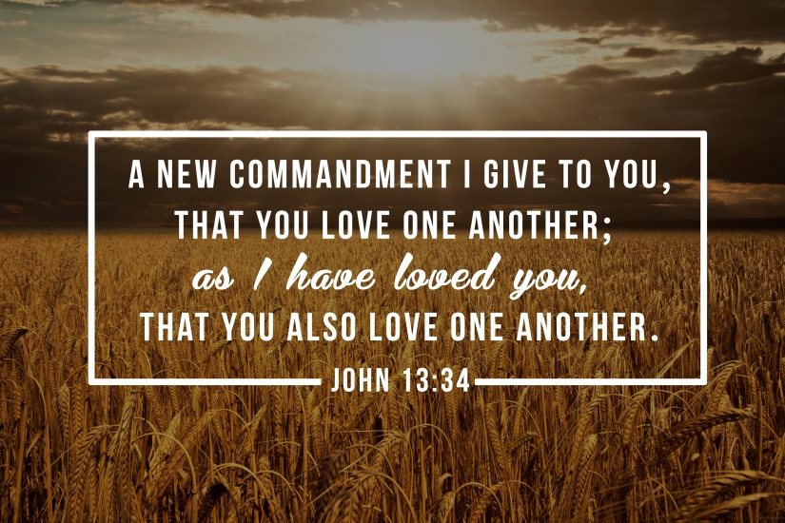

Slide 10
New Covenant includes New Commandment
John 13:34-35 NLT
34 So now I am giving you a new commandment: Love each other. Just as I have loved you, you should love each other.
35 Your love for one another will prove to the world that you are my disciples.
“Love one another, as I loved you”

Slide 11
New Covenant includes New Commandment
1 John 4:19 NKJV
19 We love Him because He first loved us.
1 John 4:19 NLT
19 We love each other because he loved us first.
1 John 4:19 NIV
19 We love because he first loved us.

Slide 12
New Covenant includes New Commandment
John 15:9-10,12,17 NLT
9 I have loved you even as the Father has loved me. Remain in my love.
10 When you obey my commandments, you remain in my love, just as I obey my Father's commandments and remain in his love.
12 This is my commandment: Love each other in the same way I have loved you.
17 This is my command: Love each other.
“Love one another, as I loved you”

Slide 13
New Covenant includes New Commandment
2 John 1:5-6 NLT
5 I am writing to remind you, dear friends, that we should love one another. This is not a new commandment, but one we have had from the beginning.
6 Love means doing what God has commanded us, and he has commanded us to love one another, just as you heard from the beginning.
“Love one another, as I loved you”

Slide 14
New Covenant includes New Commandment
1 John 3:11,23 NLT
11 This is the message you have heard from the beginning: We should love one another.
23 And this is his commandment: We must believe in the name of his Son, Jesus Christ, and love one another, just as he commanded us.
“Love one another, as I loved you”

Slide 15
What does Love look like?
Matthew 5:43-47 NLT
43 "You have heard the law that says, 'Love your neighbor' and hate your enemy.
44 But I say, love your enemies! Pray for those who persecute you!
45 In that way, you will be acting as true children of your Father in heaven. For he gives his sunlight to both the evil and the good, and he sends rain on the just and the unjust alike.
46 If you love only those who love you, what reward is there for that? Even corrupt tax collectors do that much.
47 If you are kind only to your friends, how are you different from anyone else? Even pagans do that.
“Love one another, as I loved you”

Slide 16
What does Love look like?
1 Timothy 1:5 NLT
5 The purpose of my instruction is that all believers would be filled with love that comes from a pure heart, a clear conscience, and genuine faith.
1 Timothy 6:11 NLT
11 But you, Timothy, are a man of God; so run from all these evil things. Pursue righteousness and a godly life, along with faith, love, perseverance, and gentleness.
“Love one another, as I loved you”

Slide 17
What does Love look like?
1 Corinthians 7:17-19
17 Each of you should continue to live in whatever situation the Lord has placed you, and remain as you were when God first called you. This is my rule for all the churches.
18 For instance, a man who was circumcised before he became a believer should not try to reverse it. And the man who was uncircumcised when he became a believer should not be circumcised now.
19 For it makes no difference whether or not a man has been circumcised. The important thing is to keep God’s commandments.
“Love one another, as I loved you”

Slide 18
What does Love look like?
Galatians 6:2 NLT
2 Share each other’s burdens, and in this way obey the law of Christ.
Galatians 6:2 NET
2 Carry one another's burdens, and in this way you will fulfill the law of Christ.
Galatians 6:2 NET
2 Bear one another’s burdens, and so fulfill the law of Christ.
“Love one another, as I loved you”

Slide 19
You are a New Creation
Galatians 6:15 NLT
15 It doesn’t matter whether we have been circumcised or not. What counts is whether we have been transformed into a new creation.
Galatians 5:6 NLT
6 For when we place our faith in Christ Jesus, there is no benefit in being circumcised or being uncircumcised. What is important is faith expressing itself in love.
“Love one another, as I loved you”

Slide 20
Law of Christ
1 Corinthians 9:20-21 NLT
20 When I was with the Jews, I lived like a Jew to bring the Jews to Christ. When I was with those who follow the Jewish law, I too lived under that law. Even though I am not subject to the law, I did this so I could bring to Christ those who are under the law.
21 When I am with the Gentiles who do not follow the Jewish law, I too live apart from that law so I can bring them to Christ. But I do not ignore the law of God; I obey the law of Christ.
“Love one another, as I loved you”

Slide 21
Jews
Old Covenant
New Creation
New Covenant
Gentiles
Idols

Slide 22
Ministers of his New Covenant
2 Corinthians 3:6 NLT
6 He has enabled us to be ministers of his new covenant. This is a covenant not of written laws, but of the Spirit. The old written covenant ends in death; but under the new covenant, the Spirit gives life.
Romans 7:6 NLT
6 But now we have been released from the law, for we died to it and are no longer captive to its power. Now we can serve God, not in the old way of obeying the letter of the law, but in the new way of living in the Spirit.
“Love one another, as I loved you”

Slide 23
Led by the Spirit
Galatians 5:25-26 NLT
25 Since we are living by the Spirit, let us follow the Spirit's leading in every part of our lives.
26 Let us not become conceited, or provoke one another, or be jealous of one another.
Galatians 5:18 NLT
18 But when you are directed by the Spirit, you are not under obligation to the law of Moses.
Galatians 5:18 NET
18 But if you are led by the Spirit, you are not under the law.
“Love one another, as I loved you”

Slide 24
Fruit of the Spirit
Galatians 5:22-23 NET
But the fruit of the Spirit is love, joy, peace, patience, kindness, goodness, faithfulness, gentleness, and self-control
“Love one another, as I loved you”

Slide 25
Fruit of the Spirit
Galatians 5:22-23 NET
But the fruit of the Spirit is love, joy, peace, patience, kindness, goodness, faithfulness, gentleness, and self-control
If Fruit is singular, then another translation could be:
Galatians 5:22-23 NET
But the fruit of the Spirit is love, which looks like joy, peace, patience, kindness, goodness, faithfulness, gentleness, and self-control
“Love one another, as I loved you”

Slide 26
Summary
Jesus gives us a New Covenant
New Covenant has a New Commandment
New Commandment is “Love one another, as I loved you”
You are a New Creation in Christ (you are not Jew or Gentile)
You are Ministers of the New Covenant
You are led by the Spirit
Love looks like joy, peace, patience, kindness, goodness, faithfulness, gentleness, and self-control
Old Covenant is gone and the New Covenant has come.

