Slide 1
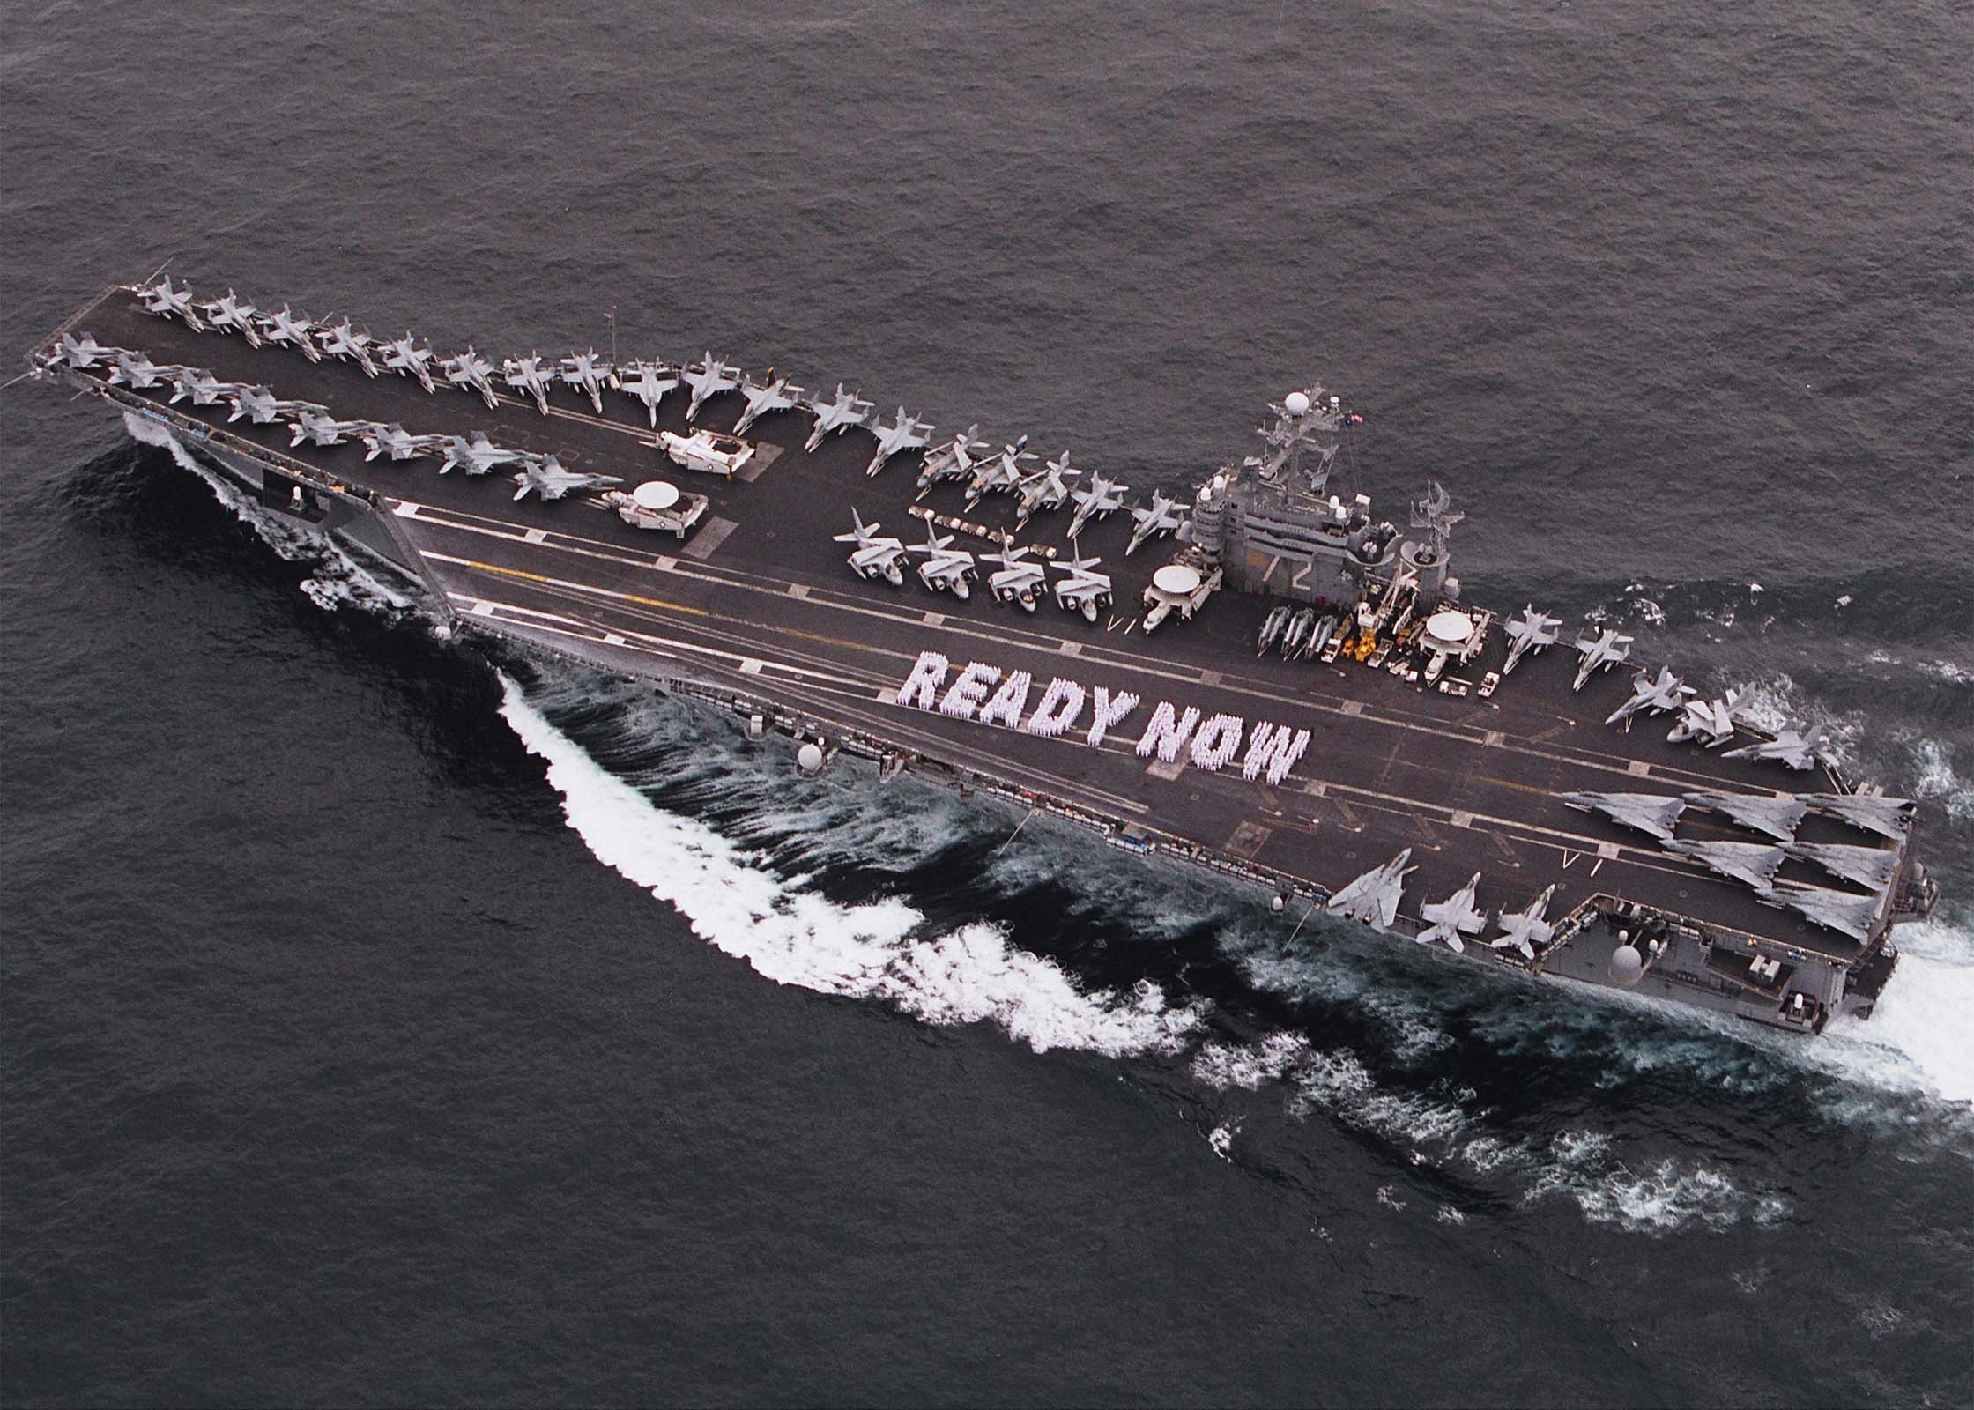
“Be ready now!”

Slide 2
Matthew 24:44
New International Version
⁴⁴ So you also must be ready, because the Son of Man will come at an hour when you do not expect him.

Slide 3
Matthew 25:13
New International Version
¹³ “Therefore keep watch, because you do not know the day or the hour.

Slide 4
Luke 12:40
New International Version
⁴⁰ You also must be ready, because the Son of Man will come at an hour when you do not expect him.”

Slide 5
Philippians 4:5
New Living Translation
⁵ Let everyone see that you are considerate in all you do. Remember, the Lord is coming soon.[

Slide 6
James 5:9
New International Version
⁹ Don’t grumble against one another, brothers and sisters, or you will be judged. The Judge is standing at the door!

Slide 7
Psalms 23
New International Version
¹ The Lord is my shepherd, I lack nothing. ² He makes me lie down in green pastures, he leads me beside quiet waters, ³ he refreshes my soul. He guides me along the right paths for his name’s sake. ⁴ Even though I walk through the darkest valley, I will fear no evil, for you are with me; your rod and your staff, they comfort me. ⁵ You prepare a table before me in the presence of my enemies. You anoint my head with oil; my cup overflows. ⁶ Surely your goodness and love will follow me all the days of my life, and I will dwell in the house of the Lord forever.

