Slide 1
Bethany Deaf Assembly Jesus www.BDAChurch.com Jesus Sermons | Events | Calendar | Give {clear browser cache if you have issues}

Slide 2
Apostle John
1, 2 and 3 John

Slide 3
APOSTLE JOHN
John and James are sons of Zebedee (Mark 10:35 ; Luke 5:10; Matthew 4:21)
John is the younger brother of James
Fishermen (Matthew 4:18-22)
James was beheaded (Acts 12:2)
Jesus nicknamed them as “sons of thunder” (Mark 3:17)
James and John were called to follow Jesus (Matthew 4:21-22)
One of the Original 12 Apostles (Mark 3:13-19)
Peter, James and John saw Jesus raise Jairus’ daughter from the dead (Mark 5:37)
Peter, James and John saw Jesus on the Mount of Transfiguration (Matthew 17:1)
Peter, James and John prayed with Jesus in the Garden of Gethsemane (Mark 14:33)
Last original Apostle to die. Only one to not die as a martyr

Slide 4
APOSTLE JOHN
Apostles leave Jerusalem by AD 68 due to persecution
While living in Ephesus (Eusebius, Church History, 3.23):
Wrote the Gospel of John
Wrote the three letters of 1, 2 and 3 John
While on the island of Patmos:
Wrote the book of Revelation

Slide 5
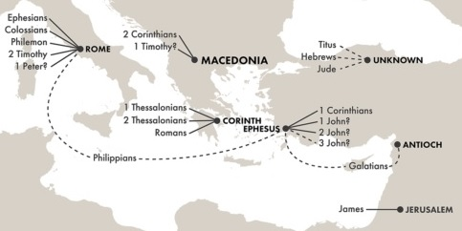

Slide 6
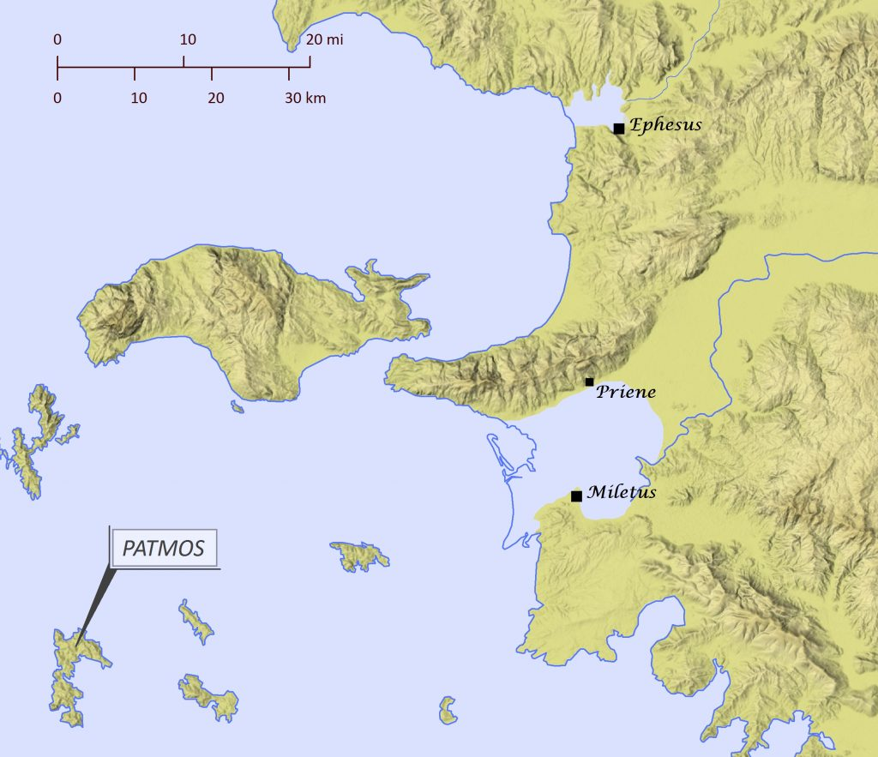

Slide 7
1 John 1:4 We are writing these things so that you may fully share our joy.
1 John 2:1 My dear children, I am writing this to you so that you will not sin. But if anyone does sin, we have an advocate who pleads our case before the Father. He is Jesus Christ, the one who is truly righteous.
1 John 2:12 I am writing to you who are God’s children because your sins have been forgiven through Jesus.
1 John 2:13 I am writing to you who are mature in the faith because you know Christ, who existed from the beginning. I am writing to you who are young in the faith because you have won your battle with the evil one.
1 John 2:21 So I am writing to you not because you don’t know the truth but because you know the difference between truth and lies.
1 John 2:26 I am writing these things to warn you about those who want to lead you astray.

Slide 8
CONTRASTS
Light | Darkness | 1 John 1:5
Loving the Father | Loving the World | 1 John 2:15-16
Christ | Antichrist | 1 John 2:18, 22
Truth | Lies | 1 John 2:20-21
Children of God | Children of the devil | 1 John 3:1-10
Eternal Life | Eternal Death | 1 John 3:14
Love | Hatred | 1 John 3:15-16
True Prophecy | False Prophecy | 1 John 4:1-3
Love | Fear | 1 John 4:18-19
Having Life | Not Having Life | 1 John 5:11-12

Slide 9
SIX DEGREES OF SEPARATION is the theory that any person on earth can be connected to any other person through five connections.
You > Larry > Curly > Moe > Tom > Jerry > Sally

Slide 10
SIX DEGREES OF SEPARATION
You > Larry > Curly > Moe > Tom > Jerry > Sally
TWO DEGREES OF SEPARATION
Jesus > Apostle John’s Letters > You

Slide 11
1 John 1:1-4 NLT
1 We proclaim to you the one who existed from the beginning, whom we have heard and seen. We saw him with our own eyes and touched him with our own hands. He is the Word of life.
2 This one who is life itself was revealed to us, and we have seen him. And now we testify and proclaim to you that he is the one who is eternal life. He was with the Father, and then he was revealed to us.
3 We proclaim to you what we ourselves have actually seen and heard so that you may have fellowship with us. And our fellowship is with the Father and with his Son, Jesus Christ.
4 We are writing these things so that you may fully share our joy.

Slide 12
The beginning of 1 John sounds the same as the beginning of John
John 1:1-2 NET
1 In the beginning was the Word, and the Word was with God, and the Word was fully God.
2 The Word was with God in the beginning.
John 1:14 NET
14 Now the Word became flesh and took up residence among us. We saw his glory – the glory of the one and only, full of grace and truth, who came from the Father.

Slide 13
Marcion
Early 100s AD.
Marcion combined Christianity with Greek Philosophy.
Emphasize knowledge instead of faith.
Rejected the Old Testament.
Removed references to the Old Testament from the New Testament. This started the ~300 year process of curating scripture into a Canon of 66 books.
Claimed that Jesus was not fully divine and fully human.
Believed that Jesus is the son of God but appeared as a ghost.

Slide 14
CONTRAST
1 John 1:5-7 NLT
5 This is the message we heard from Jesus and now declare to you: God is light, and there is no darkness in him at all.
6 So we are lying if we say we have fellowship with God but go on living in spiritual darkness; we are not practicing the truth.
7 But if we are living in the light, as God is in the light, then we have fellowship with each other, and the blood of Jesus, his Son, cleanses us from all sin.
Light | Darkness | 1 John 1:5

Slide 15
1 John 1:7 NET
7 But if we walk in the light as he himself is in the light, we have fellowship with one another and the blood of Jesus his Son cleanses us from all sin.

Slide 17
Example of looking up the Greek word for “walk” in the light

Slide 18
1 John 1:8-10 NLT
8 If we claim we have no sin, we are only fooling ourselves and not living in the truth.
9 But if we confess our sins to him, he is faithful and just to forgive us our sins and to cleanse us from all wickedness.
10 If we claim we have not sinned, we are calling God a liar and showing that his word has no place in our hearts.

Slide 19
WALKING IN THE LIGHT vs NOT WALKING IN THE LIGHT
Confess your sins
I have no sins

Slide 20
1 John
Chapter 2

Slide 21
1 John 2:1-6 NLT
1 My dear children, I am writing this to you so that you will not sin. But if anyone does sin, we have an advocate who pleads our case before the Father. He is Jesus Christ, the one who is truly righteous.
2 He himself is the sacrifice that atones for our sins—and not only our sins but the sins of all the world.
3 And we can be sure that we know him if we obey his commandments.
4 If someone claims, “I know God,” but doesn’t obey God’s commandments, that person is a liar and is not living in the truth.
5 But those who obey God’s word truly show how completely they love him. That is how we know we are living in him.
6 Those who say they live in God should live their lives as Jesus did.

Slide 22
WALKING IN THE LIGHT vs NOT WALKING IN THE LIGHT
Confess your sins
Obey His commandments
I have no sins
Does not obey His commandments

Slide 23
1 John 2:7-11 NLT
7 Dear friends, I am not writing a new commandment for you; rather it is an old one you have had from the very beginning. This old commandment—to love one another—is the same message you heard before.
8 Yet it is also new. Jesus lived the truth of this commandment, and you also are living it. For the darkness is disappearing, and the true light is already shining.
9 If anyone claims, “I am living in the light,” but hates a fellow believer, that person is still living in darkness.
10 Anyone who loves a fellow believer is living in the light and does not cause others to stumble.
11 But anyone who hates a fellow believer is still living and walking in darkness. Such a person does not know the way to go, having been blinded by the darkness.

Slide 24
WALKING IN THE LIGHT vs NOT WALKING IN THE LIGHT
Confess your sins
Obey His commandments
Love one another
Does not cause others to stumble
I have no sins
Does not obey His commandments
Hates a believer
Causes others to stumble

Slide 25
1 John 2:12-14 NLT
12 I am writing to you who are God’s children because your sins have been forgiven through Jesus.
13 I am writing to you who are mature in the faith because you know Christ, who existed from the beginning. I am writing to you who are young in the faith because you have won your battle with the evil one.
14 I have written to you who are God’s children because you know the Father. I have written to you who are mature in the faith because you know Christ, who existed from the beginning. I have written to you who are young in the faith because you are strong. God’s word lives in your hearts, and you have won your battle with the evil one.

Slide 26
WALKING IN THE LIGHT vs NOT WALKING IN THE LIGHT
Confess your sins
Obey His commandments
Love one another
Does not cause others to stumble
With confession, sins are forgiven
God’s Word lives in your heart
I have no sins
Does not obey His commandments
Hates a believer
Causes others to stumble

Slide 27
CONTRAST
1 John 2:15-17 NLT
15 Do not love this world nor the things it offers you, for when you love the world, you do not have the love of the Father in you.
16 For the world offers only a craving for physical pleasure, a craving for everything we see, and pride in our achievements and possessions. These are not from the Father, but are from this world.
17 And this world is fading away, along with everything that people crave. But anyone who does what pleases God will live forever.
Loving the Father | Loving the World | 1 John 2:15-16

Slide 28
WALKING IN THE LIGHT vs NOT WALKING IN THE LIGHT
Confess your sins
Obey His commandments
Love one another
Does not cause others to stumble
Loves the Father
With confesses, sins are forgiven
God’s Word lives in your heart
I have no sins
Does not obey His commandments
Hates a believer
Causes others to stumble
Loves the World
Craves physical pleasure
Craves visual pleasure
Pride in personal achievements

Slide 29
1 John 2:18-22 NLT
18 Dear children, the last hour is here. You have heard that the Antichrist is coming, and already many such antichrists have appeared. From this we know that the last hour has come.
19 These people left our churches, but they never really belonged with us; otherwise they would have stayed with us. When they left, it proved that they did not belong with us.
20 But you are not like that, for the Holy One has given you his Spirit, and all of you know the truth.
21 So I am writing to you not because you don’t know the truth but because you know the difference between truth and lies.
22 And who is a liar? Anyone who says that Jesus is not the Christ. Anyone who denies the Father and the Son is an antichrist.
Christ | Antichrist | 1 John 2:18, 22
Truth | Lies | 1 John 2:20-21

Slide 30
WALKING IN THE LIGHT vs NOT WALKING IN THE LIGHT
Confess your sins
Obey His commandments
Love one another
Does not cause others to stumble
Loves the Father
With confesses, sins are forgiven
God’s Word lives in your heart
Knows the Truth
I have no sins
Does not obey His commandments
Hates a believer
Causes others to stumble
Loves the World
Craves physical pleasure
Craves visual pleasure
Pride in personal achievements
Denies the Father and the Son

Slide 31
1 John 2:23-27 NLT
23 Anyone who denies the Son doesn’t have the Father, either. But anyone who acknowledges the Son has the Father also.
24 So you must remain faithful to what you have been taught from the beginning. If you do, you will remain in fellowship with the Son and with the Father.
25 And in this fellowship we enjoy the eternal life he promised us.
26 I am writing these things to warn you about those who want to lead you astray.
27 But you have received the Holy Spirit, and he lives within you, so you don’t need anyone to teach you what is true. For the Spirit teaches you everything you need to know, and what he teaches is true—it is not a lie. So just as he has taught you, remain in fellowship with Christ.

Slide 32
WALKING IN THE LIGHT vs NOT WALKING IN THE LIGHT
Confess your sins
Obey His commandments
Love one another
Does not cause others to stumble
Loves the Father
With confesses, sins are forgiven
God’s Word lives in your heart
Knows the Truth
Remain in Fellowship with Christ
I have no sins
Does not obey His commandments
Hates a believer
Causes others to stumble
Loves the World
Craves physical pleasure
Craves visual pleasure
Pride in personal achievements
Denies the Father and the Son

Slide 33
1 John 2:28-29 NLT
28 And now, dear children, remain in fellowship with Christ so that when he returns, you will be full of courage and not shrink back from him in shame.
29 Since we know that Christ is righteous, we also know that all who do what is right are God’s children.

Slide 34
WALKING IN THE LIGHT vs NOT WALKING IN THE LIGHT
Confess your sins
Obey His commandments
Love one another
Does not cause others to stumble
Loves the Father
With confesses, sins are forgiven
God’s Word lives in your heart
Knows the Truth
Remain in Fellowship with Christ
Full of Courage
I have no sins
Does not obey His commandments
Hates a believer
Causes others to stumble
Loves the World
Craves physical pleasure
Craves visual pleasure
Pride in personal achievements
Denies the Father and the Son

Slide 35
1 John
Chapter 3

Slide 36
1 John 3:1-3 NLT
1 See how very much our Father loves us, for he calls us his children, and that is what we are! But the people who belong to this world don’t recognize that we are God’s children because they don’t know him.
2 Dear friends, we are already God’s children, but he has not yet shown us what we will be like when Christ appears. But we do know that we will be like him, for we will see him as he really is.
3 And all who have this eager expectation will keep themselves pure, just as he is pure.

Slide 37
WALKING IN THE LIGHT vs NOT WALKING IN THE LIGHT
Keep yourself pure
Not keeping yourself pure

Slide 38
1 John 3:4-6 NLT
4 Everyone who sins is breaking God’s law, for all sin is contrary to the law of God.
5 And you know that Jesus came to take away our sins, and there is no sin in him.
6 Anyone who continues to live in him will not sin. But anyone who keeps on sinning does not know him or understand who he is.

Slide 39
1 John 3:7-10 NLT
7 Dear children, don’t let anyone deceive you about this: When people do what is right, it shows that they are righteous, even as Christ is righteous.
8 But when people keep on sinning, it shows that they belong to the devil, who has been sinning since the beginning. But the Son of God came to destroy the works of the devil.
9 Those who have been born into God’s family do not make a practice of sinning, because God’s life is in them. So they can’t keep on sinning, because they are children of God.
10 So now we can tell who are children of God and who are children of the devil. Anyone who does not live righteously and does not love other believers does not belong to God.
Children of God | Children of the devil | 1 John 3:1-10

Slide 40
WALKING IN THE LIGHT vs NOT WALKING IN THE LIGHT
Keep yourself pure
Does not practice sin
Do what is right
Loves other believers
Not keeping yourself pure
Continues to practice sin
Does not do what is right
Does not love other believers

Slide 41
1 John 3:11-13 NLT
11 This is the message you have heard from the beginning: We should love one another.
12 We must not be like Cain, who belonged to the evil one and killed his brother. And why did he kill him? Because Cain had been doing what was evil, and his brother had been doing what was righteous.
13 So don’t be surprised, dear brothers and sisters, if the world hates you.

Slide 42
1 John 3:14-16 NLT
14 If we love our brothers and sisters who are believers, it proves that we have passed from death to life. But a person who has no love is still dead.
15 Anyone who hates another brother or sister is really a murderer at heart. And you know that murderers don’t have eternal life within them.
16 We know what real love is because Jesus gave up his life for us. So we also ought to give up our lives for our brothers and sisters.
Eternal Life | Eternal Death | 1 John 3:14
Love | Hatred | 1 John 3:15-16

Slide 43
John 15:12-14 NLT
12 This is my commandment: Love each other in the same way I have loved you.
13 There is no greater love than to lay down one’s life for one’s friends.
14 You are my friends if you do what I command.

Slide 44
1 John 3:17-19 NLT
17 If someone has enough money to live well and sees a brother or sister in need but shows no compassion—how can God’s love be in that person?
18 Dear children, let’s not merely say that we love each other; let us show the truth by our actions.
17 Our actions will show that we belong to the truth, so we will be confident when we stand before God.
20 Even if we feel guilty, God is greater than our feelings, and he knows everything.
21 Dear friends, if we don’t feel guilty, we can come to God with bold confidence.

Slide 45
1 John 3:22-24 NLT
22 And we will receive from him whatever we ask because we obey him and do the things that please him.
23 And this is his commandment: We must believe in the name of his Son, Jesus Christ, and love one another, just as he commanded us.
24 Those who obey God’s commandments remain in fellowship with him, and he with them. And we know he lives in us because the Spirit he gave us lives in us.

Slide 46
WALKING IN THE LIGHT vs NOT WALKING IN THE LIGHT
1) Confess your sins
2) Obey His commandments
3) Love one another
4) Does not cause others to stumble
5) Loves the Father
6) With confesses, sins are forgiven
7) God’s Word lives in your heart
8) Knows the Truth
9) Remain in Fellowship with Christ
10) Full of Courage
I have no sins
Does not obey His commandments
Hates a believer
Causes others to stumble
Loves the World
Craves physical pleasure
Craves visual pleasure
Pride in personal achievements
Denies the Father and the Son

Slide 47
WALKING IN THE LIGHT vs NOT WALKING IN THE LIGHT
11) Keep yourself pure
12) Does not practice sin
13) Do what is right
14) Loves other believers
15) Love => Action
16) Believe in the name of his Son, Jesus Christ
Not keeping yourself pure
Continues to practice sin
Does not do what is right
Does not love other believers
No action with love
Does not believe in the name of his Son, Jesus Christ

Slide 48
1 John
Chapter 4

Slide 49
1 John 4:1-3 NLT
1 Dear friends, do not believe everyone who claims to speak by the Spirit. You must test them to see if the spirit they have comes from God. For there are many false prophets in the world.
2 This is how we know if they have the Spirit of God: If a person claiming to be a prophet acknowledges that Jesus Christ came in a real body, that person has the Spirit of God.
3 But if someone claims to be a prophet and does not acknowledge the truth about Jesus, that person is not from God. Such a person has the spirit of the Antichrist, which you heard is coming into the world and indeed is already here.
True Prophecy | False Prophecy | 1 John 4:1-3

Slide 50
1 John 4:4-6 NLT
4 But you belong to God, my dear children. You have already won a victory over those people, because the Spirit who lives in you is greater than the spirit who lives in the world.
5 Those people belong to this world, so they speak from the world’s viewpoint, and the world listens to them.
6 But we belong to God, and those who know God listen to us. If they do not belong to God, they do not listen to us. That is how we know if someone has the Spirit of truth or the spirit of deception.

Slide 51
1 John 4:7-10 NLT
7 Dear friends, let us continue to love one another, for love comes from God. Anyone who loves is a child of God and knows God.
8 But anyone who does not love does not know God, for God is love.
9 God showed how much he loved us by sending his one and only Son into the world so that we might have eternal life through him.
10 This is real love—not that we loved God, but that he loved us and sent his Son as a sacrifice to take away our sins.

Slide 52
WALKING IN THE LIGHT vs NOT WALKING IN THE LIGHT
11) Keep yourself pure
12) Does not practice sin
13) Do what is right
14) Loves other believers
15) Love => Action
16) Believe in the name of his Son, Jesus Christ
17) Sacrificial love
Not keeping yourself pure
Continues to practice sin
Does not do what is right
Does not love other believers
No action with love
Does not believe in the name of his Son, Jesus Christ

Slide 53
1 John 4:11-13 NLT
11 Dear friends, since God loved us that much, we surely ought to love each other.
12 No one has ever seen God. But if we love each other, God lives in us, and his love is brought to full expression in us.
13 And God has given us his Spirit as proof that we live in him and he in us.

Slide 54
1 John 4:15-17 NLT
15 All who declare that Jesus is the Son of God have God living in them, and they live in God.
16 We know how much God loves us, and we have put our trust in his love. God is love, and all who live in love live in God, and God lives in them.
17 And as we live in God, our love grows more perfect. So we will not be afraid on the day of judgment, but we can face him with confidence because we live like Jesus here in this world.
our love grows more perfect = perfecting

Slide 55
WALKING IN THE LIGHT vs NOT WALKING IN THE LIGHT
11) Keep yourself pure
12) Does not practice sin
13) Do what is right
14) Loves other believers
15) Love => Action
16) Believe in the name of his Son, Jesus Christ
17) Sacrificial love
18) Face Him with confidence
Not keeping yourself pure
Continues to practice sin
Does not do what is right
Does not love other believers
No action with love
Does not believe in the name of his Son, Jesus Christ

Slide 56
1 John 4:18-21 NLT
18 Such love has no fear, because perfect love expels all fear. If we are afraid, it is for fear of punishment, and this shows that we have not fully experienced his perfect love.
19 We love each other because he loved us first.
20 If someone says, “I love God,” but hates a fellow believer, that person is a liar; for if we don’t love people we can see, how can we love God, whom we cannot see?
21 And he has given us this command: Those who love God must also love their fellow believers.
Love | Fear | 1 John 4:18-19

Slide 57
1 John
Chapter 5

Slide 58
1 John 5:1-3 NLT
1 Everyone who believes that Jesus is the Christ has become a child of God. And everyone who loves the Father loves his children, too.
2 We know we love God’s children if we love God and obey his commandments.
3 Loving God means keeping his commandments, and his commandments are not burdensome.

Slide 59
1 John 5:4-8 NLT
4 For every child of God defeats this evil world, and we achieve this victory through our faith.
5 And who can win this battle against the world? Only those who believe that Jesus is the Son of God.
6 And Jesus Christ was revealed as God’s Son by his baptism in water and by shedding his blood on the cross—not by water only, but by water and blood. And the Spirit, who is truth, confirms it with his testimony.
7 So we have these three witnesses—
8 the Spirit, the water, and the blood—and all three agree.

Slide 60
1 John 5:7-8 NLT
7 So we have these three witnesses—
8 the Spirit, the water, and the blood—and all three agree.
1 John 5:7-8 NKJV
7 For there are three that bear witness in heaven: the Father, the Word, and the Holy Spirit; and these three are one.
8 And there are three that bear witness on earth: the Spirit, the water, and the blood; and these three agree as one.

Slide 61
1 John 5:9-12 NLT
9 Since we believe human testimony, surely we can believe the greater testimony that comes from God. And God has testified about his Son.
10 All who believe in the Son of God know in their hearts that this testimony is true. Those who don’t believe this are actually calling God a liar because they don’t believe what God has testified about his Son.
11 And this is what God has testified: He has given us eternal life, and this life is in his Son.
12 Whoever has the Son has life; whoever does not have God’s Son does not have life.
Having Life | Not Having Life | 1 John 5:11-12

Slide 62
1 John 5:13-15 NLT
13 I have written this to you who believe in the name of the Son of God, so that you may know you have eternal life.
14 And we are confident that he hears us whenever we ask for anything that pleases him.
15 And since we know he hears us when we make our requests, we also know that he will give us what we ask for.

Slide 63
1 John 5:16-19 NLT
16 If you see a fellow believer sinning in a way that does not lead to death, you should pray, and God will give that person life. But there is a sin that leads to death, and I am not saying you should pray for those who commit it.
17 All wicked actions are sin, but not every sin leads to death.
18 We know that God’s children do not make a practice of sinning, for God’s Son holds them securely, and the evil one cannot touch them.
19 We know that we are children of God and that the world around us is under the control of the evil one.

Slide 64
Matthew 12:31-32 NLT
31 “So I tell you, every sin and blasphemy can be forgiven—except blasphemy against the Holy Spirit, which will never be forgiven.
32 Anyone who speaks against the Son of Man can be forgiven, but anyone who speaks against the Holy Spirit will never be forgiven, either in this world or in the world to come.

Slide 65
1 John 5:20-21 NLT
20 And we know that the Son of God has come, and he has given us understanding so that we can know the true God. And now we live in fellowship with the true God because we live in fellowship with his Son, Jesus Christ. He is the only true God, and he is eternal life.
21 Dear children, keep away from anything that might take God’s place in your hearts.

Slide 66
WALKING IN THE LIGHT vs NOT WALKING IN THE LIGHT
1) Confess your sins
2) Obey His commandments
3) Love one another
4) Does not cause others to stumble
5) Loves the Father
6) With confesses, sins are forgiven
7) God’s Word lives in your heart
8) Knows the Truth
9) Remain in Fellowship with Christ
10) Full of Courage
I have no sins (denial)
Does not obey His commandments
Hates a believer
Causes others to stumble
Loves the World
Craves physical pleasure
Craves visual pleasure
Pride in personal achievements
Denies the Father and the Son

Slide 67
WALKING IN THE LIGHT vs NOT WALKING IN THE LIGHT
11) Keep yourself pure
12) Does not practice sin
13) Do what is right
14) Loves other believers
15) Love => Action
16) Believe in the name of his Son, Jesus Christ
17) Sacrificial love
18) Face Him with confidence
Not keeping yourself pure
Continues to practice sin
Does not do what is right
Does not love other believers
No action with love
Does not believe in the name of his Son, Jesus Christ

Slide 68
Bethany Deaf Assembly Jesus www.BDAChurch.com Jesus Sermons | Events | Calendar | Give {clear browser cache if you have issues}

Slide 69
Sisters
Relatives
Sally
Molly
Mother
Mother
Son
Son
Cousins
Joe
Jeff

Slide 70
Luke 1:36
Relative
Cousins
Kinswoman
Sister?
Elizabeth
Mary
Salome
Mother
Mother
Mother
Son
Son
Son
Cousins
Cousins
John
Jesus
John/James

Slide 71
Luke 1:36
Relative
Cousins
Kinswoman
Sister?
Elizabeth
Mary
Salome
Mother
Mother
Mother
Son
Son
Son
Cousins
Cousins
John
Jesus
John/James

Slide 72
Mark 15:40 NLT
40 Some women were there, watching from a distance, including Mary Magdalene, Mary (the mother of James the younger and of Joseph), and Salome.
Mark 15:40 | Matthew 27:56 | John 19:25
Mary Magdalene | Mary Magdalene | Mary Magdalene
Mary (mother of James and Joseph) | Mary (mother of James and Joseph) | Mary (wife of Clopas)
Salome | Mother of James and John, the sons of Zebedee | His mother’s sister
 |  | Jesus’ mother

Slide 73
Matthew 27:56 NLT
56 Among them were Mary Magdalene, Mary (the mother of James and Joseph), and the mother of James and John, the sons of Zebedee.
Mark 15:40 | Matthew 27:56 | John 19:25
Mary Magdalene | Mary Magdalene | Mary Magdalene
Mary (mother of James and Joseph) | Mary (mother of James and Joseph) | Mary (wife of Clopas)
Salome | Mother of James and John, the sons of Zebedee | His mother’s sister
 |  | Jesus’ mother

Slide 74
John 19:25 NLT
25 Standing near the cross were Jesus’ mother, and his mother’s sister, Mary (the wife of Clopas), and Mary Magdalene.
Mark 15:40 | Matthew 27:56 | John 19:25
Mary Magdalene | Mary Magdalene | Mary Magdalene
Mary (mother of James and Joseph) | Mary (mother of James and Joseph) | Mary (wife of Clopas)
Salome | Mother of James and John, the sons of Zebedee | His mother’s sister
 |  | Jesus’ mother

Slide 75
Bethany Deaf Assembly Jesus www.BDAChurch.com Jesus Sermons | Events | Calendar | Give {clear browser cache if you have issues}

