Slide 1
The holy spirit as fire

Slide 2
Note: 3 observations
Powerful presence proving He Is God
Purifying those who follow Him
Poured into believers to live victorious Christian lives

Slide 3

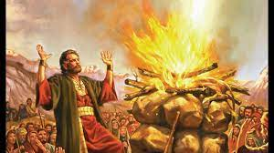

#1 Powerful presence proving He Is God
I Kings 18 Elijah and the prophets of Baal
Obadiah – Elijah’s long time friend
Ahab – King of Israel (N. 10 Tribes)
Jezebel – Ahab’s wicked wife
The Challenge: 450 priests of Baal and Elijah

Slide 4
After Baal’s prophets failed; Elijah’s turn:
V36 “Lord, the God of Abraham, Isaac, and Israel and that I am Your servant and have done all these things at Your command…
V37 Answer me, so these people will know You, Lord, are God, and that you are turning their hearts back again…
V38 Then the fire of the Lord fell and burned up the sacrifice, the wood, the stones, the soil, and also licked up the water in the trench.”
Fire to KNOW that He is God – there is no other – Who is Holy and turns us back to Him

Slide 5
Beware of “strange fire” - Lev. 10: 1-7
Aaron’s two sons (2 of 5 just anointed priests), Nadab and Abihu
Took their own censers – not the sacred ones
Offered it together – only supposed to be One priest
Brought their own fire instead of using the altar fire
One Hebrew translation said they were drunk and arrogant

Slide 6
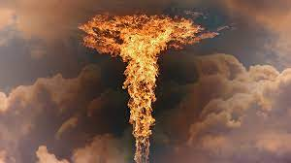
Fire from heaven struck them dead
The Lord told Moses to have Aaron and his sons stay in the Tent of Meetings, do not mourn for Nadab and Abihu’s death…they defiled the holiness of God… stay silent… but let the people mourn and bury the two dead
God is a holy God Who does not accept self-centered appearances of worship … keep the sacred holy… do not let the sacred become profane (unholy)

Slide 7
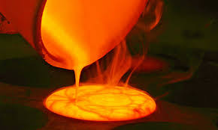
#2. Purifying those who follow Him
Psalms 66: 10, “For You, O God, have tested us; You have refined us like silver.”
Hebrews 12: 7, “He is testing you as His sons…”
James 1: 3, “You know that the testing of your faith produces perseverance…”

Slide 8
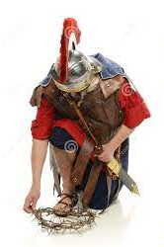
And Bless the Lord…
I Cor. 10: 13, “No temptation has seized you except what is common to man. And God is faithful; He will NOT let you be tempted beyond what you can bear. He WILL provide a way out so you can endure it.”
Romans 8: 37, “in ALL things we are more than conquerors through Him (Christ Jesus) Who loves us!”

Slide 9
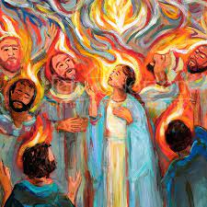
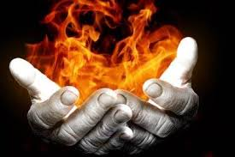
#3 Poured into believers to live victorious Christian lives
Acts 1: 8, “You will receive power when the Holy Spirit comes on you; and you will BE My witnesses.”
Acts 2 – the Day of Pentecost – the birth of the Church… the Holy Spirit now dwells within believers – not only comes upon (OT)…

Slide 10
Witnesses that Christ lives within us, the Holy Spirit empowers the believer to live holy and pure lives…
Gal 5: 19 – 22, “…sexual immorality, impurity, …dissension, hatred, fits of rage, discord, self-ambition, envy, etc. those who live like this will not inherit the Kingdom of God.
But the fruit of the Spirit is love, joy, peace, patience, kindness, goodness, faithfulness, gentleness and self-control…”

Slide 11
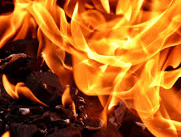
Hence the Holy Spirit – as fire will…
Prove He is a Holy God
Purify those who follow Him
Pour His Spirit within – enabling us to be victorious

