Slide 1

Old and New
Testament History
Wednesday Bible Study – 3/8/2023

Slide 2
The Bible
Old Testament (39 books)
Pentateuch: Genesis, Exodus, Leviticus, Numbers, and Deuteronomy
Historical Books: Joshua, Judges, Ruth, I Samuel, II Samuel, I Kings, II Kings, I Chronicles, II Chronicles, Ezra, Nehemiah, and Esther
Poetic Literature: Job, Psalms, Proverbs, Ecclesiastes, and Song of Solomon
Major Prophets: Isaiah, Jeremiah, Lamentations, Ezekiel, and Daniel

Slide 3
Minor Prophets: Hosea, Joel, Amos, Obadiah, Jonah, Micah, Nahum, Habakkuk, Zephaniah, Haggai, Zechariah, and Malachi
New Testament (27 books)
Gospels (3+ 1): Matthew, Mark, Luke, and John
Church History (1): Acts
Pauline Letters (9): Romans, I Corinthians, II Corinthians, Galatians, Ephesians, Philippians, Colossians, I Thessalonians, II Thessalonians
Pastoral Epistles (4): I Timothy, II Timothy, Titus, Philemon

Slide 4
&
General Letters/Epistles (8): Hebrews; James; I & II Peter; I, II, & III John; and Jude
Apocalyptic Letter: Revelation
39 books in OT 3x9 = 27 (NT) 39 + 27 = 66 books!

Slide 5
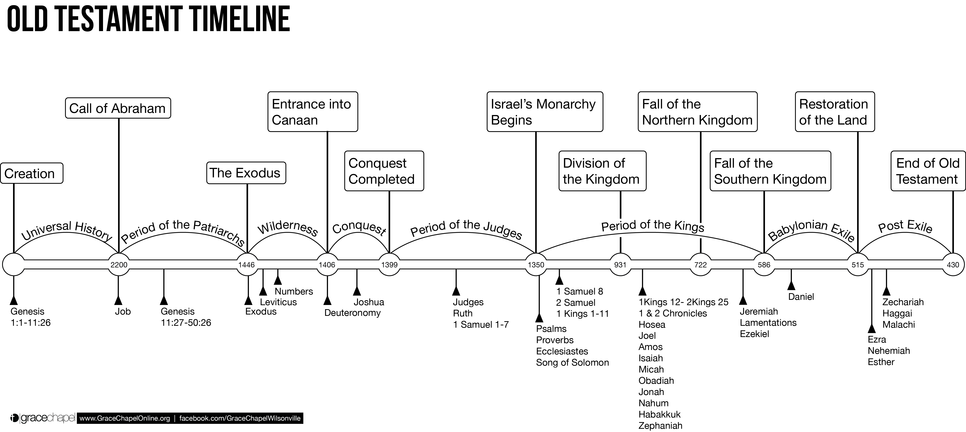
The “big rocks” in OT history
Universal History includes Adam & Eve; Cain and Abel; Enoch; Tower of Babel; Noah; and etc.
Period of Kings – 920’s bc -it was Rehoboam (Solomon’s son/David’s grandson) who caused the split which became the Kingdom of Judah or Southern Kingdom (Judah & Benjamin) and the Kingdom of Israel under Jeroboam (the northern 10 Tribes)

Slide 6
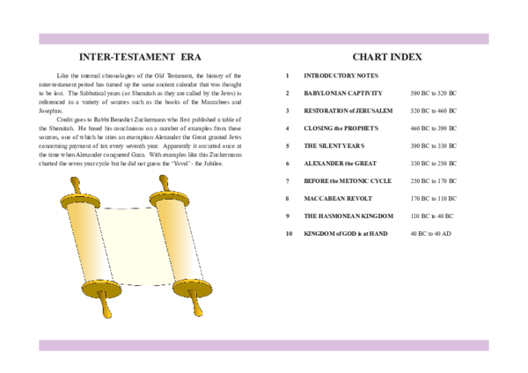
Inter testamental Period
Metonic Cycle = Greek control – Antiochus & abomination of discretion
Maccabean Revolt = Mattathias Maccabee – the Hammer
Hasmonean, Priest family, after the revolt their family ruled Israel.

Slide 7
