Slide 1
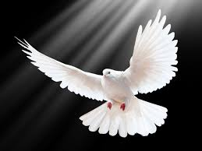
The Holy Spirit Like Dove
Genesis 6 and Matthew 3

Slide 2
Symbolizes: Peace Gen 8 – Noah Rest Ps 55: 6 – David Purity & Beauty Song of Sol 5: 2 Holy & Perfect Song of Sol 6: 9 Trusting Hosea 7: 11 Gentle Matt 10: 16 Used as sin offerings by the poor – Leviticus 12: 6 & Luke 2: 24

Slide 3
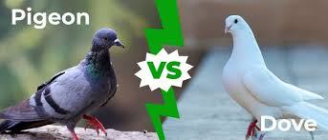
Pigeons stayed in towns, lived in cages and did not migrate.
Doves were called “wild” and migrated seasonally. They were often used to predict Spring’s arrival – new life. Often lived among rocks.

Slide 4
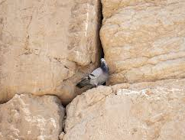
Song of Solomon 2: 14
“My dove in the cleft (cracks) of the rock, in the hiding places in the mountainside, show me your face…”

Slide 5
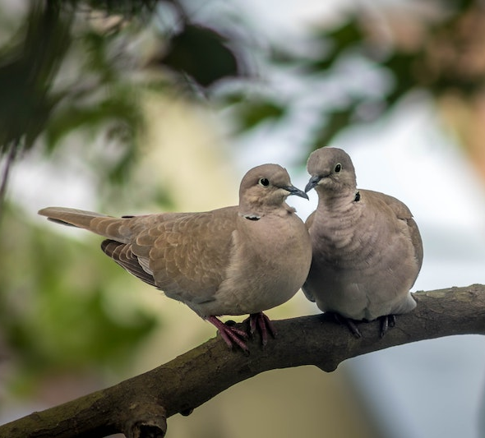
Song of Solomon 2: 12
“Flowers appear on the earth; the season of singing has come, the cooing of doves is heard in our land.”
(Male calling for his bride)

Slide 6
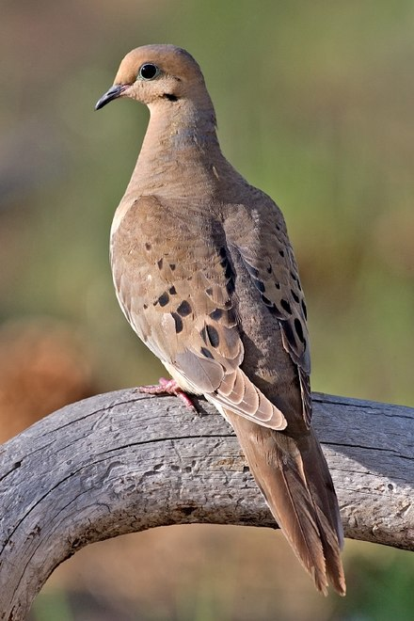
Mourning/Turtle Dove - Misunderstood
Isaiah 38: 14 …Israel moans like a dove in trouble
Isaiah 58: 11 “…we moan like doves; we look for justice but it is far from us.”
Isaiah did not know much about doves, he thought their cooing was because of pain – in reality doves are happiest when they are cooing. Historians say Isaiah probably should have said pigeons not doves.

Slide 7
Doves used as a sin offering by the poor
Lev. 5: 7 “Anyone who cannot afford a lamb is to bring 2 doves or 2 young pigeons to the Lord as a penalty for their sin – one for a sin offering and the other for a burnt offering.”
Luke 2: 22-24, “Every first born male is to be consecrated…”

Slide 8
Earliest Biblical mention of the dove was in the story of Noah & the flood in Gen. 8 – symbol of peace and hope.
Both raven & dove picked because both were loyal and would come back to their mates
Raven flew around and returned
Dove went out – returned
2nd time went out – returned with an olive branch to feed his family

Slide 9
Jesus’ Water Baptism – Matthew 3: 16-17
”As soon as Jesus was baptized, he went up out of the water. At that moment heaven opened, and …the Spirit of God descended like a dove and alighting on Him. And a voice from heaven said, ‘This is My Son, Whom I love with Him, I am well pleased.’”

Slide 10
Why is the dove symbolic of the Holy Spirit?
He fills us with peace and hope (Noah)
He is gentle and pure (Song of Solomon)
Leads us to rest (David)
God, Himself, reveals the Holy Spirit in the likeness of a dove to remind us that not only is He holy and just, but He is loving and gentle, guiding us to peace, hope, and rest in Him.

Slide 11
Matthew 10: 16 & 17 Jesus said…
“I am sending you out like sheep among wolves. Therefore be as shrewd/wise as snakes and as innocent/gentle as doves. Be on your guard…”

