Slide 1
Good Friday

Slide 2
Passover
Matt 26: 1-16
Mark 14: 12-72
Luke 22: 7-71
John 13 – 17:26

Slide 3
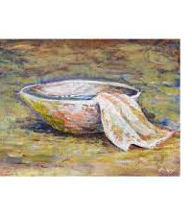
Pause…get a towel and basin…

Slide 4
The Supper

Slide 5
Communion elements are ready…

Slide 7
Gethsemane
Matt 26: 36-46
Mark 14: 32-42
Luke 22: 39-48
John 18: 1

Slide 8
Kiss of Betrayal
Matt 26
Mark 14
Luke 22
John 13 & 18

Slide 9
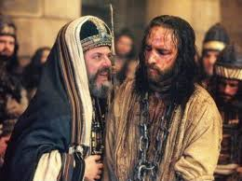
Jesus Arrested
Matt 26 -27 Mark 14 -15
Luke 22-23 Joh18 -19

Slide 10
3 Trials
#1. Before Caiaphas and the Sanhedrin
Matt 26
Mark 14

Slide 11
#2a. Before Pilate Matt 27 Mark 15 Luke 23 John 19

Slide 12
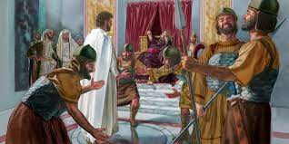
#2b. Before King Herod Luke 23 …Herod laughed and mocked Jesus then sent Him back to Pilate

Slide 13
Jesus mocked and beaten… Matt 27 Mark 15 Luke 22 John 19

Slide 14
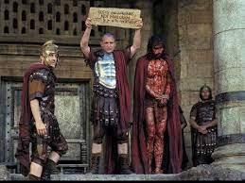
#3. Final Trial Before Pilate
Matt 27
Mark 15
Luke 23
John 19

Slide 15
Condemned
“Crucify Him!”
“Crucify Him!!”
“Crucify Him!!!”

Slide 17
“Eli, Eli, lema sabachthani” “It is finished”…

