Slide 1

PLAY VIDEO

Slide 2
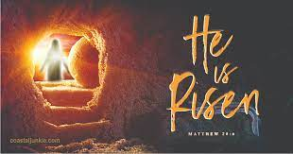
Indeed!
Matt 28: 1-15
Mark 16: 1-14
Luke 24: 1-49
John 20: 1 – 21:14
I Cor 15: 1-20

Slide 3
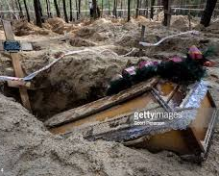
Fun fact…
Matt 27: 52 After Jesus rose from the dead, OT saints arose and people saw them walking in Jerusalem

Slide 4
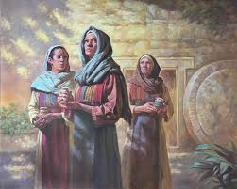
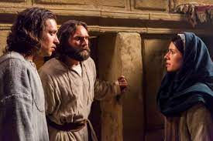
Resurrection Morning
The women went to the tomb
Mary tells the disciples – He is not there

Slide 5
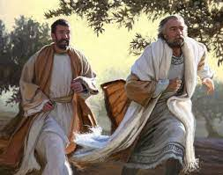
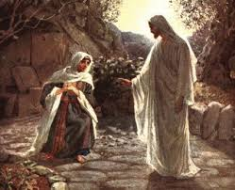
Sunday morning events continue
Peter & John run to the tomb
Mary returns to tomb and sees Jesus

Slide 6
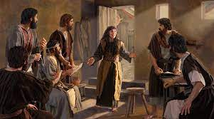
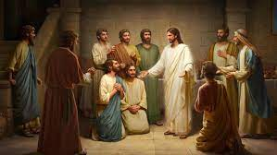
Mary runs back to tell the disciples – she saw Jesus and spoke to Him – they did not believe her…
Jesus appeared to them that evening – but Thomas was not there…

Slide 7
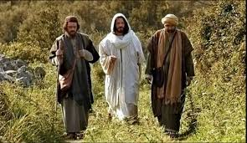
The Road to Emmaus
In Luke 24, Jesus appears to two believers: Cleopas and another not named
“Were not our hearts burning within us while He walked with us on the road and opened scriptures to us?”

Slide 8
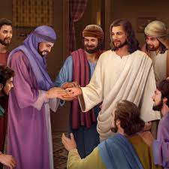
One week later…
Jesus appears to His disciples – especially to Thomas…

Slide 9
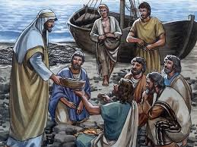
“Afterwards” Jesus appears to 7 of the disciples in Galilee
John 21 The disciples return to fishing fish – not men
Jesus appears to them on the shore
He cooks for them, feeds them, then encourages them in their calling – fishers of men…

Slide 10
He is risen!
Paul reports in I Cor. 15:
V3 Christ died according to scriptures
V4 He was buried and rose from the dead on the 3rd day –as scripture said
V5 He appeared to Cephas (Peter) and the other Disciples
V6 He appeared to more than 500 people before His ascension
V8 Jesus appeared to me (Paul) on the road to Damascus!

Slide 11
No resurrection?
V13 & 14 Without a resurrection our preaching and faith would be in vain!
V15 We would be liars!
V17 Your faith would be futile and you would be still dead in your sins!
V20 “But Christ has indeed been raised from the dead!”

Slide 12
Indeed!
INDEED!
INDEED!

