Slide 1
The Book of Acts
Acts 1

Slide 2
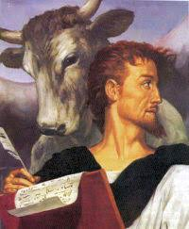
Introduction:
When: 63 – 69 ad, before Rome was set on fire by Nero in 64 ad and before the destruction of Jerusalem in 70 ad. The writer does not mention either of these major events in the Book of Acts. Also written before Rome decided what to do with Paul – before Paul was beheaded in 67 ad.
Who wrote Acts: Luke, a doctor (Col 4:14), a Greek, and fellow traveler with Paul as seen in the “we” verses: Acts 16:10 – 17 and Acts 27:1 – 28: 16.

Slide 3
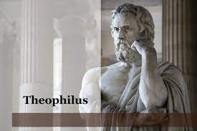
Who did Luke write Acts for: Both the book of Luke and Acts were written to Theophilus.
“Theophilus” means: “loved of God”, “a friend of God”, or “one who loves God”.
Theophilus is called “most excellent Theophilus” – means he was a governor in the Roman political system.

Slide 4
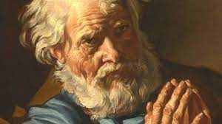
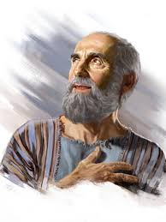
The book of Acts is a bridge between the Gospel message to the growth of the Church
Acts 1 – 12 focuses on Peter
Acts 13 – 28 focuses on Paul

Slide 5
Most important verse:
Acts 1:8
“But you shall receive power when the Holy Spirit comes on you; and you will be My witnesses in Jerusalem, and in all of Judea, and Samaria, and to the ends of the earth.”

Slide 6
Acts 1
V1: “in my former book…” = the gospel of Luke
Vv2 & 3: Purpose explained: to record all that Jesus did and taught until He was taken up.
V3: Gave much proof that He rose from the dead during the 40 days from His resurrection to His ascension
V4 & 5: He ate with them and commanded they stay in Jerusalem - …”wait for the gift My Father promised, which you have heard Me speak about. For John baptized with water, but in a few days you will be baptized with the Holy Spirit.”

Slide 7
Vv. 6 & 7 The Disciples still did not understand, “Are you going to restore Israel now?”… Jesus said, “It is not for you to know…”
Acts 1: 8
“But you shall receive power when the Holy Spirit comes on you; and you will be My witnesses in Jerusalem, and in all of Judea, and Samaria, and to the ends of the earth.”

Slide 8
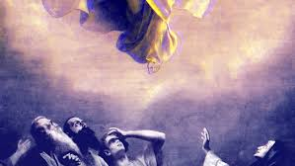
V9. Jesus was taken up before their very eyes…

Slide 9
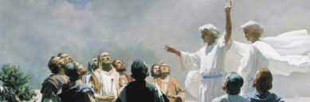
Vv 10-11, The angels said, “why do you stand here looking into the sky? This same Jesus, Who has been take from you into heaven, will come back in the same way you have seen Him go into heaven.”
A promise given:

Slide 10
The purpose for the baptism in the Holy Spirit is for believers to be:
Witnesses in Jerusalem
in all of Judea
in Samaria
Into all the earth

Slide 11
What is your Jerusalem? Your family!
What is your Judea? Your workplace or Deaf Community
What is your Samaria? Other relationships
What is your “ends of the world”? Missions Trips

Slide 12
The purpose for being born again and filled with the Holy Spirit is to tell others about Jesus!
When was the last time you shared with a non-Christian about what Jesus has done in your life?
Acts 1 is about believers in Jesus telling others – He lives in your life – Go and Tell!

