Slide 1
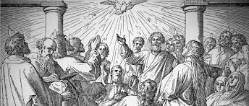
The Day of Pentecost (Shavuot) Acts 2

Slide 2
Last week: Are you a disciple? Applying Jesus’ teaching to your daily life? Can others see the fruit of the Spirit in your life? Do you share Jesus with others?

Slide 3
How is your homework doing?
You
________
_________
________
Who?
Who?
Who?

Slide 4
Background from the end of Acts 1:
After seeing Jesus ascend into heaven, the disciples returned to Jerusalem.
They went to the “room” where they were staying – the upper room (banquet room) where they celebrated the Passover meal with Jesus – the home of John Mark’s family (Mark - the author of the Book of Mark).
All 11 disciples were there, plus Jesus’ mother and His brothers, plus others – 120 people there.
Matthias chosen to replace Judas Iscariot.

Slide 5
March/April Yearly:
Feast of the Unleavened Bread: started with the Passover supper and lasted 7 days
First Fruits Celebrated on the 1st Sunday after Passover – Spring harvest. (Easter Sunday)
Pentecost: 50 days after the First Fruits Feast

Slide 6
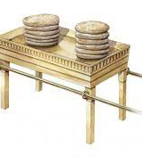
Feast of the Unleavened Bread
Exodus 12: 17 – 20
Preparing for the Passover, all yeast was to be removed and homes were cleaned to remove any yeast in the home. Yeast = picture of sin
Bread made without yeast to show the urgency of the time… no time to wait for the yeast to raise the bread dough
Symbolic of Sanctification – the cleansing of our sins…

Slide 7
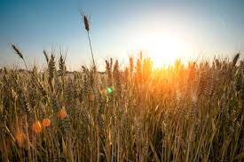
The Day of First Fruits:
Spring or early harvest was celebrated by bringing an offering of the first harvest to be an offering to the Lord
Symbolic of Christ’s resurrection: in I Cor. 15, Jesus is called the First Fruit of the resurrection
Celebrated the Sunday after Passover

Slide 8
Pentecost - Different Names:
Shavuot = the 49 days between the First Fruit celebration and the Day of Pentecost…it is the celebration of the giving of the Torah (10 Commandments+) and God coming to mankind through His Word
Pentecost is the 50th Day after Passover – to celebrate God’s provision and the escape from Egypt ( bondage)
Exodus 23:16 = Feast of the Harvest
Exodus 34: 24, Leviticus 23: 15 – 22 and Deuteronomy 16: 9 – 12 = Feasts of Weeks

Slide 9
How did the Jews Celebrate Pentecost
A wave offering: used 2 loaves of freshly made bread and a killed lamb were waved over the head of the priest
7 one year old male lambs, 1 young bull, and 2 rams were used as burnt offerings (volunteer or free will offerings )
2 lambs for fellowship offering (just because/love offering)
1 goat sacrificed for a sin offering
The “feel” of the day was to rejoice and give thanks for all that God had done for His people. A time to be thankful!

Slide 10
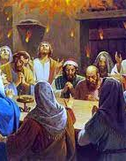
Acts 2!
The 120 were gathered together on the Day of Pentecost giving thanks for what the Lord had done in their lives
The room shook and the presence and power of the Holy Spirit filled the room and filled each one with the Holy Spirit – the Baptism of the Holy Spirit … to be continued next week…

Slide 11
WHAT DOES PENTECOST MEAN TO US TODAY?
“We owed a dept (our sins) – we could not pay… He paid a dept (for our sins) – He did not owe”…
Remember where we came from! What He saved me from
John 14 – 16 = the infilling (baptism) of the Holy Spirit is for all believers … it is a gift from the Father, sent by the Son… so we can BE witnesses as victorious Christians!

