Slide 1
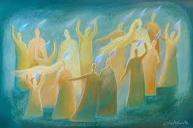
The Infilling of the Holy Spirit has come!
Acts 2: 2 - 18
What were they doing?

Slide 2
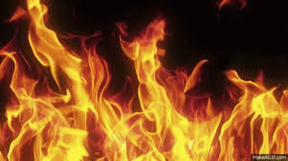
V 2 A sound like a violent blowing wind
Came from heaven - Holy Spirit came from God
Filled the whole house – Complete presence
When they were sitting – All waiting upon the Lord
V3 They saw – witnessed/experienced
Flames of fire separating
Resting upon each of them (120+ people)

Slide 3
V 4 All of them were filled with the Holy Spirit
All began to speak in other languages (tongues)
As the Spirit enabled them/ gave them the ability to…

Slide 4
V5 God-fearing Jews from every nation were in Jerusalem – celebrating the Feast of Pentecost/Thanksgiving
V6 They heard the sound
Crowds gathered in bewilderment (huh???)
Because each one heard their own language spoken
V7 They were utterly (completely) amazed asking
“Aren’t these speaking Galileans?”
“How do they know our language?”

Slide 5
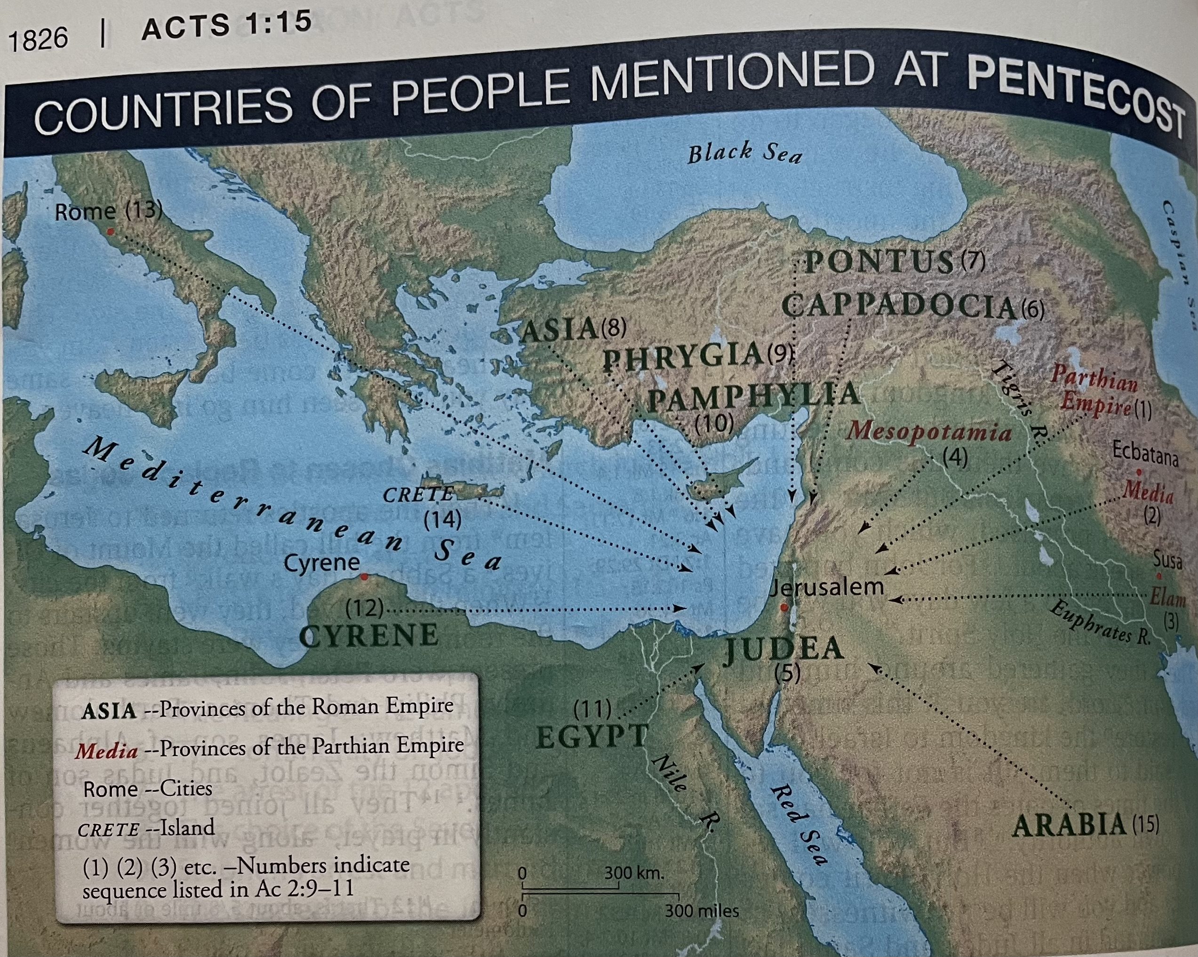
Acts 2: 9 – 11
15 Nations were there:
Parthians, Medes,
Elamites, Mesopotamia,
Judea, Cappadocia,
Pontus, Asia, Phrygia,
Pamphylia, Egypt, Libya- Cyrene, Rome, Cretans, & Arabs

Slide 6
People gathered there were both Jews and Jewish converts
They heard the 120+ filled with the Holy Spirit declaring the wonders of God
In their own language (Revelation 7)
V12 Amazed and perplexed, they asked, “What does this mean?”
V13 Others mocked, “They’re drunk!”

Slide 7
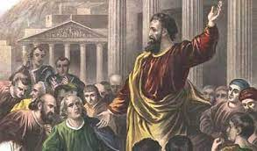
Peter spoke:
Vv 14 – 15 “They are NOT drunk! It’s only 9:00 am!”
Vv 16 – 21 He explains they are watching Joel 2: 28 – 32 fulfilled!

Slide 8
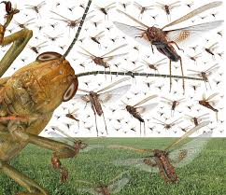
A look at the Prophet Joel
Basically unknown background (7th – 5th century bc)
Lived in Judea – in Jerusalem area
His message: Restoration happens after judgement and repentance
Locust: 460 sq miles; 40 – 80 million bugs per mile; eat 432 million lbs per day
National Geographic info…

Slide 9
The Message from Peter & Joel:
God said, “In the last days
I will pour out My Spirit on all people...
Your sons and daughters will prophesy (tell future & voice of God)
Your young men will see visions (full active spiritual power)
Your old men will dream dreams (wise ponderings)
And upon My servants, both men and women, I will pour out My Spirit in those days and they will prophesy…”

