Slide 1
Call “Jesus”
Acts 2: 21 - 47

Slide 2
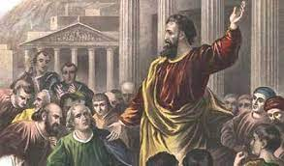
Remember - Peter spoke:
Vv 14 – 15 “They are NOT drunk! It’s only 9:00 am!”
Vv 16 – 21 He explains they are watching Joel 2: 28 – 32 fulfilled!

Slide 3
“And anyone who calls on the name of the Lord (Jesus) will be saved.” Acts 2:21
“Calls”
Strong ask (appeal) to someone over you
Distress shout or cry
Believe and confess with all your heart
Peter’s message continues …

Slide 4
V22 God validated Jesus as the Messiah through the signs and wonders (miracles) Jesus did
V23 It was God’s deliberate plan to allow the wicked to crucify Jesus – our sins…
V24 But God raised Jesus up from the dead!
V25 – 35 Even King David prophesied about Jesus: Ps 16 & 110
He will not be abandoned to the realm of death
His body will not decay (resurrection will…)
He will be seated at the “right hand of the Father” – a position of honor and authority.
V36 God has made this Jesus, Whom you have crucified, both Lord and Messiah!

Slide 5
Truth spoken will always cause a response…
V37 learning this message… “They were cut to the heart…”
They cried out, “What shall we do?”
V38 Peter replied, “Repent, be baptized in Jesus’ name for forgiveness of your sins and you will receive the gift of the Holy Spirit…”
V39 “This promise is for you, your children and all who are a far off” (generations to come)

Slide 6
“And anyone who calls on the name of the Lord (Jesus) will be saved.” Acts 2:21
V41 3,000 saved that day
VV 42 – 47 “They devoted themselves to the apostles’ teaching and to fellowshipping, to breaking of bread (communion) and prayer. Everyone was filled with awe at the miracles they saw, … the believers were all together and had everything in common…they broke bread in their homes and ate together with glad and sincere hearts, praising God and enjoying the favor of all people. And the Lord added to their numbers daily those who were saved…”

Slide 7
Fellowshipping – Koinonia (grk)
To Share
To Communicate with each other
To Contribute
To Give of yourself
To Participate
To make oneself a partner and make another’s needs “my own” to relieve their pain…

Slide 8
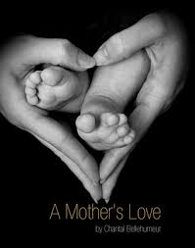
Mothers’ Day!
Today – a perfect day to look at the Church – our church BDA –
The Church is pictured like a Lady – the Bride of Christ
The one whom God chooses to nurture, disciple, and grow His children to become fully whole and mature reflections of Jesus…
BDA’s Open Forums are designed as beginning opportunities to commit to healing and growing together in the likeness of Jesus…

