Slide 1
Check your motives…
Acts 5: 17 - 42

Slide 2
The Story: Acts 5: 17 - 42
Vv18-19, The apostles continued to meet in the Temple, those accepting Jesus in their heart increased daily! The Sadducees and High Priest were jealous! Arrested them-again…
Vv19-20, Night – an angel of the Lord opened the jail doors and told them to go and continue to preach/teach about this new life.
Vv21-23, Apostles did as they were told – preached again in the Temple; Sanhedrin sent for the apostles; they were not there; doors were locked and guards still standing there…

Slide 3
Vv 24-25, The Sanhedrin were “perplexed and wondered what this would lead to… Look at their mindset: not puzzled because of the miracle of the apostles’ freedom; and wondered at what this might “cause”… (a revolt? Roman revenge? Political embarrassment? Or???)
Vv 26-27, Brought the apostles to face the Sanhedrin… carefully because they feared how the people would react…
Vv 28, “We gave you orders to stop!”
Vv 29-32, Peter again states, “We must obey God!...Jesus is risen! We are witnesses of these things!...”

Slide 4
Vv33-39, The Sanhedrin was furious! Mad! But Gamaliel spoke: (Gamaliel was a highly respected Pharisee, teacher of the Law, and respected by “all” – Paul’s personal tutor) – apostles sent out
Remember there were two other self-proclaimed ‘messiahs’, those two enjoyed success for a while but failed and their “movements” died – no longer exists…
Leave these men alone! Let them go!
If their purpose and activity is of human origin – they will FAIL; but if it is from God, you will not stop it and you will be fighting against God!

Slide 5
Vv40-42, Gamaliel’s speech persuaded them to let the apostles go… So the temple guards beat the apostles and freed them.
The apostles left the Sanhedrin rejoicing because they had been counted (called) worthy of suffering disgrace for the name of Jesus
And day after day, they never stopped teaching and proclaiming the good news that Jesus is the Messiah…

Slide 6
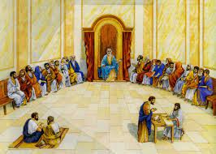
Three (3) different motives:
Jealous – loosing power of influence & political control
Their mindset: perplexed – not at the miracle; wondered – crisis repair mode
Lost control of their emotions, lost objectivity
Motivated to “survive on top”
#1. Sanhedrin

Slide 7
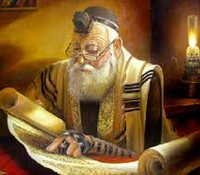
#2. Gamaliel
Logical and reasonable
Understood – God is in control
Man cannot stop God
Be careful not to fight God!

Slide 8
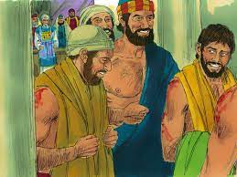
#3. The Apostles
Because they were witnesses:
Understood – Obedience is a choice
Understood personally being disgraced for Jesus gave them a freedom that no one could take away
Understood in spite of circumstances – God is still in control!

Slide 9
What motivates you to serve Jesus?
Why do you serve Jesus?
What are you a witness of?

