Slide 1
Persecution scatters believers and the good news of Jesus spreads!
Acts 8: 1 - 25

Slide 2

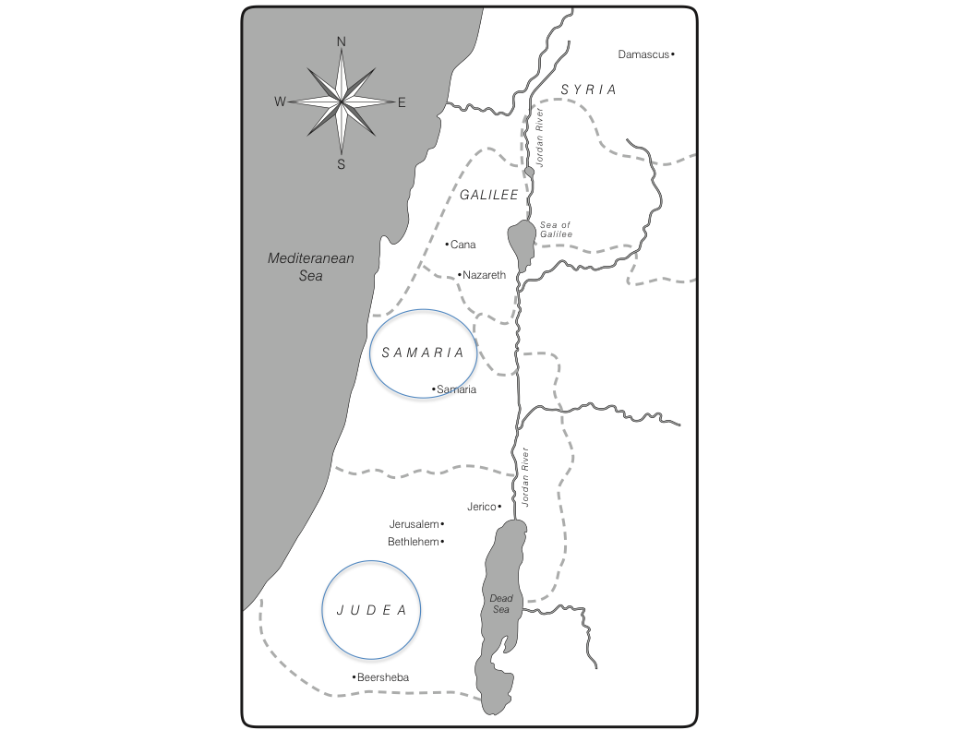
The Story:
Saul/Paul:
We are introduced to Saul – as the one who approved of Stephen’s stoning (death)
He began to persecute Christians – dragging men and women to prison
The believers scattered throughout Judea and Samaria
They taught about Jesus as they went and everywhere they travelled

Slide 3
Introduction to Philip and his ministry
Philip and his family moves to the city of Samaria in the country of Samaria
He preached Jesus and people were healed, demons exited people who were possessed, paralytics were healed
People listened, saw the miracles, and paid close attention to the words he taught
Many believed, repented, and obeyed His word
Great joy was in that city (Samaria)

Slide 4
Meet Simon:
Simon – a sorcerer (witchcraft magician) boast of his powers and was called, “The Great Power of God” – had many “followers”
His ”followers” heard Philip’s preaching and many repented and became believers and were water baptized
Even Simon became a believer, was baptized, and followed Philip everywhere

Slide 5
Peter & John
The Apostles in Jerusalem sent Peter & John to see what was happening in Samaria
They noted that the new believers were not yet filled with the Holy Spirit and laid hands on them and prayed – the believers were filled with the Holy Spirit

Slide 6
Simon saw the ministry of Peter and John and offered to pay them for that “power” – “saw” means an external action implying he saw the others speaking in tongues like Acts 2
Peter rebukes Simon: “your money will die with you”; “your heart is not right with God”; “repent”; “I (Peter) see that you are full of bitterness and are captive to sin”
Simon cries out for prayer
Peter and John return to Jerusalem

Slide 7
Note:
Saul = good intentions – wrong choices and actions
Philip = lived a pure & dedicated life of obedience – brought joy to those around him
Peter & John = used of the Lord to present the filling of the Holy Spirit to believers. Used of the Lord to judge & rebuke sin and call to repentance
Simon = self absorbed, narcissist, was baptized but held on to lust of power, did not humble himself to have the apostles lay hands on him (lack of humility), still captive of sin and bitterness, when confronted – cried out for prayer

Slide 8
What about us?
We, too, can have good intentions but make wrong choices
We, too, can be filled with the Holy Spirit, live obedient lives, and be a fragrant of joy to those around us
We, too, can be used to judge sin, rebuke sin and call others to repentance
We, too, struggle with sin and bitterness – call for prayer!
Romans 8 - no more trapped by sin, we are conquerors in Jesus Christ! In Jesus, sin has no more control over our lives!

