Slide 1
“Do you believe with all your heart?”
Acts 8: 26 - 40

Slide 2
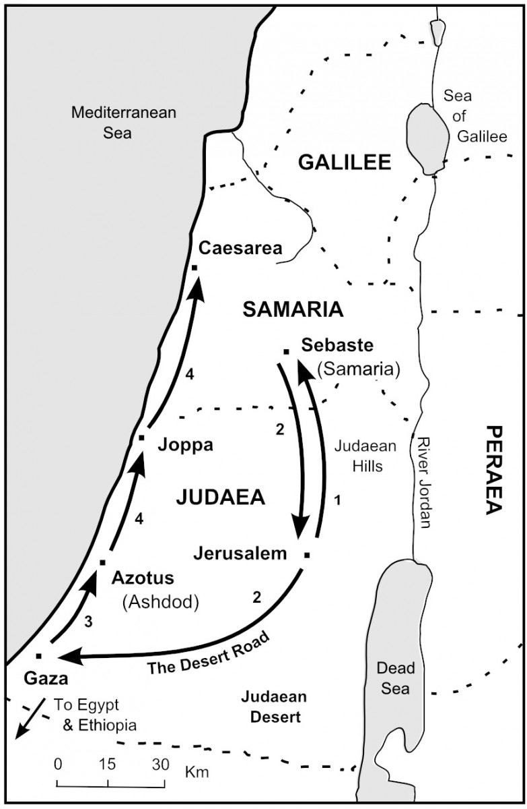
The Story:
Earlier (last week’s msg): The Lord used Philip for revival in Samaria
V26 An angel of the Lord said to Philip to go to the road that went from Jerusalem to Gaza
V27 Philip met an Ethiopian eunuch, an important official in charge of all of Kandake’s (Queen of Ethiopia) treasury. He was in Jerusalem to worship God.

Slide 3
V28 He was on his way home, sitting in his chariot reading the Book of Isaiah
V29 The Spirit of the Lord told Philip to go stand near
V30 Philip heard the Eunuch reading Isaiah and asked, “Do you understand what you are reading?”
V31”How can I unless someone explains it to me?” He invited Philip to join him.
V32 He was reading from Isaiah 53

Slide 4
Isaiah 53
“He was led like a sheep to the slaughter, and as a lamb before the shearer is silent, so he did not open his mouth.
In his humiliation he was deprived of justice. Who can speak of his descendants? For his life was taken from earth.”

Slide 5
V34 & 35 The Eunuch asked who this was being spoken about. And Philip told him the good news about Jesus
V36 & 37 As they traveled along, the Eunuch saw some water and asked, “What stands in my way from being baptized?” And Philip said, “If you believe with all your heart, you may.” He responded, “I believe that Jesus Christ is the Son of God.”
V38 The Eunuch gave orders to stop the chariot

Slide 6
V38 Both Philip and the Eunuch went into the water and Philip baptized him.
V39 When they came out of the water, the Spirit of the Lord suddenly took Philip away and the Eunuch did not see Philip again. The Eunuch went on his way home rejoicing.
V40 Philip appeared in Azotus, traveling about preaching Jesus in every town he went from Azotus to Caesarea

Slide 7
Let’s examine His Word!
An angel spoke to Philip – no surprised reaction!
Philip obeyed and met an Ethiopian Eunuch on the road to Gaza
Ancient Jewish history records Zephaniah confirms that Manasseh sent a large group of Jewish soldiers to Ethiopia to protect their borders against Egypt.
We find in Ps 87:4, “they (Ethiopians) have become citizens of Zion (Jewish converts).”

Slide 8
This Ethiopian Eunuch could have been part of that history – either a Jew placed in Ethiopia during Joshua’s time or an Ethiopian who converted to Judaism because of the Jewish interaction in Ethiopia Not sure, either Jewish himself or Ethiopian convert
Eunuch was going home from Jerusalem – celebrated Passover and Pentecost, now going home
“Eunuch” = title of great authority, not only mean ‘castrated’& he was the treasurer of all of Candace’s (title for queen) treasury.

Slide 9
The Spirit told Philip to go near the Eunuch’s chariot.
The Eunuch “happened” to be reading Isaiah 53!
“He was led like a sheep to the slaughter, and as a lamb before the shearer is silent, so he did not open his mouth.
In his humiliation he was deprived of justice. Who can speak of his descendants? For his life was taken from earth.”

Slide 10
As they traveled together, the Eunuch asked Philip to explain – Philip told him that Jesus is the lamb that was killed – Jesus’ human bloodline no longer exists – Jesus’ sacrifice was complete!
The Eunuch saw some water, told the chariot driver to stop and asked Philip what would block him from being baptized…
Philip stated, “If you believe with all your heart, you may.”
Eunuch responded, “I believe that Jesus Christ is the Son of God.”

Slide 11
They went into the water and Philip baptized the Eunuch.
When they got out of the water, the Spirit of the Lord took Philip to Azotus.
The Eunuch returned to Ethiopia rejoicing
Philip preached in every town he went to on his way to Casaera

Slide 12
God saw the hungry heart of the Ethiopian
Sent His obedient servant to be the answer to the Ethiopian’s prayers
The Ethiopian accepted Jesus, was baptized, went home and shared his experience with joy
Philip had an amazing experience – being Spirit led… Are you willing to be used by the Lord to make a difference in someone else’s life?

