Slide 1
“Get up and go!”
Acts 9: 32 – 43;
I Samuel 16;
I Kings 19; and
John 5

Slide 2
Healing of Aenas – Acts 9: 32 – 35
Peter in Lydda
Paralyzed man – Aenas – paralyzed for 8 years
Peter said, “Jesus heals you, get up…”
Immediately, he got up and all who lived in Lydda saw and turned to the Lord

Slide 3
Tabitha – 9: 36 – 43
In Joppa, a disciple named Tabitha or Dorcas (grk) was always doing good and serving the poor
Became sick and died
The widows wept and prepared Tabitha’s body for burial, placing her in an upstairs room
Some from Joppa heard that Peter was in Lydda and asked to come

Slide 4

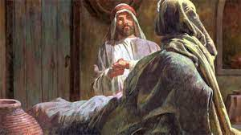
V39 Peter entered the room and saw the widows there
They showed him the clothes and robes Tabitha made
V40 Peter sent all of them out and got on his knees & prayed, then said to her, “Get up…”
V41 Peter took her by the hand and helped her to her feet

Slide 5
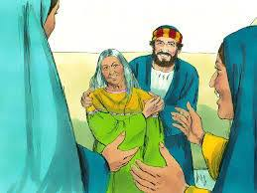
Peter calls in the widows first
This became known all over Joppa and many people believed
Peter stayed in Joppa with Simon the Tanner (leather worker)

Slide 6
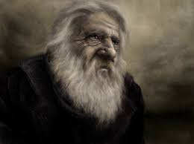
Get up and go…!
I Samuel 16
Saul rebels against God
God removes Saul as King
Samuel leaves and never sees Saul again – mourning
God tells Samuel, “Enough! Get up and go…”

Slide 7
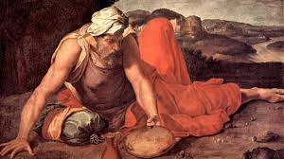
Get up and go!
I Kings 19
Elijah experiences a great victory
Jezebel’s threat
Elijah runs … God asks, “What are you doing here?”
The Lord sent an angel to minister to Elijah 3 times, then told Elijah, “get up and eat…”

Slide 8
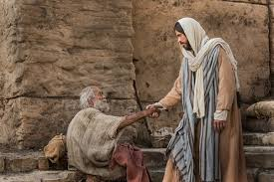
Get up and go!
John 5
Jesus heals the lame man at the Pool of Bethesda
Jesus told him, “Get up, pick up your mat, and walk – go!”

Slide 9
It is time!
Get up and go!

