Slide 1
Will you change history?
Acts 11: 19 - 30

Slide 2
Everywhere to anywhere!
Last week: Quantum Leap Change: Israel chosen to be the world’s priests (Ex 19) – now Believers committed to Jesus are called “the Priesthood of believers” I Peter 2
You are the priests/pastors of your family, your friends, and your Deaf Community! Their duties & role were to represent Jesus to the people and represent/present the people to Jesus…

Slide 3
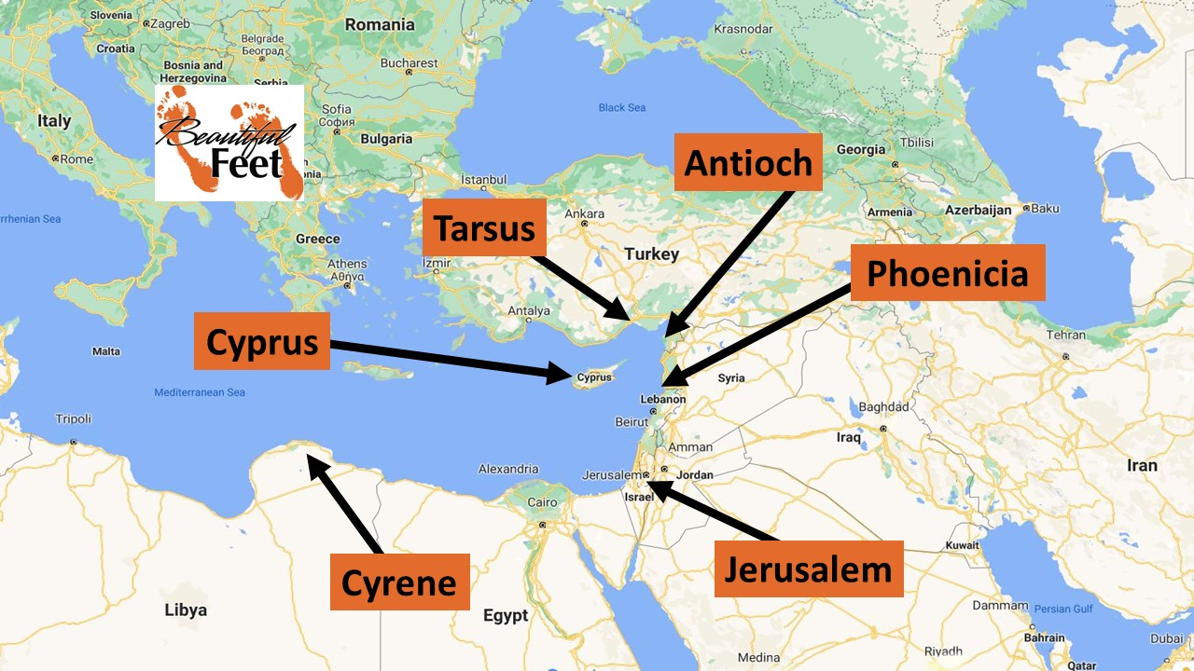
Acts 11: 19 – 30 introduces us to several important cities:
Jerusalem
Phoenicia (Lebanon area)
Antioch of Syria (Turkey)
Tarsus – P/Saul’s home
Cyprus – Barnabas’ home
Cyrene – Libya (N. Africa)

Slide 4
V19 – Persecution after Stephen’s death caused believers to scatter throughout the Roman Empire (diaspora)
They traveled as far as Phoenicia, Cyprus, and Antioch – spreading the Word only to the Jews
V20 – however, some came from Cyprus and Cyrene who went to Antioch and spoke in Greek to the Greeks – sharing the good news about Jesus
V21 – Missio Dei (the heart of God)! The Lord’s hand was with them, and a great number believed and turned to the Lord!

Slide 5
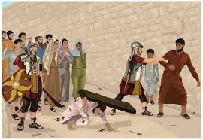
Cyrene – Matt 27: 23 “Simon of Cyrene” a Jewish convert in Jerusalem to celebrate the Passover and Pentecost – forced to help Jesus carry the cross
Father of Alexander and Rufus (who most likely were there and saw their dad forced help Jesus carry the cross) – Mark 15:21 & Acts 16:13 (Rufus = Church leader)
Something Miraculous Happens When Confronting the Cross

Slide 6

A look at Antioch of Syria
300 bc Greeks ruled – Greek language became the common language
64 bc Roman Empire ruled and became the 3rd largest city in the Roman Empire (Rome, Alexandria/N. Africa, and Antioch)
Peter is called the founder of the Antioch Church
47 – 55 ad Paul’s headquarters
Acts 11 – first place “Christians” used

Slide 7

Remember the missio Dei? So many were saved, Jerusalem leaders heard!
V22 The Jerusalem Church sent Barnabas (born in Cyprus)
V23 When he arrived, he saw what the grace of God had done
V23 He encouraged them and taught them to remain true to the Lord with all their hearts
V24 He was a good man, full of the Holy Spirit, and a great number of people accepted Jesus into their hearts

Slide 8
Game changer!
V25 Barnabas went to Tarsus to look for P/Saul,
V26 and when Barnabas found P/Saul, he brought S/Paul to Antioch
Approximately 15 years passed between Acts 9 to Acts 11 Paul’s stay and escape from Damascus, 3 years spent in the Syrian desert, returned to his home in Tarsus – Barnabas brought him to the Disciples in Jerusalem, then P/Saul returned to Tarsus and again, Barnabas brings P/Saul to Antioch – ministered 1 year there and many were saved
This is where they were first called “Christians”

Slide 9
The church takes action
Vv27 & 28 – We meet Agabus – a Spirit-filled Christian prophet (we will see him again in Acts 21:10)
He prophesies there will be a serious famine that will spread though the entire Roman Empire – Luke tells us the famine did happen during the reign of the Roman Emperor Claudius (reigned 41 ad to 54 ad)
The Antioch Church decided that they would be committed to helping the Churches throughout Judea

Slide 10
Two big Pictures in these verses:
Simon of Cyrene
Forced to carry Jesus’ cross
2 Sons: Alexander and Rufus
Rufus becomes a Church leader
P/Saul Persecution and Conversion
Barnabas’ Relationship
Brought them to Antioch
Christians grow
Church reaches beyond their walls
Generations effected…

Slide 11
Your life?
Deaf School, Mainstream, Oral program
Accepted Jesus in your heart
Relationships
Your Life’s Impact?
Born Deaf/Hard of Hearing
What will your story be?
Will your life change someone’s history?

