Slide 1
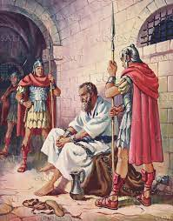
God answers prayer!
Acts 12: 1 - 25

Slide 2
4 main characters:
Herod
Soldiers
Peter
The Church

Slide 3
Herod Agrippa – grandson of Herod the Great
v1Thrived the praises of the Jews so he killed James the brother of John and arrested Peter
V19 When Peter was found missing, he ordered the guards executed
Vv20 – 24 because he enjoyed being called “the voice of God”, an angel of the Lord struck him dead – stomach burst open and worms were seen eating his internals…

Slide 4
The soldiers
V4 16 soldiers assigned to arrest and guard Peter
V18 chaos happened the morning after Peter was arrested – “where is he?”
V19 Herod questioned them and then had them executed

Slide 5
Peter
V3 Peter is arrested and sent to prison
V6-12 Peter fell asleep chained to 2 guards, the angel of the Lord “struck” his side, and told him to get up, get dressed, hurry and follow me…the angel lead Peter out into the street then disappeared
Peter finally realized he was not dreaming! This is really happening!
Peter goes to Mary’s home (John Mark’s home) where the church is praying for him

Slide 6
The praying church
V13-24 Rhoda, a servant girl, goes to answers the door, hears Peter’s voice, leaves Peter outside and runs to tell those praying
V15 “You’re out of your mind”
V17 Peter is finally let in and he testifies of what God had done – answered their prayers!
Peter encouraged them to keep spreading the gospel and this testimony – then left…

Slide 7
God Answers Prayer!
Missionary in Africa & 8 Angels (1980’s)
Mrs. Tripplet and her visitor in El Salvador (1970’s)
My healing of a ruptured disc (1975)
Wendy’s healing (1990)
Does Jesus still answer prayers today?
Is Jesus Christ the same yesterday, today and forever?

