Slide 1
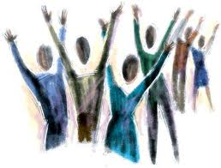
Worship
People of His Presence

Slide 2
Meaning & Purpose
To acknowledge object’s and/or persons worth
To express reverence
To have a sense of awe
To bow low before

Slide 3
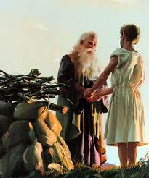
Biblical Beginnings
Worship 1st mentioned in Genesis 22:5
Abraham tells his servant to stay at the bottom of the mountain while Isaac and he goes to worship the Lord – they will return
Obedience + Faith + Sacrifice

Slide 4
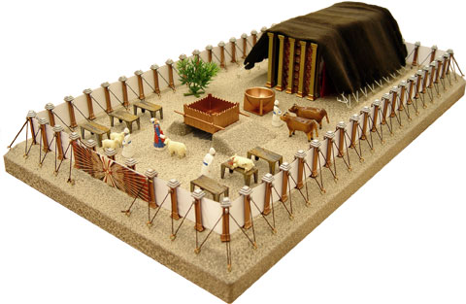
The Tabernacle
Genesis 25 – 40, God uses Moses to establish a mobile place of worship
Genesis 40:34 – 38, “Then the cloud covered the Tent of Meetings, and the glory of the Lord filled the tabernacle…the cloud of the Lord was over the tabernacle by day and fire by night in sight of all…”

Slide 5
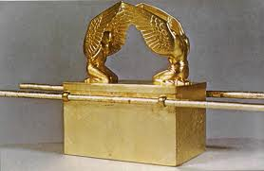
The Ark of the Covenant
Held the 10 Commandments, Aarons budding staff, and pot of manna
When Israel was not obedient – their enemy would steal the Ark
The Mercy Seat of God – middle of the top of the Ark – light from heaven

Slide 6
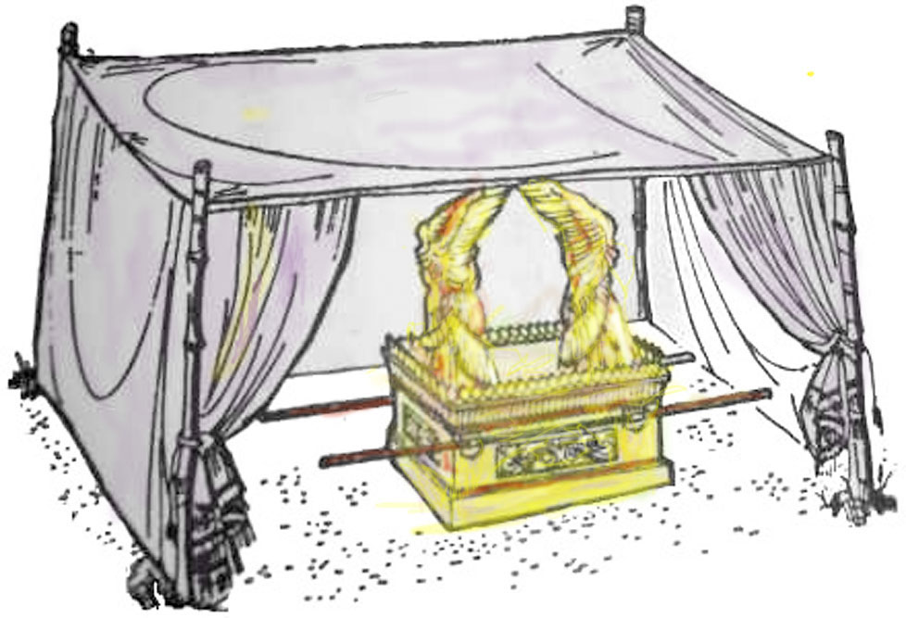
David’s Tabernacle
II Samuel 6 – 7: David brings the Ark of the Covenant to Jerusalem
Notice – how open the Ark is – in view of all the people of Israel
A type of worship through Christ.

Slide 7
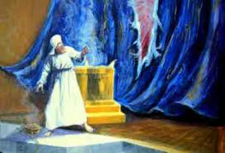
The Temple Curtain Torn
Matthew 27: 50 – 51, “And when Jesus had cried out again in a loud voice, He gave up His Spirit. At that moment the curtain of the Temple was torn in two from top to bottom…”

Slide 8
Three Temples
Solomon’s Temple: 2 Samuel 6 – 8, destroyed in 586 bc by the Babylonians
Zerubbabel’s Temple: The Book of Ezra, built in 520 bc, destroyed between 400 – 300 bc
Herod’s Temple: built around 20 bc, destroyed in 70 ad by Romans (Nero) – this is the Temple that existed when Jesus ministered physically on earth

Slide 9
As a believer – You are His Temple
“Don’t you know that you yourselves are God’s temple and that God’s Spirit lives in you?”
I Corinthians 3: 16

Slide 10
A Royal Priesthood
“But you are a chosen people, a royal priesthood, a holy nation, a people belonging to God, that you may declare the praises of Him who called you out of darkness into His wonderful light.”
I Peter 2: 9

Slide 11
Why do we worship/praise Him?
We are commanded to! “Praise the Lord! Sing to the Lord a new song, and praise in the congregation of saints/believers.” Psalms 149:1
  “Then a voice came from the throne, saying, ‘Praise our God, all you His servants and those who fear Him both small and great.” Revelation 19: 5
Because He is worthy! “I will call upon the Lord, Who is worthy to be praised; so shall I be saved from my enemies.” I Samuel 22: 4

Slide 12
Why continued…
Because it is good to praise the Lord! “It is good to give thanks to the Lord, and to sing praises to Your name, O Most High; to declare Your loving kindness in the morning, and Your faithfulness every night.” Psalms 92:1 & 2
Strength comes when we praise Him! “Do not sorrow, for the joy of the Lord is my strength” Nehemiah 8:10

Slide 13
Why continued…
Brings fulfillment! “Delight yourself in the Lord, and He shall give you the desires of your heart.” Proverbs 37: 4
Invites His presence! “But You are holy, Who (You) inhabit the praises of Israel/ Your people.” Psalms 22: 3

Slide 14
What blocks praise?
Sin: “But your iniquities/sins have separated you from God; your sins have hidden His face from you, so that He will not hear you.” Isaiah 59: 2
What do? “If you confess our sins, He is faithful and just to forgive us our sins and to cleanse us from all unrighteousness.” I John 1: 9
Condemnation: false guilt brought by satan – Not God.
What do? “There is now no condemnation to those who are in Christ Jesus…” Romans 8: 1

Slide 15
Blocks continued…
Don’t care (indifference): “I have this against you, that you have left your first love.” Revelation 2:4
What do? “Return to Me and I will return to you!” Malachi 3: 7
Rebellion: “For rebellion is as the sin of witchcraft/ worshiping evil and stubbornness is as iniquity and idolatry…” I Samuel 15: 22 & 23
What do? “If you obey my commands, you will remain in My love…” John 15: 10

Slide 16
Blocks continued…
Anger: “Therefore, let everyone be…slow to anger; for anger does not produce the righteousness of God.” James 1: 19 – 20
What do? “ Let all bitterness, wrath, anger…and evil speaking be put away…forgiving one another, just as Christ also forgave you.” Eph. 4: 29 - 30
Fear of people: “The fear of people brings a snare/ trap, but whoever trusts the Lord shall be safe.” Proverbs 29: 5

Slide 17
Difference between Praise and Worship???
Worship – defined earlier as giving – demonstrating someone or thing is worthy of adoration – songs tends to speak directly to the Lord
Praise is a form of worship – a call to give thanks for Who He is and what He has done, to rally worshippers’ attention, and tends to be “fast” – “up-beat”

Slide 18
Hebrew words for Praise
Halal = to make a show; to boast; to celebrate, to rave about; to glory in; and to shine. Used 160 times in the OT… to play with joy before Him
Tehillah = to sing a clear song of praise; to celebrate Him in song; to boast about Him in song. Used 57 times in the OT…emphasis is a clear song to Him… the focus is now directly to Him.
Shabach = to shout with a loud voice; to shout in triumph; to glory in victory. “Deaf shout”

Slide 19
Hebrew words continued…
Zamar = to touch or play strings; singing with instruments (drums, etc.)
Yadah = to give confession of thanksgiving; to extend hands toward the Lord – mimetic form of praise
Todah = hands raised in adoration, reverence and submission
Barak = to kneel in adoration – to be caught-up in silence

Slide 20
Summary…
Praise is a more demonstrative form of worship; it includes your hands, feet, shouts, claps, dance, jump, sway, hands waving, hands straight up in surrender… etc.
Adoration form is more focused on Him alone, the romance of being alone with Him, reverence of being in the presence of the Holiest of Holies… God Himself…

Slide 21
Two Thoughts…
Worship Him in spirit and in truth = “God is a spirit. Those who worship Him must worship Him in spirit and in truth.” John 4: 24
Songs from the Spirit = “…Instead, be filled with the Spirit, speaking to one another with psalms, hymns, and songs from the Spirit. Sing and make music from your heart to the Lord, always giving thanks to God the Father for everything, in the name of our Lord Jesus Christ.” Ephesians 5:18-20

Slide 22
Worship Leaders
Were appointed by the leadership after prayer: I Chronicles 16: 5, Asaph was appointed by David to lead the worship team
Were anointed of God: I John 2: 20 & 27, “But you have an anointing from the Holy One…which you have received from Him Who abides in you…”
Were spiritually mature and able to lead: Psalms 78: 72, “So he shepherded them according to the integrity of his heart, and guided them by the skillfulness of his hands.”

Slide 23
Worship Leaders continued…
Committed and Faithful: I Corinthians 4: 2, “Moreover it is required in stewards/workers that one be found faithful.”
Respectful and sensitive to God’s presence: Habakkuk 2: 20, “But the Lord is in His holy temple. Let all the earth keep silence before Him.”
Arranging the Songs…preparing yourself spiritually is always first… then…

Slide 24
The Actual Service: Arrange Your Songs and Lead Us!
Remember you are calling us into His presence…
Start with a Halal or Yadah – something playful and full of praise. Calling us to tell each other about the goodness of God – we are singing/talking about God
Move towards talking to God – the focus now changes to talking/singing to Him…You are leading us to His throne and leaving us to stand face to face with our Savior – Now your task is done!

Slide 25
Example:
Praise Him, praise Him, praise Him in the morning…
What a mighty God we serve, what a mighty God we serve
His name is wonderful…
Your Name is wonderful…
I need you, O, I need you…

Slide 26
Now what did you bring?...
Is it a praise song/poem/psalm?
Or
Is it a song/poem/psalm of adoration?

Slide 27
Your Turn!
Get in groups of 2 or 3
Design a worship service of 4 – 5 songs
Practice
Present

