Slide 1
1 Corinthians 1

Slide 2
Background surrounding church of Corinth
Most frustrating and dysfunctional church of all
Corinth was a prominent city in the Greek state/province (Roman) of Achaia
Located east of Italy, south of Macedonia, and west of the capital Greek city of Athens
Athens was the intellectual capital of the region, Corinth was rife with the sensory (5 senses) and sensual (satisfying the 5 senses) life of Greece
Commercial capital of the area, land traffic from Achaia to Macedonia and points north pass through the city and most sea traffic from eastern Mediterranean bound for Rome stopped in Corinth’s port

Slide 3
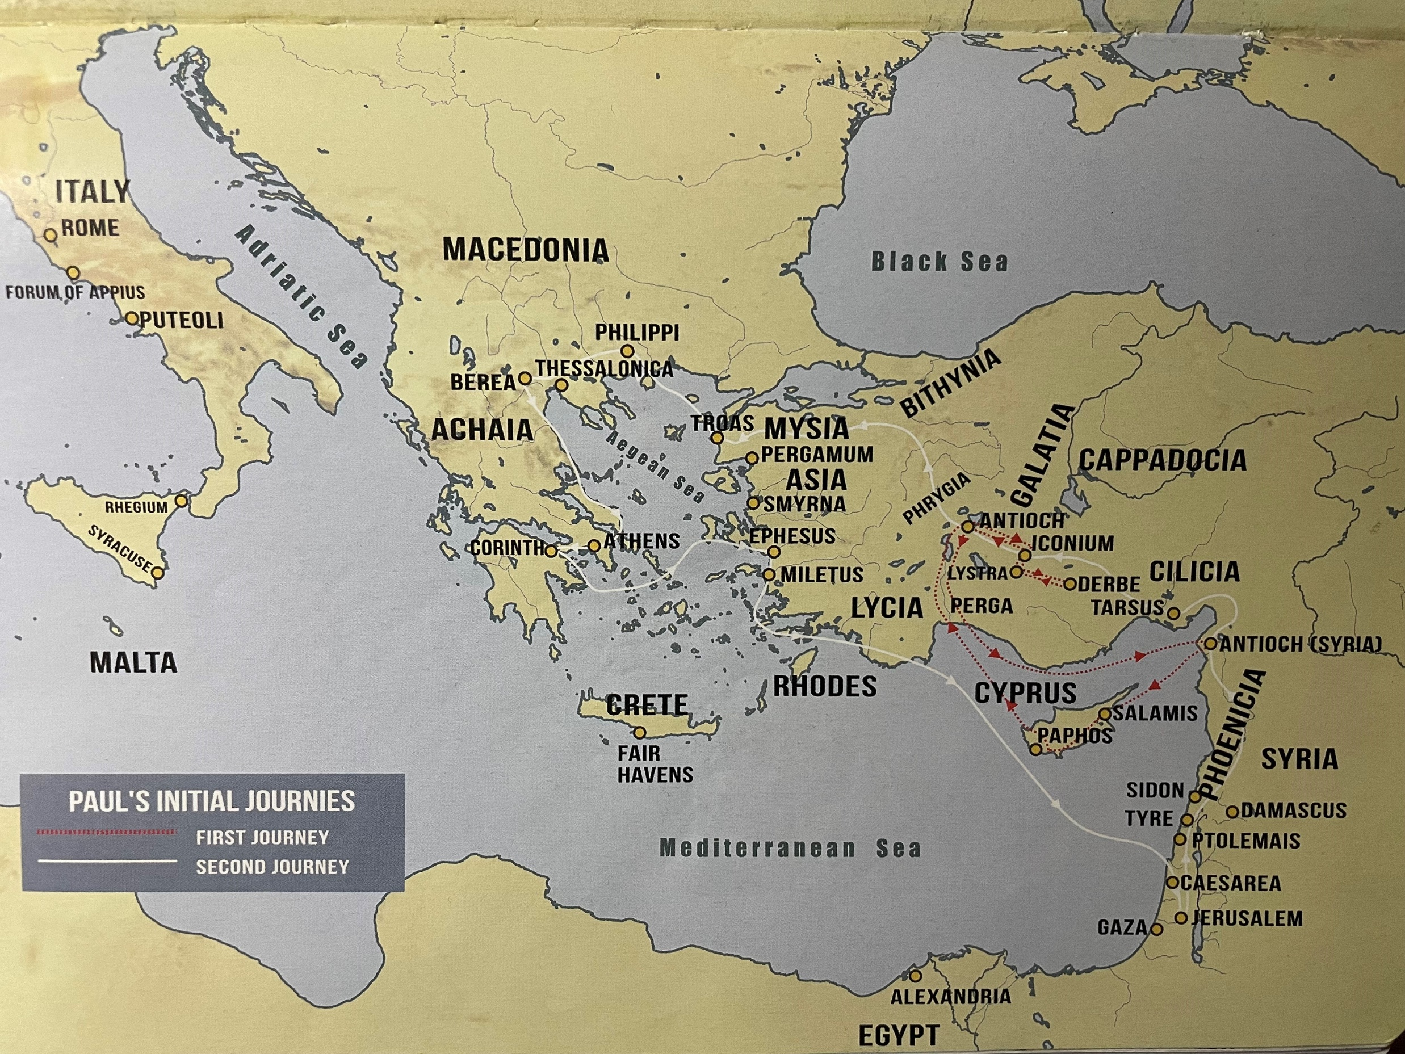

Slide 4
Background surrounding church of Corinth
Corinth was built at the foot of a high hill, on the top of which stood a citadel
Corinth was rich and immoral, a city that lived without self control
When people said, “you live like a Corinthian”, you knew what they meant
  Code language for indulging in wild and unrestrained life
Center for sports, government, military, and business
Rich and prosperous and always great and wealthy until it was destroyed by the Romans in 146 BC and rebuilt by Julius Caesar a hundred years later
Corinth had temples that honored various gods and goddesses (Venus was the principal deity worshipped – goddess of love or licentious passion)
  At least 1000 beautiful females served as prostitutes to the temple of Venus

Slide 5
Background surrounding church of Corinth
Corinth church fit the stereotype of their pagan peers
Corinthian believers felt that in Christ they had full license to do whatever they pleased
In this letter, Paul expresses his concerns that they were living more like citizens of this world than citizens of the kingdom of heaven
Paul visited Corinth for the first time on his 2nd missionary trip, somewhere between AD 49 and 52 and stayed in Corinth a year and half – this is where Paul founded the church (Acts 18:1-17)
Paul wouldn’t have stayed that long but the Lord told him that He had people in the city (Acts 18:9-11)

Slide 6
Background surrounding church of Corinth
Paul’s 3rd missionary journey, he was stationed in Ephesus and heard disturbing news about what was going on in the church (1 Cor 1:11)
1 Corinthians and 2 Corinthians are considered “problem solving” letters, meaning remedial (correcting) work needs to be done to bring the church into alignment with the principles of unity, love, sound doctrine, and respect for authority
1 Corinthians deals primarily with intra-church problems
Every time Paul begins with “Now concerning…” (occurs 6 times 7:1, 25; 8:1; 12:1; 16:1, 12), Paul offers specific guidance on the issue at hand

Slide 7
Background surrounding church of Corinth
Paul was a spiritual father to the immature believers at Corinth
Paul set to tackle one area at a time
Paul expressed not only his concerns, but his frustration as well
Paul was going to visit the Corinth church after his stay in Ephesus (4:21)
Paul wrote 1 Corinthians while he was staying in Ephesus
Paul met Aquila and his wife Priscilla (tentmakers by trade) in Corinth (Acts 18)

Slide 8
Background surrounding church of Corinth
1 Corinthians deals with the areas of
  Divisions (3:1-9)
  Immorality (4; 6:12-20)
  Lawsuits among believers (6:1-11)
  Confusion about marriage (7)
  Eating food sacrificed to pagan idols (8)
  Abuses of the Lord’s Supper (10:14-22)
  Improper decorum in worship services (11; 14)
  Abuses of spiritual gifts (12)
  Confusion about the Resurrection (15)
  Lack of Discipline in finances (16:1-4)
We know more about the church of Corinth more than any other church mentioned in the Bible

Slide 9
Background surrounding church of Corinth
6 themes of 1 Corinthians:
  Wisdom – Paul compares the shortcomings of human wisdom in light of divine wisdom (1:18 – 2:16)
  Rewards – Paul mentions two seats, judgement seat of God and judgement seat of Christ (Romans 14:10, 2 Cor 5:10) and rewards (3:1–15)
  Spiritual Gifts in the Church – 4 times discussed (Romans 12, Ephesians 4, 1 Peter 4, and 1 Corinthians 12-14). Corinthians takes more instruction from Paul because of their abuse of their gifts
  Resurrection – 15:1-58 talks about both Christ’s and our resurrections
  Christian Living – Paul addresses those believers who have a pagan background: immorality (5:1-12; 6:12-20), settling disputes between believers (6:1-11), marriage (7:1-40), tension between liberty and license (8:1-13; 10:23 – 11:1), and separating pagan feasts from the Lord’s Supper (11:17-22)
  Love – Following 12 chapters of patient, apostolic teaching, correction, and problem solving, Paul brings in a shaft of resplendent (attractive and impressive) light in the form of love (12:31) and shows love in one of the most moving, transcendent treatises (a work that structures a subject) on love in all of human literature

Slide 10
Background surrounding church of Corinth
When a church has a contentious (controversial/argumentative), undisciplined, out of balance, problem-filled issues, it starts with love, agape love, just like Jesus reminded the church of Ephesus in Revelation 2:1-5 about their first love
Historically Paul wrote his letter to the Romans in Corinth in his subsequent visit to Corinth roughly around 58 AD (6 years after church was founded)

Slide 11
1 Corinthians 1:1-3 (ESV) Greeting
1 Paul, called by the will of God to be an apostle of Christ Jesus, and our brother Sosthenes,
2 To the church of God that is in Corinth, to those sanctified in Christ Jesus, called to be saints together with all those who in every place call upon the name of our Lord Jesus Christ, both their Lord and ours:
3 Grace to you and peace from God our Father and the Lord Jesus Christ.
Notes:
Paul introduces himself as the author of the letter and that he’s an apostle for Jesus Christ
It was the normal pattern for writing letters during his time
Currently we write a letter by saying who the letter is to first, and we conclude with writing who the letter is from
But in Paul’s time, the letter began with writing who the letter is from and then stating who the letter is to before going into content
Paul declares himself an apostle, having authority and standing which were not appreciated by the church of Corinth
Paul emphasized that he’s an apostle not by men, but by Him, through His Will
Apostle can mean special ambassador to the world and to the church
Paul mentions Sosthenes as their brother
May be the same man mentioned in Acts 18:17 as the head of a Corinthian synagogue who was beaten because he protected Paul
Sosthenes likely replaced Crispus (Acts 18:8) as ruler of the synagogue
It’s possible Sosthenes may have been Paul’s scribe (amanuensis – a literary or artistic assistant, particularly one who takes dictation or copies manuscripts) with the salutation only having been written by Paul (1 Cor 16:21)
Greek word for church is ekklesia
Greek culture it was a citizen-assembly of a Greek city, but the Jewish usage denotes a community of believers in Jesus
Same word is used in the Septuagint where it denotes the people of Israel in the religious character as Yahweh’s “assembly”
“Church of God” includes believers in Palestine (1 Cor 15:9) and at large (1 Cor 10:31-32)
Paul writes to those who are “sanctified in Christ Jesus” to indicate that the members of the church are set apart from the world, especially the context of the city’s wickedness. It’s one thing to be in Corinth, it’s another to be in Christ in Corinth
The word “saints” is not wholly different than the word “sanctified”
The word "saints," ἅγιοι hagioi, means those who are holy, or those who are devoted or consecrated to God.
Paul calls “the church of God that is in Corinth”… show a distinction between the church and the world.
Church is sanctified in Christ Jesus to distinguish themselves as being set apart for Jesus and not engaged in the customs/pleasures of the city
“To be” in “called to be saints” was inserted by translators, so it actually says “called saints together”
It wasn’t based on their outward appearance, it wasn’t Paul preparing to rebuke them, it was a fact that they were saints
Paul expected his epistle to be read by other churches
“Call on the name of the Lord” was from the OT, frequently mentioned… same as in Acts where Peter preached (Acts 2:21) from Joel 2:32
epikaloumenois, to invoke the name, implies worship, and prayer
To call upon the name of Jesus means we realize the end of ourselves and need him for strength and peace, that he knows our frame as he has worn it, and it shows our faith in Him, admits that He is the climax, the name of the Lord is a strong tower -
To call upon the name of Jesus means to realise and bring near to ourselves, for our consolation and encouragement, for our strength and peace, the blessed thought of His manhood, so really and closely knit to ours; to grasp the blessedness of the thought that He knows our frame because He Himself has worn it, and understands and pities our weakness, being Himself a man. To Him whom we adore as Lord we draw near in tenderer, but not less humble and prostrate, adoration as our brother when we call on the name of the Lord Jesus, and thus embrace as harmonious, and not contradictory, both the divinity of the Lord and the humanity of Jesus. To call on the name of Christ is to embrace in our faith and to beseech the exercise on our behalf of all which Jesus is as the Messiah, anointed by God with the fulness of the Spirit. As such He is the climax, and therefore the close of all revelation, who is the long-expected fruition of the desire of weary hearts, the fulfilment, and therefore the abolition, of sacrifice and temple and priesthood and prophecy and all that witnessed for Him ere He came. We further call on the name of Christ the Anointed, on whom the whole fulness of the Divine Spirit dwelt in order that, calling upon Him, that fulness may in its measure be granted to us. So the name of the Lord Jesus Christ brings to view the divine, the human, the Messiah, the anointed Lord of the Spirit, and Giver of the divine life. To call on His name is to be blessed, to be made pure and strong, joyous and immortal. ‘The name of the Lord is a strong tower, the righteous runneth into it and is safe.’ Call on His name in the day of trouble and ye shall be heard and helped.
Notice that Paul says that Jesus Christ is both their and our Lord, the one and same
Peace always follows grace… grace is given and peace happens as a result… grace is the source of peace
The title “Lord Jesus Christ” is mentioned at least six times in the first 10 verses

Slide 12
1 Corinthians 1:4-9 (ESV) Thanksgiving
4 I give thanks to my God always for you because of the grace of God that was given you in Christ Jesus,
5 that in every way you were enriched in him in all speech and all knowledge—
6 even as the testimony about Christ was confirmed among you—
7 so that you are not lacking in any gift, as you wait for the revealing of our Lord Jesus Christ,
8 who will sustain you to the end, guiltless in the day of our Lord Jesus Christ.
9 God is faithful, by whom you were called into the fellowship of his Son, Jesus Christ our Lord.
Notes:
Paul’s thankful for God’s work in the Corinth church and the only reason is because of the grace of God
Church of Corinth was financially rich and also rich in their speech and knowledge of Jesus as well as their gifts and are eagerly anticipating Jesus’ return
God’s work was evident in what they said, what they learned, having supernatural elements in their lives and their expectant anticipation of His return
Notice this was only possible by the grace of God, not by their own achievements
The word “enriched” is the Greek root word (ploutizo) for plutocrat which means one that is very wealthy
Historically the Corinth church was known as the most gifted church at the time
Now you can see why Paul was evidently concerned about their uses of gifts as Paul had confidence in them through God for the church
Their gifts were expressed in the carnal rather than what God had intended for
Paul comments on God being the one who sustains and remains faithful but the church of Corinth had become faithless and it was their own fault, not God’s
Corinth church built corrupt lives on the godly foundation which they had been given
Notice so far in the first 10 verses, Jesus is mentioned 11 times… fix your eyes on Jesus (Hebrews 12:2)
Confirmed among you
Bore witness to Christ in their/our hearts
Not lacking in any gift – God doesn’t withhold in the areas of spiritual gifts

Slide 13
1 Corinthians 1:10-17 (ESV) Divisions in the Church
10 I appeal to you, brothers, by the name of our Lord Jesus Christ, that all of you agree, and that there be no divisions among you, but that you be united in the same mind and the same judgment.
11 For it has been reported to me by Chloe's people that there is quarreling among you, my brothers.
12 What I mean is that each one of you says, “I follow Paul,” or “I follow Apollos,” or “I follow Cephas,” or “I follow Christ.”
Notes:
Paul’s encouraging believers to be united in mind and discernment (judgement)
Unity doesn’t mean there’s no disagreements among believers, but asking a caring concerned question is a whole lot different than a contentious (likely to cause arguments, controversial), strife-ridden comment
Divisions – Greek word schismata where we get the word schism (division)
Notice Paul didn’t hide the source of hearing about quarreling in the church… “Chloe’s people” where Chole resides in Corinth to hear/see about what’s going on in the church
Gossip or attacks made anonymously are not worth looking into or repeating
A substantiated report of discord disgracing the church deserves follow up
Suppose Joann stopped being pastor and Michael took the place of being our pastor then some of you leave because Michael doesn’t have Joann’s personality and Hawaiian background and among others.
That’s what happened at the church in Corinth… it’s called spiritual elitism…

Slide 14
1 Corinthians 1:10-17 (ESV) Divisions in the Church
13 Is Christ divided? Was Paul crucified for you? Or were you baptized in the name of Paul?
14 I thank God that I baptized none of you except Crispus and Gaius,
15 so that no one may say that you were baptized in my name.
16 (I did baptize also the household of Stephanas. Beyond that, I do not know whether I baptized anyone else.)
17 For Christ did not send me to baptize but to preach the gospel, and not with words of eloquent wisdom, lest the cross of Christ be emptied of its power.
Notes:
Notice Paul invokes himself as being crucified for them to make them realize it’s not him nor any other human, but Jesus Christ Himself whom we owe our lives to
Paul alludes baptism to a few people that he did on his own
People in church were using a particular man’s baptism as some sort of significance to their standing thus contributing to the divisions in the church
This shows that baptism isn’t central to salvation at all, if it were, then Paul wouldn’t thank God that he baptized such a few
The fact that Paul doesn’t remember all who he baptized shows that it wasn’t as important to Paul as preaching the gospel
Verse 14 indicates Paul wasn’t a sacramentalist, someone who believes that a certain sacrament (like baptism) was essential to salvation
But that doesn’t mean we should undervalue or neglect it
NOTE: being baptized by a well known apostle had no bearing on having an advantage to those who weren’t baptized by him
The power of baptism is in the spiritual reality it represents, not in who performs
“Not with words of eloquent wisdom” – means we can’t water down the gospel with our intellect or eloquence… if we preach the gospel with a reliance of wisdom of words, then it can render the gospel ineffective

Slide 15
1 Corinthians 1:18-31 (ESV) Christ the Wisdom and Power of God
18 For the word of the cross is folly to those who are perishing, but to us who are being saved it is the power of God.
19 For it is written, “I will destroy the wisdom of the wise, and the discernment of the discerning I will thwart.”
20 Where is the one who is wise? Where is the scribe? Where is the debater of this age? Has not God made foolish the wisdom of the world?
Notes:
The mere word of the “cross” has both a positive and negative impact on transforming a life unifying them with the rest or causing division among others
One can reject it and perish while another can receive it and be saved
Back in the 1st century, when the “word of the cross” was used and the concept of the cross was prevalent, it was like saying “word of the electric chair” has the power to impact people… that’s why Paul said it’s folly to those who are perishing
“To us who are being saved” means people are moving in one of the two directions
Verse 19 is a quotation of Isaiah 29:14 - therefore, behold, I will again do wonderful things with this people, with wonder upon wonder; and the wisdom of their wise men shall perish, and the discernment of their discerning men shall be hidden.”
The whole point is that no amount of wisdom of man can come close to that wisdom of Jesus Christ
Which means the message of the cross is the only place God can be found
In the past, intelligent humans believed in God, but nowadays the more intelligence one is, the less regard they have for God.
Isaiah 55:8-9 - For my thoughts are not your thoughts, neither are your ways my ways, declares the Lord. For as the heavens are higher than the earth, so are my ways higher than your ways and my thoughts than your thoughts.

Slide 16
1 Corinthians 1:18-31 (ESV) Christ the Wisdom and Power of God
21 For since, in the wisdom of God, the world did not know God through wisdom, it pleased God through the folly of what we preach to save those who believe.
22 For Jews demand signs and Greeks seek wisdom,
23 but we preach Christ crucified, a stumbling block to Jews and folly to Gentiles,
24 but to those who are called, both Jews and Greeks, Christ the power of God and the wisdom of God.
Notes:
It pleases God that the “foolishness” of the message being preached helps save those who believe
There’s no better way to reach people and get them saved… think about it
Greeks/Gentiles seek wisdom through proof and reason while the Jews demand signs, but a message of Christ crucified is a stumbling block to the Jews and foolishness to the Greeks/Gentiles
Jews during Paul’s time were looking for a sign of the Messiah’s (same word as Greek Christ) deliverance, they weren’t looking for the word of the cross
The desire for deliverance wasn’t the problem, but the rejection of God’s way of deliverance was
They likely thought God would deliver them in a similar manner as Exodus, from Roman rule
Matthew 12:38-39 – Then some of the scribes and Pharisees answered him, saying, “Teacher, we wish to see a sign from you.” ³⁹ But he answered them, “An evil and adulterous generation seeks for a sign, but no sign will be given to it except the sign of the prophet Jonah.
Stumbling block – skandalon – anything in the way over which one may fall, anything that gives offense or that causes one to fall into sin
Jews treated “Christ crucified” with scorn – more offensive to them than anything else
Jews forget the prophesy in Isaiah 53:3 - He was despised and rejected by men, a man of sorrows and acquainted with grief; and as one from whom men hide their faces^{[f]}
he was despised, and we esteemed him not.
Whatever views you have about the future, about the rapture, about the judgement, about heaven, don’t hold tightly onto them
Greeks valued the pursuit of wisdom in terms of academic or philosophical terms, so they didn’t value the wisdom expressed in the word of the cross
Desire for wisdom wasn’t the problem, rejection of God’s wisdom was
We preach Christ (Messiah) crucified to make both the Jews and Gentiles dumbfounded
“Christ crucified” is an oxymoron as Christ represents power, splendor, triumph while crucified means weakness, defeat, and humiliation
Put both words together and it confounds both the Jew and Gentile alike
Show next slide on “we preach Christ crucified!”
Jews saw “Christ crucified” as an offense or scandal
Paul used to be on the side of the Jews who saw “Christ crucified” as an affront to his sense of who God is so he persecuted the church before his salvation
Gentiles saw “Christ crucified” as foolishness or folly
The point is His wisdom is so different than ours He made Him to stand out in the “word of the cross” that humans would never resonate with or thought of… that’s what makes Him so brilliant since He can better save people that way instead of relying through human wisdom
“Christ crucified” message is sometimes suggested to be changed for the people of today as they can’t relate to it
But look at Paul… he couldn’t relate to it at first either and look what happened

Slide 17
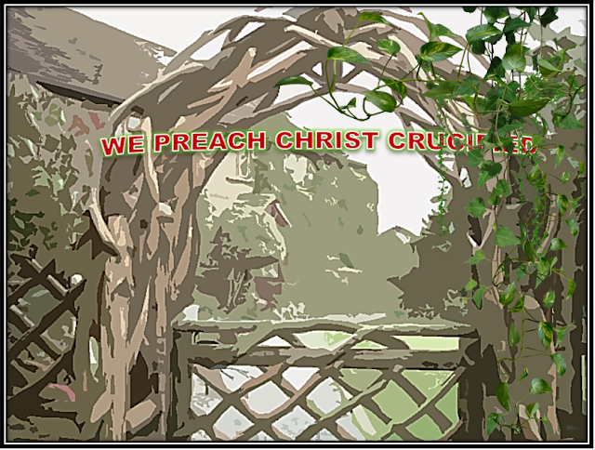

Slide 18
1 Corinthians 1:18-31 (ESV) Christ the Wisdom and Power of God
Story of a church that started out strong had the words “we preach Christ crucified!” inscribed on an archway leading to the churchyard
Over time, two things happened: the church lost its passion for Jesus and His gospel and the ivy began to grow on the archway
Growth of the ivy showed the spiritual decline:
  “Crucified” was covered – “we preach Christ” – church focused on the “wonders” of Jesus
  “Christ” was covered – “we preach” – church lost Jesus in its message, preaching wisdom without Him
  “preach” was covered – “we” – church became a social gathering place all about them and nothing about God

Slide 19
1 Corinthians 1:18-31 (ESV) Christ the Wisdom and Power of God
25 For the foolishness of God is wiser than men, and the weakness of God is stronger than men.
26 For consider your calling, brothers: not many of you were wise according to worldly standards, not many were powerful, not many were of noble birth.
27 But God chose what is foolish in the world to shame the wise; God chose what is weak in the world to shame the strong;
Notes:
God’s wisdom of foolishness and weakness at the cross was a lot stronger and wiser than anything man could do or think of
There’s really no foolishness with God… it’s just comparing God’s plan with that of man’s
Paul reminded the believers at Corinth that they’re not better and not exactly wise, mighty, or even noble
We are all foolish… we should be proud to be foolish for Him

Slide 20
1 Corinthians 1:18-31 (ESV) Christ the Wisdom and Power of God
28 God chose what is low and despised in the world, even things that are not, to bring to nothing things that are,
29 so that no human being might boast in the presence of God.
30 And because of him you are in Christ Jesus, who became to us wisdom from God, righteousness and sanctification and redemption,
31 so that, as it is written, “Let the one who boasts, boast in the Lord.”
Notes:
Believers were among the foolish things of the world
This was to make sure they checked their egos at the door because it was God who chose them not because of any greatness associated with them
God was essentially trying to bring the high and lofty down to the same level as of the low and weak, “so that no human being might boast in the presence of God”
Jesus represents wisdom, righteousness, sanctification, and redemption
He constantly communicates all those attributes through us who are in Jesus Christ
We are made righteous in a good standing before God
We are sanctified from the world for Him
We are purchased with a price from Him
Verse 31 is from Jeremiah 9:23-24 - , Thus says the Lord: “Let not the wise man boast in his wisdom, let not the mighty man boast in his might, let not the rich man boast in his riches, but let him who boasts boast in this, that he understands and knows me, that I am the Lord who practices steadfast love, justice, and righteousness in the earth. For in these things I delight, declares the Lord.”
The path for God’s glory is Christ crucified and the evidence of God’s glory is His choice of the lowly

