Slide 1
Bethany Deaf Assembly Jesus www.BDAChurch.com Jesus Sermons | Events | Calendar | Give {clear browser cache if you have issues}

Slide 2
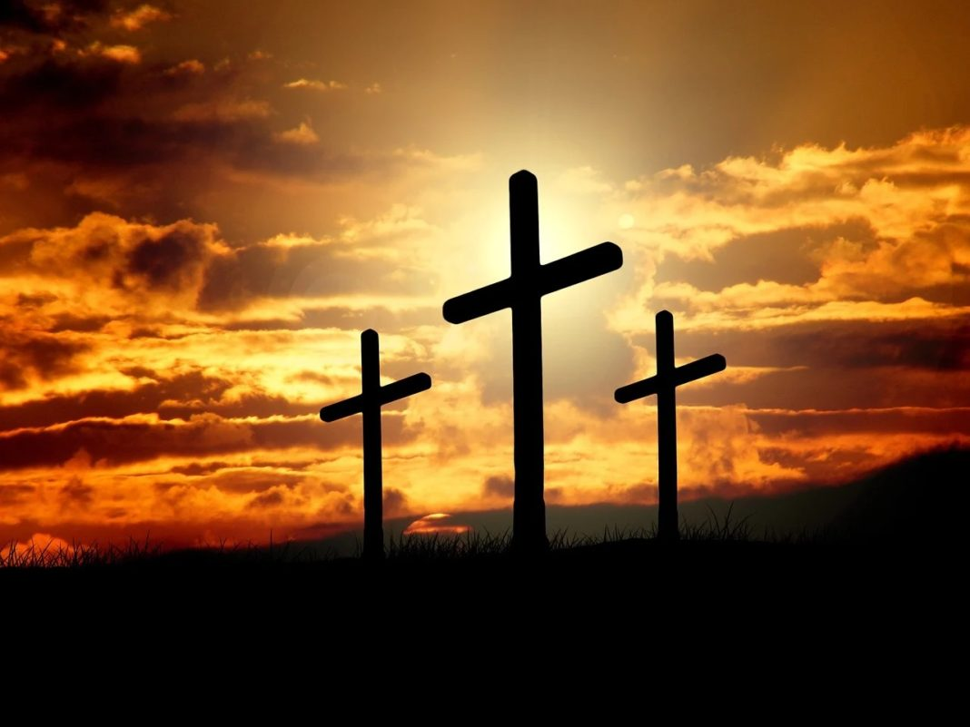

Slide 3
What is your theology for the thief on the cross?

Slide 4
Luke 23:39-43 NLT 39 One of the criminals hanging beside him scoffed, “So you’re the Messiah, are you? Prove it by saving yourself—and us, too, while you’re at it!” 40 But the other criminal protested, “Don’t you fear God even when you have been sentenced to die? 41 We deserve to die for our crimes, but this man hasn’t done anything wrong.” 42 Then he said, “Jesus, remember me when you come into your Kingdom.” 43 And Jesus replied, “I assure you, today you will be with me in paradise.”

Slide 5
Those who believed what Peter said were baptized and added to the church that day—about 3,000 in all. Acts 2:41 NLT

Slide 6
Even as Peter was saying these things, the Holy Spirit fell upon all who were listening to the message. The Jewish believers who came with Peter were amazed that the gift of the Holy Spirit had been poured out on the Gentiles, too. Acts 10:44-45 NLT

Slide 7
For every time you eat this bread and drink this cup, you are announcing the Lord’s death until he comes again. 1 Corinthians 11:26 NLT

Slide 8
One day as these men were worshiping the Lord and fasting, the Holy Spirit said, “Appoint Barnabas and Saul for the special work to which I have called them.” So after more fasting and prayer, the men laid their hands on them and sent them on their way. Acts 13:2-3 NLT

Slide 9
One of the men lying there had been sick for thirty-eight years. Jesus told him, “Stand up, pick up your mat, and walk!” Instantly, the man was healed! He rolled up his sleeping mat and began walking! But this miracle happened on the Sabbath John 5:5, 8-9 NLT

Slide 10
If you are a thief, quit stealing. Instead, use your hands for good hard work, and then give generously to others in need. Ephesians 4:28 NLT

Slide 12
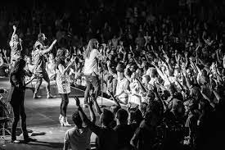

Slide 13
For this is how God loved the world: He gave his one and only Son, so that everyone who believes in him will not perish but have eternal life. John 3:16 NLT

Slide 14
For this is how God loved the world: He gave his one and only Son, so that everyone who believes in him will not perish but have eternal life. John 3:16 NLT

Slide 16
Bethany Deaf Assembly Jesus www.BDAChurch.com Jesus Sermons | Events | Calendar | Give {clear browser cache if you have issues}

