Slide 1
Paul’s 1st Missionary Journey Begins
Acts 13: 13 - 52

Slide 2
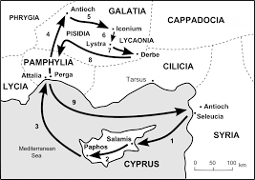
From Paphos to Perga in the region of Pamphylia
John Mark returns home to Jerusalem
Paul and Barnabas continue to Antioch #2 – in the Pisidia region

Slide 3
A Pattern of sharing the Gospel is established:
First to the Synagogue (“church” - Temple is in Jerusalem)
Went in, sat down, did not call attention to themselves
The Leaders of the Synagogue noticed their visitors and asked if they (Paul and Barnabas) had “words of exhortation to share” – testimony
Paul stood up… (the crowd was mixed with both Jewish and Gentile followers of the Jewish religion and practices)

Slide 4
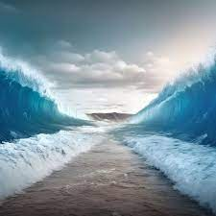
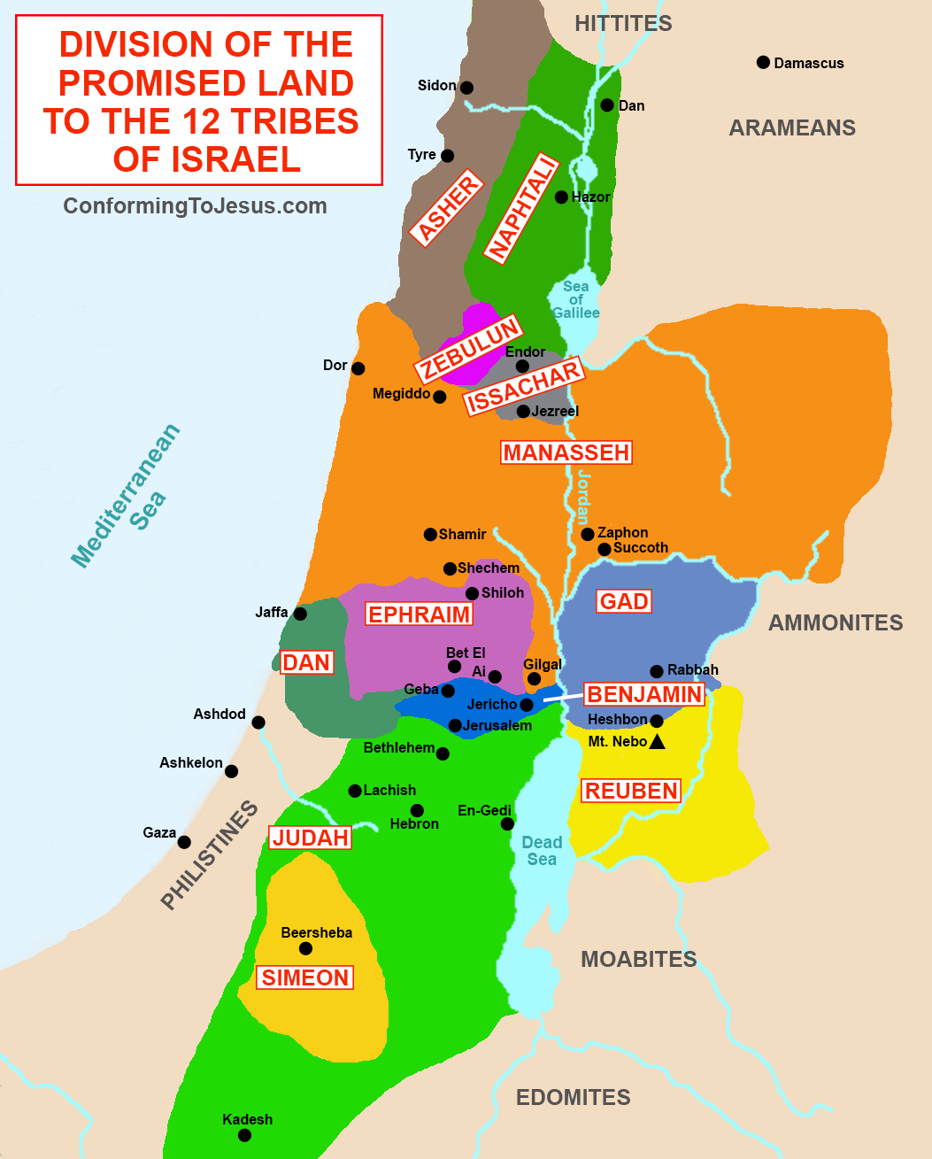
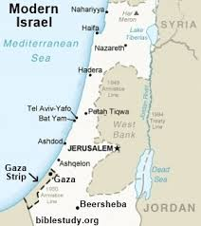
Paul first gave a historical context:
God chose Abraham’s Ancestors:
In Egypt/slavery, they prospered
His mighty power freed them
He cared for them in the wilderness – 40 years
He overthrew 7 nations in Canaan for them to inherit the Promise Land
All of this took about 450 years

Slide 5
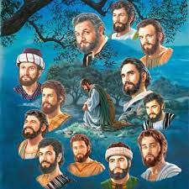
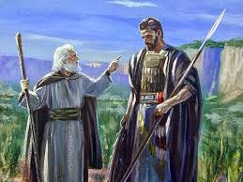
God sent many prophets to guide Israel – God was their King!
But they wanted to be just like everyone else…
They chose Saul, taller than the others, handsome…but insecure…infirmities lead to his destruction…
He hid when they were looking to crown him
He was very jealous of David’s victories
Cruel to Israel and to his son
Disobeyed God and Samuel several times
Eventually, killed himself…

Slide 6
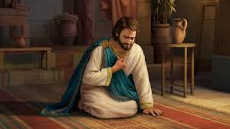
Then came David – Tribe of Judah and chosen by God
God chose because David worshiped God with all his heart
God called David, “A man after My own heart” – a friend
And because he did everything God asked him - obedient

Slide 7
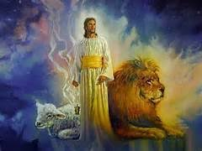
From King David, God brought to Israel the Savior Jesus
It was to Abraham’s family and God-fearing Gentiles who God sent the message of salvation
The Jews and rulers did not realize that they were fulfilling prophecy by crucifying Jesus
Jesus rose from the dead forgiving all our sins
Jesus lives today!

Slide 8
Paul’s Summary:
Though King David was a great King, Jesus is even greater!
When David died, he was buried and his body decayed like any other person’s body would…
But Psalms 2: 7; Psalms 16: 10; and Isaiah 55: 3 state that the Savior’s body will never decay… the Resurrection!
Forgiveness of sins is for everyone who will believe in Jesus
Justification (payment for) sins is through the sacrifice of Jesus on the Cross and His resurrection – obedience to the Laws of Moses could not accomplish this!

Slide 9
Paul ends their stay in Perga with:
Many Jews and Gentiles believed in Jesus after Paul’s teaching…the Word spread throughout the region
Many Jews were jealous of the crowds who believed and started spreading lies against Paul and Barnabas
Paul warned them to “be careful you do not mock God’s plans – you WILL perish!”
They persecuted (beat-up) Paul and Barnabas, told them to leave the region… the dusted off the dirt on their sandals (Jewish tradition)
And left went on to Iconium filled with joy and the Holy Spirit!

Slide 10
What did I see in Spain?
Over 300+ Deaf (few hearing) from 30+ countries
Many were from countries where “Deaf” is either a sickness or a shame – the external environment is against serving the Lord
They were rejoicing and filled with the Holy Spirit as they told their stories of salvation and surviving in their homelands
Ukrainian Deaf told of barely escaping Russian bombs and their homes totally destroyed and they are seeking ways of sharing Jesus with other Ukrainian Deaf that do not know Jesus – they could leave to safety – they return to share Jesus
A few Jewish Christians (Messianic Jews) were there – one man’s home was 6 miles from the Gaza strip bombed… took a while to hear from his wife and children – they are ok – flights delayed from Spain to Israel … they were determined to get back home to share Jesus more urgently…

Slide 11
The WDAG (World Deaf Assemblies of God) Conference theme was “Rivers of Living Water” - John 7: 37 & 38
Every night the altar was filled with men and women seeking the Lord and for the infilling of the Holy Spirit
Could we face what Paul and Barnabas faced? Could we face what many of our Deaf Christian brothers and sisters face everyday?
Are we as hungry for His presence as they are?

