Slide 1
Given to the Lord, unresolved conflicts Produce blessings
Acts 15: 36 – 16: 5

Slide 2
The story:
Chapter 15’s Jerusalem Council concluded – letter to the non-Jewish believers written and sent with Barnabas and Paul to Antioch and etc.
Paul and Barnabas ready to go on their 2nd Missionary Journey – CONFLICT: Barnabas wants John Mark to go with them. Paul does not! The argument becomes so “sharp” v39 that Barnabas takes John Mark to Cyprus and Paul takes Silas on Paul’s 2nd Journey. First conflict…unresolved…
As they travel through Syria, they share the Jerusalem letter/decision and the churches are greatly encouraged.

Slide 3
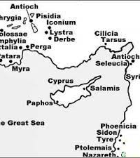
While in Lystra, Paul & Silas meet Timothy.
Timothy is recognized as a “disciple” – spiritually mature & young leader
Mother, Jewish, a strong Christian
Father, Greek, no mention of spiritual life
Paul circumcises Timothy – 2nd conflict…

Slide 4
What is Paul doing? Behavior conflicts with what was decided in Jerusalem!?
Two basic ways of responding to conflict: “fight” or “flight”
Paul and Barnabas: definitely a fight that seemed unresolved
Paul and team with Timothy: a “flight” response or a preventative action. They knew everyone in the region knew Timothy’s dad was Greek and the Jews were stirring “issues” against Timothy. Circumcision opened doors for Timothy that would not have been if he remained uncircumcised. (52ad)
This was not circumcision for salvation, this was removing a cultural block that opened doors for Timothy to minister freely

Slide 5
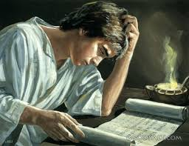
Timothy
I Tim 1: Lois = Grandmother and Eunice = mother… Godly Christian women
One of three men Paul called “spiritual son”
I Cor 16 tells us Timothy is timid and a bit reserved (quiet natured)
Paul advises him to take care of his stomach issues (“sickly”)
Becomes the Pastor of the Church at Ephesus
Is stoned and beaten at 80+ years old in 97 ad in Ephesus

Slide 6
John Mark or Mark
Mary (the owner of the home where Jesus had the Last Supper/
Passover Feast) – his mother
Tradition says he is the young man/boy running in the woods when Jesus was arrested
This is the same home where Peter goes after the angel releases him from prison
Barnabas’ younger cousin
After the argument between Paul and Barnabas, Barnabas takes John Mark to Cyprus ( Barnabas’ home)
Barnabas is martyred on Cyprus and John Mark goes to Ephesus

Slide 7
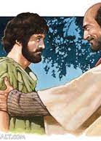
Tradition has Peter and John Mark reuniting – now called Mark (perhaps because the Apostle John was also a part of the Ephesus church)
John Mark becomes the secretary for Peter – the Gospel of Mark is this Mark
In Colossians, Paul requests to have Mark join him because he (Mark) is valuable to the kingdom
Ministered in N. Africa (Alexandria) where he was dragged by a horse by the neck through the city until he was dead… 68 ad (approximately 2 years before Paul was beheaded)

Slide 8
Given to the Lord, unresolved conflicts Produce blessings
Did Paul and Barnabas (beloved friends/brothers) ever meet on earth again? No… And we never hear of the men ruining each other’s name…though unresolved…it was given to God
Both men continued to serve the Lord in obedience – giving their all, committed to Christ
Timothy and John Mark were results of different options of conflict resolution: Fight or Flight (move on)
How you process conflicts will either bless or keep the wound open… before the Lord: your choice…

