Slide 1
“Wait, we are roman citizens!”
Acts 16: 16 - 40

Slide 2
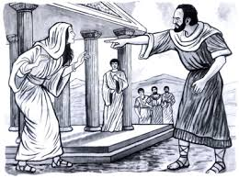
V16 – 18 The Slave Girl
Paul, Silas, Luke, and team were still staying with Lydia in Philippi
For several days, a demon possessed slave girl, who could predict the future (predict not KNOW = demons are NOT Omniscient), followed Paul and group. She constantly shouted, “These men are servants of the Most High God, who are telling you the way to be saved.”
Paul becomes annoyed and said, “In the name of Jesus Christ, I command you to come out of her!” Instantly, the demon left.

Slide 3
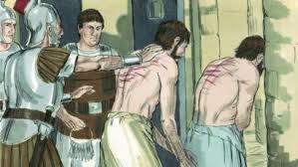
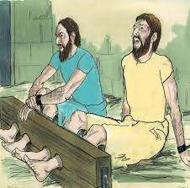
The girl’s owners realized they were loosing money because she was no longer possessed. Brought Paul and Silas to their town Magistrate (Mayor) complaining that Paul and Silas were teaching practices that Rome did not approve.
Meet the Jailor: v25 - 31
The Mayor ordered Paul and Silas flogged and jailed. The jailor put them in the most secure part of the prison.
At midnight, the other prisoners could hear them praying and singing praises

Slide 4
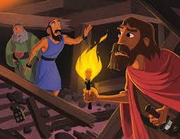
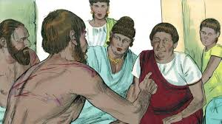
V26 A violent earthquake shook all the prison doors open and all the chains fell off.
The jailor assumed all the prisoners escaped and started to kill himself, but Paul called out, “Don’t harm yourself, we are all here!”
The jailor fell at their feet and asked, “what must I do to be saved?” He brought Paul and Silas to his home, fed them, cleaned their wounds.
Paul and Silas ministered the Word to him and his family – he and his household were saved. “Believe in the Lord Jesus and you will be saved and your household…” v31

Slide 5
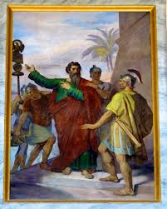
V35 Paul and Silas – Roman Citizens!
Daylight, Mayor releases them from jail, however, Paul declares their Citizenship and demands a formal escort out of jail – publicly you punished us then publicly free us!
They escorted Paul and Silas to Lydia’s home and are asked to leave the city “asap”
Paul and Silas encourages the young church leaders and leave Philippi – he intentionally and publicly identified himself with the church – now providing Roman covering!

Slide 6
What do we see?...
There is a cost to serving Jesus
What is your “prison”?
There is great victory! The slave girl saved, the jailor’s household saved, the Philippian Church protected – chance to grow and…
In the midst of chaos and crisis – Paul and Silas prayed and sang praises…what are you doing?

