Slide 1
Guilty by association
Acts 17: 1-15

Slide 2
Guilty by association!
Experience?

Slide 3

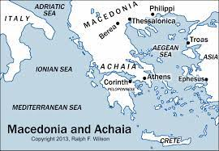
From Philippi to Thessalonica then
Berea

Slide 4
Acts 17: 1 - 15
Paul, Silas, Luke and team arrive at Thessalonica – the Roman capital city of that region
They minister at the synagogue for 3 Sabbaths
Explaining and proving that the Messiah (Jesus) was to suffer, die, and rise again – this seems to be one of the main “issues”
Many believed: Jews, Greeks, and prominent woman
Non-believing Jews became jealous and spread lies against them

Slide 5
They stirred the town into an uproar – so the rushed into Jason’s house looking for Paul and team.
Paul and team not there, so the crowd dragged Jason out of his home and took him to the city officials saying, ‘Jason is housing these men who have cause trouble all over the world!’
Great conflict among the City Council leaders v8 Jason had to pay a large fine then released…Guilty!

Slide 6
At night, the believers in Thessalonica sent Paul & team to Berea
The Bereans were called ‘noble character’ = they welcomed Paul’s debate and searched Scriptures to check if true or not…hungry for truth
Many believed in Jesus after their studying the Word

Slide 7
V12 Tell us “many believed” v13 Opposition again! Thessalonians come to Berea to start trouble again!
V14 The Bereans immediately take Paul to the coast to send him (boat) to Athens
V15 Paul sends a message to his team to meet him in Athens as soon as possible…

Slide 8
Who do you want to be labelled a friend/associate?
What do people say about you?

