Slide 1
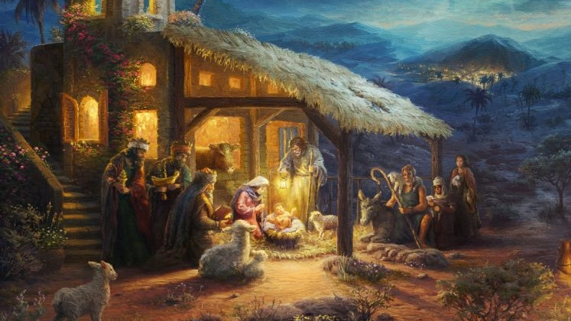

Slide 2
Silent night, holy night All is calm, all is bright Round yon Virgin, Mother and Child Holy Infant so tender and mild Sleep in heavenly peace Sleep in heavenly peace Silent night, holy night Shepherds quake at the sight Glories stream from heaven afar Heavenly hosts sing Alleluia Christ the Savior is born Christ the Savior is born Silent night, holy night Son of God, love's pure light Radiant beams from Thy holy face With the dawn of redeeming grace Jesus Lord, at Thy birth Jesus Lord, at Thy birth

Slide 3
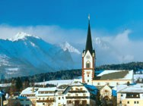
In 1816, exact date unknown, Joseph Mohr, a Roman Catholic assistant priest, created “Silent night, holy night!” as a poem in Mariapfarr in the Lungau region. In 1818, Christmas Eve, Franz Xaver Gruber, an organist, composes a melody for the poem. Performed as two voices with a guitar.
Mariapfarr

Slide 4
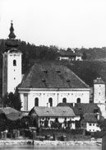
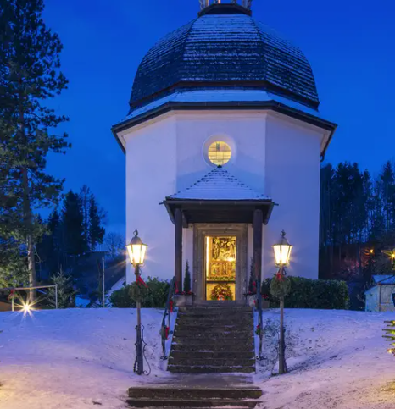
St. Nicholas church, 1818
Oberndorf, Salzburg
St. Nicholas church, Today
Oberndorf, Salzburg

Slide 5
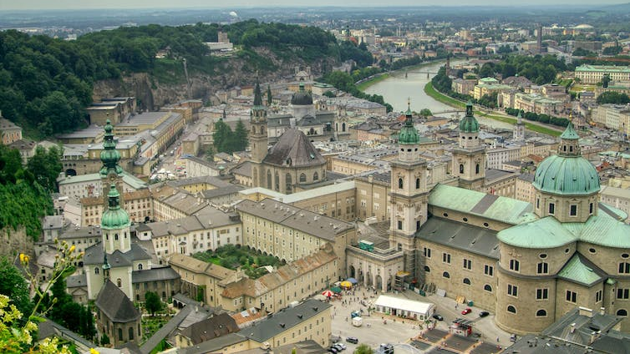
Salzburg, Austria

Slide 6
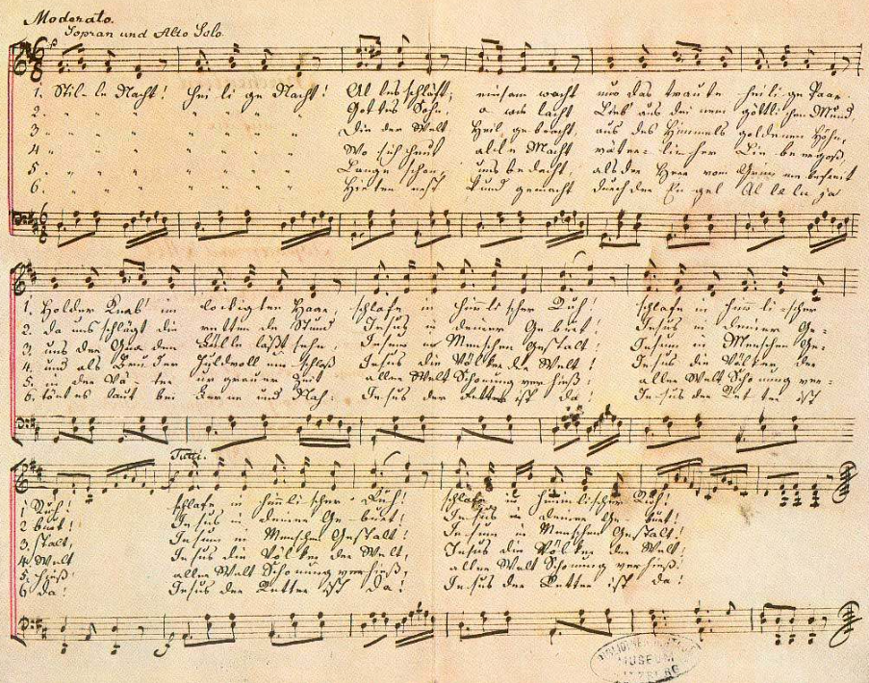

Slide 7
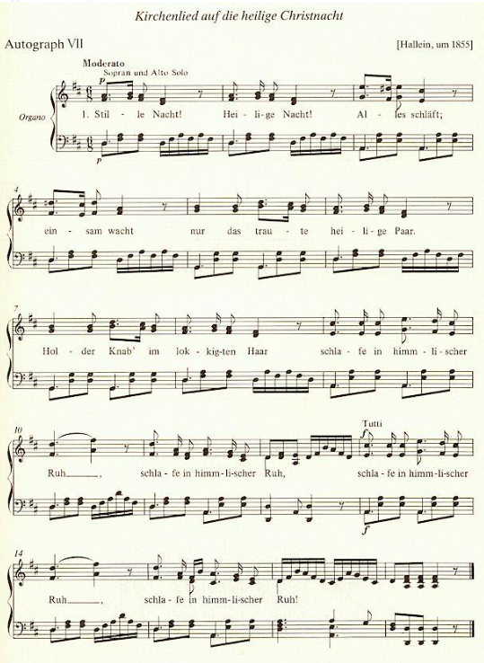

Slide 8
1. Stille Nacht! Heilige Nacht! Alles schläft; einsam wacht Nur das traute heilige Paar. Holder Knab im lockigten Haar, Schlafe in himmlischer Ruh! Schlafe in himmlischer Ruh! 2. Stille Nacht! Heilige Nacht! Gottes Sohn! O wie lacht Lieb´ aus deinem göttlichen Mund, Da uns schlägt die rettende Stund`. Jesus in deiner Geburt! Jesus in deiner Geburt! 3. Stille Nacht! Heilige Nacht! Die der Welt Heil gebracht, Aus des Himmels goldenen Höhn Uns der Gnaden Fülle läßt seh´n Jesum in Menschengestalt, Jesum in Menschengestalt 4. Stille Nacht! Heilige Nacht! Wo sich heut alle Macht Väterlicher Liebe ergoß Und als Bruder huldvoll umschloß Jesus die Völker der Welt, Jesus die Völker der Welt. 5. Stille Nacht! Heilige Nacht! Lange schon uns bedacht, Als der Herr vom Grimme befreit, In der Väter urgrauer Zeit Aller Welt Schonung verhieß, Aller Welt Schonung verhieß. 6. Stille Nacht! Heilige Nacht! Hirten erst kundgemacht Durch der Engel Alleluja, Tönt es laut bei Ferne und Nah: Jesus der Retter ist da! Jesus der Retter ist da!

Slide 9
Silent night, holy night All is calm, all is bright Round yon Virgin, Mother and Child Holy Infant so tender and mild Sleep in heavenly peace Sleep in heavenly peace Silent night, holy night Shepherds quake at the sight Glories stream from heaven afar Heavenly hosts sing Alleluia Christ the Savior is born Christ the Savior is born Silent night, holy night Son of God, love's pure light Radiant beams from Thy holy face With the dawn of redeeming grace Jesus Lord, at Thy birth Jesus Lord, at Thy birth

Slide 10
Silent night, holy night All is calm, all is bright Round yon Virgin, Mother and Child Holy Infant so tender and mild Sleep in heavenly peace Sleep in heavenly peace Matthew 1:25 NLT 25 But he did not have sexual relations with her until her son was born. And Joseph named him Jesus. Luke 2:5-7 NLT 5 He took with him Mary, to whom he was engaged, who was now expecting a child. 6 And while they were there, the time came for her baby to be born. 7 She gave birth to her firstborn son. She wrapped him snugly in strips of cloth and laid him in a manger, because there was no lodging available for them.

Slide 11
Silent night, holy night All is calm, all is bright Round yon Virgin, Mother and Child Holy Infant so tender and mild Sleep in heavenly peace Sleep in heavenly peace Mark 1:24 NLT 24 “Why are you interfering with us, Jesus of Nazareth? Have you come to destroy us? I know who you are—the Holy One of God!” Matthew 11:29 NLT 29 Take my yoke upon you. Let me teach you, because I am humble and gentle at heart, and you will find rest for your souls.

Slide 12
Silent night, holy night Shepherds quake at the sight Glories stream from heaven afar Heavenly hosts sing Alleluia Christ the Savior is born Christ the Savior is born Luke 2:8-14 NLT 8 That night there were shepherds staying in the fields nearby, guarding their flocks of sheep. 9 Suddenly, an angel of the Lord appeared among them, and the radiance of the Lord’s glory surrounded them. They were terrified, 10 but the angel reassured them. “Don’t be afraid!” he said. “I bring you good news that will bring great joy to all people. 11 The Savior—yes, the Messiah, the Lord—has been born today in Bethlehem, the city of David! 12 And you will recognize him by this sign: You will find a baby wrapped snugly in strips of cloth, lying in a manger.” 13 Suddenly, the angel was joined by a vast host of others—the armies of heaven—praising God and saying, 14 “Glory to God in highest heaven, and peace on earth to those with whom God is pleased.”

Slide 13
Silent night, holy night Son of God, love's pure light Radiant beams from Thy holy face With the dawn of redeeming grace Jesus Lord, at Thy birth Jesus Lord, at Thy birth Matthew 14:33, 54 NLT 33 Then the disciples worshiped him. “You really are the Son of God!” they exclaimed. 54 The Roman officer and the other soldiers at the crucifixion were terrified by the earthquake and all that had happened. They said, “This man truly was the Son of God!” Mark 1:11 NLT 11 And a voice from heaven said, “You are my dearly loved Son, and you bring me great joy.”

Slide 14
Silent night, holy night Son of God, love's pure light Radiant beams from Thy holy face With the dawn of redeeming grace Jesus Lord, at Thy birth Jesus Lord, at Thy birth John 1:4-5, 12 NLT 4 The Word gave life to everything that was created, and his life brought light to everyone. 5 The light shines in the darkness, and the darkness can never extinguish it. 12 But to all who believed him and accepted him, he gave the right to become children of God. John 9:5 NLT 5 But while I am here in the world, I am the light of the world.”

Slide 15
Silent night, holy night Son of God, love's pure light Radiant beams from Thy holy face With the dawn of redeeming grace Jesus Lord, at Thy birth Jesus Lord, at Thy birth Matthew 26:26-28 NLT 26 As they were eating, Jesus took some bread and blessed it. Then he broke it in pieces and gave it to the disciples, saying, “Take this and eat it, for this is my body.” 27 And he took a cup of wine and gave thanks to God for it. He gave it to them and said, “Each of you drink from it, 28 for this is my blood, which confirms the covenant between God and his people. It is poured out as a sacrifice to forgive the sins of many. 1 Corinthians 11:25 NLT 25 In the same way, he took the cup of wine after supper, saying, “This cup is the new covenant between God and his people—an agreement confirmed with my blood. Do this in remembrance of me as often as you drink it.”

Slide 16
Matthew 16:15 NLT 15 Then he asked them, “But who do you say I am?”

Slide 17
Matthew 16:15 NLT 15 Then he asked them, “But who do you say I am?” 16 Simon Peter answered, “You are the Messiah, the Son of the living God.”

Slide 18
Matthew 16:15 NLT 15 Then he asked them, “But who do you say I am?” 16 Simon Peter answered, “You are the Messiah, the Son of the living God.” John 14:6 NLT 6 Jesus told him, “I am the way, the truth, and the life. No one can come to the Father except through me. John 17:3 NLT 3 And this is the way to have eternal life—to know you, the only true God, and Jesus Christ, the one you sent to earth.

Slide 19
Luke 2:15-17 NLT 15 When the angels had returned to heaven, the shepherds said to each other, “Let’s go to Bethlehem! Let’s see this thing that has happened, which the Lord has told us about.” 16 They hurried to the village and found Mary and Joseph. And there was the baby, lying in the manger. 17 After seeing him, the shepherds told everyone what had happened and what the angel had said to them about this child. Luke 2:28-32 NLT 28 Simeon was there. He took the child in his arms and praised God, saying, 29 “Sovereign Lord, now let your servant die in peace, as you have promised. 30 I have seen your salvation, 31 which you have prepared for all people. 32 He is a light to reveal God to the nations, and he is the glory of your people Israel!”

Slide 20
Silent night, holy night All is calm, all is bright Round yon Virgin, Mother and Child Holy Infant so tender and mild Sleep in heavenly peace Sleep in heavenly peace Silent night, holy night Shepherds quake at the sight Glories stream from heaven afar Heavenly hosts sing Alleluia Christ the Savior is born Christ the Savior is born Silent night, holy night Son of God, love's pure light Radiant beams from Thy holy face With the dawn of redeeming grace Jesus Lord, at Thy birth Jesus Lord, at Thy birth

