Slide 1
Passion for the Word -> Service
Radical Obedience
An Intimate Walk
Acts 18: 18b - 28

Slide 2

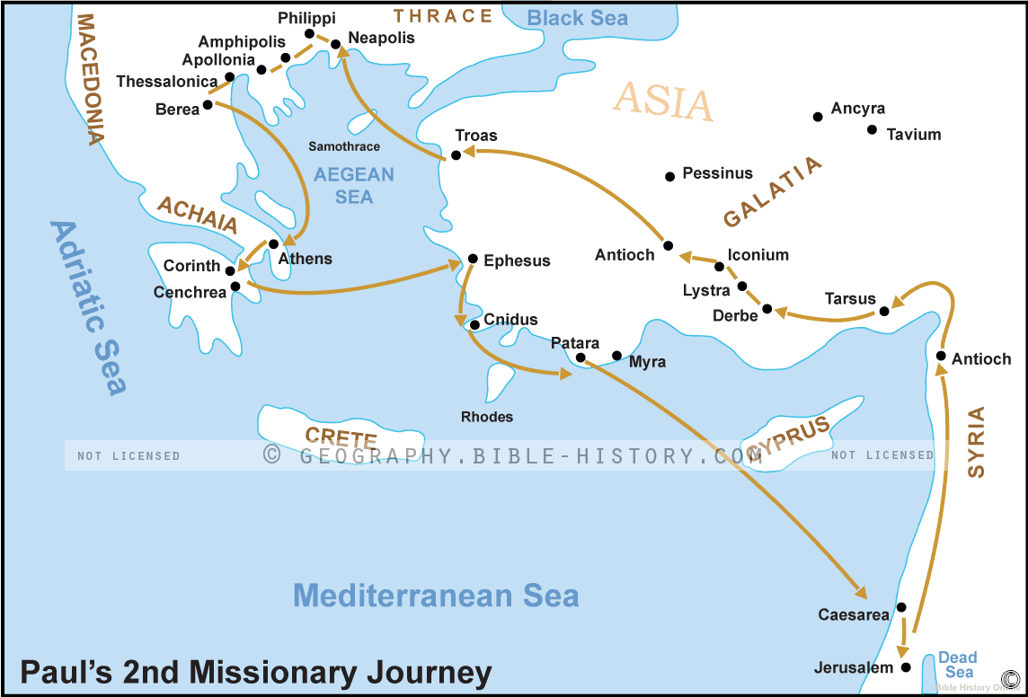



Review:
*Paul leaves Corinth to go to Syria
*Priscilla and Aquila go with Paul
*In Cenchrea – a port town for Corinth, Paul cuts his hair
*They sail to Ephesus

Slide 3
Paul cuts his hair? Nazarite Vow? What’s a Nazarite Vow?
A couple of “famous people” took the Nazarite Vow: Samson and John the Baptist (Jesus’ cousin)
Numbers 6: Could be either man or woman;
  A vow of separation at a designated time-period;
  No wine, grapes or raisins or any fermented drink;
  Cannot cut hair;
  Cannot go near or touch dead bodies or animals, etc.;
  Consecrated to the Lord ;
  Time done, shave head, and offer Fellowship Offering, and put hair under the offering to be burnt with offering.

Slide 4
Paul’s vow was most likely not a Nazarite vow, maybe a vow for deliverance from harm or from a serious illness…a time of spiritual separation (a time out)
V19 When they arrived in Ephesus, Paul went to the synagogue
V20-22 The Jews asked Paul to stay longer, he declined, promised to return after he went to Syria, and left for Antioch
V22-23 Paul went from Caesarea to Jerusalem, then to Antioch and then travelled through the regions of Galatia and Phrygia stopping at each church encouraging and strengthening the believers

Slide 5
Meanwhile… we meet Apollos in Ephesus
V 24-28 Apollos is from Alexandria (N. Africa) comes to Ephesus vigorously preaching that Jesus is the Messiah
  Very knowledgeable man – “thoroughly knew the Scriptures”
  He taught about Jesus accurately
  Knew only about John the Baptizer’s baptism – for repentance
  Spoke boldly in the synagogue
  Priscilla and Aquila invited him to their home and “explained to him the way of God more accurately”
  He wanted to go to Achaia (Greece) so the believers wrote a letter for him so the believers there would welcome him
  He vigorously preached Jesus – the Messiah publicly

Slide 6

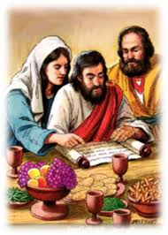
What we can learn… Apollos
An example of someone who loved and studied thoroughly the Word of God
Someone who was willing to be taught
His passion for God’s Word led him to be a servant overflowing with God’s message

Slide 7
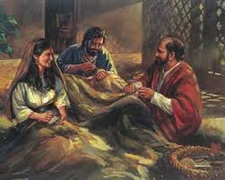
Priscilla and Aquila
They were tentmakers – blue collar workers
Radically changed by Jesus
Became teachers of the Word and recognized as pastors in the early church
Examples of radical obedience

Slide 8
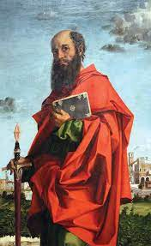
Paul
A faithful servant taking care of his relationship with Christ
Volunteered to set aside a time of fasting, praying, retreating with the Lord
Craved and acted upon a deeper designated time with the Lord.

Slide 9

What season are you in now?
A season of studying His Word leading you to serve by sharing His Word?
A time for life changing radical obedience? Or
A season to separate yourself for a deeper/intimate time with the Lord?

