Slide 1
Stay awake!
Acts 20

Slide 2


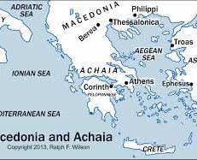



V1 Uproar ended – Paul and disciples returned to Greece – stayed 3 mos v4 Sopater; Aristarchus; Secundus; Gaius; Timothy;
Tychicus; and Trophimus went before Paul & Luke and waited at Troas v6 Paul & Luke stayed in Philippi – celebrate the Feast of the Unleavened Bread (stayed 7 days) then went on to Troas
Acts 20

Slide 3
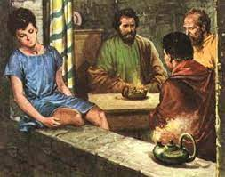
Vv7 – 12 In Troas
Paul intended to leave the next day
Talked until midnight
Eutychus, a young man, fell asleep while sitting in the window
Paul went on and on
Eutychus fell 3 floors and died
Paul went downstairs, prayed for him, he became alive, then Paul went back upstairs and finished teaching at dawn then he left…

Slide 4
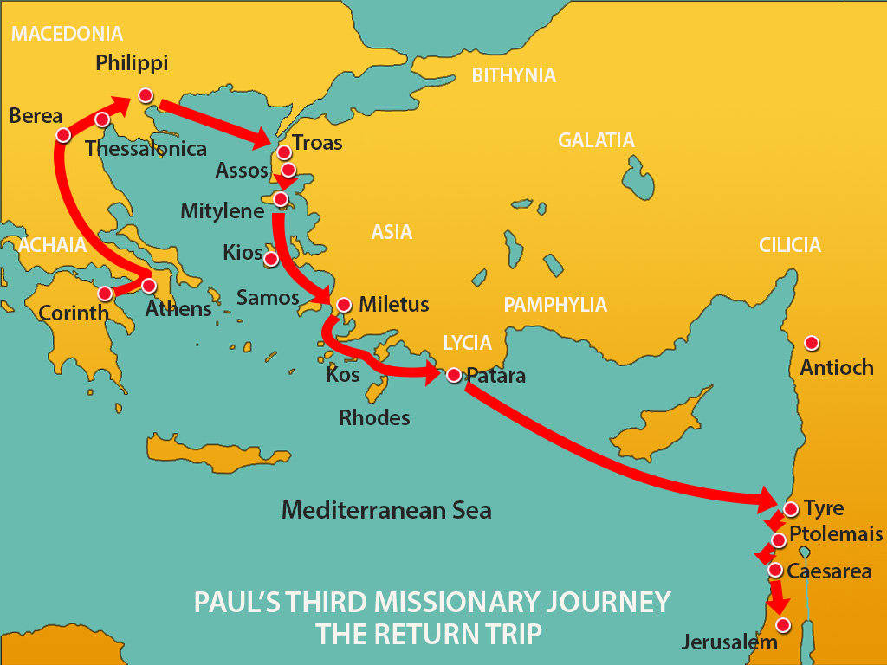
Luke & others sailed to Assos, Paul walked
Paul joined them and sailed to Mitylene & kept sailing until Miletus
Paul wanted to avoid Ephesus because he wanted to be in Jerusalem by Pentecost
Paul asked the leaders in Ephesus to meet him in Miletus

Slide 5
Paul’s most intimate conversation (vv 18 – 35) “You know…”
I served the Lord with great humility and tears
I have not hesitated to preach anything that would help you
I have preached to both Jews and non-Jews repentance and have faith in our Lord Jesus Christ
I have been warned, from city to city, by the Holy Spirit that prison and hardship awaits me…
I have considered my life worth nothing to me, my only aim is to finish the race and complete the task the Lord Jesus has given me – testifying of the good news of God’s grace…

Slide 6
Paul’s final challenge to the Ephesian Leaders:
V25… “none of you will ever see me again…”
V26-27 “Because I have preached and taught His Word, I am innocent of the blood of everyone”
Keep watch over yourselves and the flock the Holy Spirit has made you overseers
Be shepherds of the church of God, which He bought with His own blood
Wolves (deceivers) will come – WATCH and be on your guard
V32 Now I commit you to God and to the Word of His grace…

Slide 7
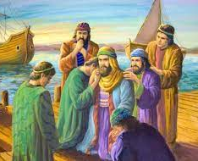
You know…
I have done my best to take care of my own needs
I showed you that hard work must help the weak – Jesus said, “it is better to give than to receive…”
He knelt down and wept with them and prayed together then he boarded the ship…

Slide 8

Our “take away”
Be careful not to fall asleep when I am preaching!
Spiritual/Church Leaders – read Act 20: 19 – 32 often!
James 3: 1 states, “Not many should presume to be teachers…you will be judged more strictly…”
Love and care for each other – guard and protect His Church

