Slide 1
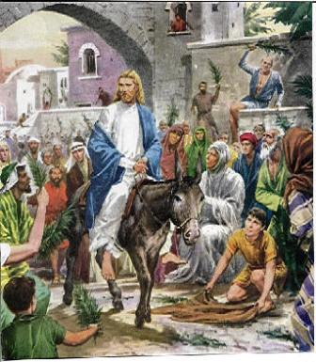
The Triumphal Entry to
The Cr0ss
John 12: 12 – 19:16
Passion Week Begins…

Slide 2
The Story
On the Sunday of Jesus’ last physical week on earth – the Passion Week begins
Jesus was coming to Jerusalem through Bethany at the Mount of Olives
Jesus sends two disciples ahead to get the colt he would ride into Jerusalem on (Zech 9: 9)
Tell them the Master has need of the colt

Slide 3
The Story continues
As Jesus rode into Jerusalem –through the Golden Gate – people put their coats on the road for the colt to walk on and other people waved palm branches as He passed.
The people shouted, “Hosanna (Save us)! Blessed is he who comes in the name of the Lord!” “Blessed is the coming Kingdom of our father David!” “Hosanna in the highest!”

Slide 4
Zechariah 9: 9
“Rejoice greatly, O Daughter of Zion! Shout, Daughter of Jerusalem!
See your King comes to you, righteous and having salvation, gentle and riding on a donkey, on a colt, the foal of a donkey.”

Slide 5
The Lambs of Nisan
The 10th day of Nisan – lamb selection day
The same day people were leading their chosen lambs home for the Passover – was the same day Jesus was led into Jerusalem – Our Passover Lamb

Slide 6
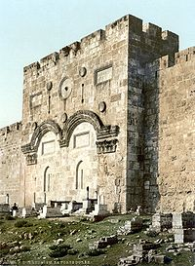
The Golden Gate
The gate where Kings would enter
Sealed in the 1500’s by Muslim rulers to prevent any Jewish or Christian king from entering

Slide 7
Some Greeks Wonder…
John 12: 20 – 36 = “We would like to see Jesus”
Vv 24 – 26 = “if this kernel of wheat does not fall into the ground, it remains only one seed. But if it dies, it produces many seeds. The man who loves his life will loose it, but the man who is willing to let it die – lives forever-you serve Me…follow Me…”

Slide 8
Vv42-43 = Many leaders believed but feared the Pharisees & and loved the praises of man.
Passion/Holy Week starts with Palm Sunday
Monday: Cleaning of the Temple: Matt 21: 12-17; Mark 11:15-19; and Luke 19: 45-48
Tues: Teaching: Matt 21:23-26:5; Mark 11:20-13:37; and Luke 20:1-21:36
Wed: Judas agrees to betray Jesus: Matt 26:14-16; Mark 14:10-11; and Luke 22: 1-6
Thursday: Maundy (Commands) Thursday: Foot washing and Last Supper: Matt 26:17-30; Mark 14:12-26; Luke 22: 7-39; and John 13:1-17:26

Slide 9
Passion Week cont.
Friday: Crucifixion, Death and Burial of Jesus: Matt 27:1-61; Mark 15:1-47; Luke 22:7-39; and John 13:1-17:26
Saturday: Black Saturday – Jesus in the tomb: Matt 27: 62-66
Sunday: Jesus’ Resurrection: Matt 28:1-10; Mark 16: 1-8; Luke 24: 1-12; and John 20: 1-18

Slide 10
The Passover Feast (The Last Supper)
Maundy Thursday
Jesus washed His disciples’ feet – “You are not greater than the Teacher – serve others as I have served you” John 13: 1-17
Vv 18 – 30 = Judas leaves to betray Jesus
V34 = “A new command I give you, ‘Love one another as I have love you – by this everyone will know that you are My disciple.’”

Slide 11
John 14 = Jesus promises the Comforter will come – the Holy Spirit
John 15 = Don’t be discouraged! I now call you friends…(v15) Servants don’t know the Master’s heart – His friends do
John 16 = Jesus explains the work of the Holy Spirit in the believers
John 17 = Jesus prays for Himself, for 12 Disciples and for Us (v20) – for those who will believe…

Slide 12
John 18 & Matt 26 = Gethsemane
“Take this from Me – but not My will – Your’s”
Luke 22: 43 – 44 = “He prayed even more earnestly – his sweat was like drops of blood”
John 18 = The Arrest & Betrayal
John 18 & 19 = 3 Trials: Before Annas (High Priest), Before the Council of High Priests, and Before Pilate

Slide 13
Three Groups
Group 1 = those who were curious and got swept into the excitement
Group 2 = those who opposed and were angry
Group 3 = those who waved palm branches and placed their coats down before Christ and sincerely loved Jesus

Slide 14
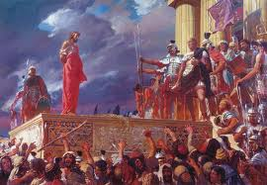
Individuals from two groups (those who did not believe and those who simply followed the crowd) screamed
“Crucify him!”
“Crucify him!”
“Crucify him!”
“Crucify him!”

Slide 15
Which Group do YOU belong?

