Slide 1

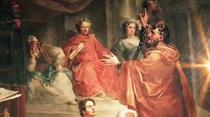
Paul’s final days in Judea
Acts 25 - 26

Slide 2
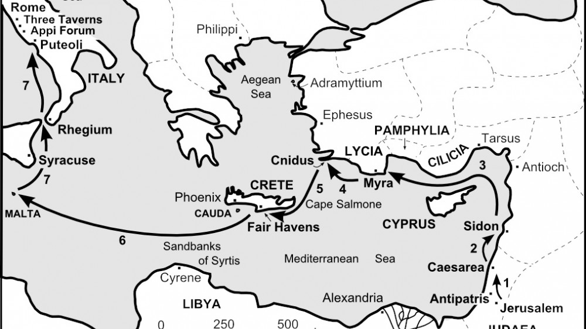

Slide 3
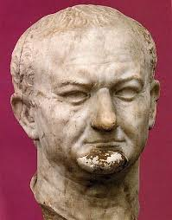
Acts 25 Festus replaces Felix
On his way to Caesarea, he stops in Jerusalem to find out ‘what’s up’ between the High Priests and Paul. He invites them to come to Caesarea
V7 They had serious charges against Paul but gave no evidence
Paul says he has not broken any Jewish laws, no temple laws nor Roman laws broken
Festus asks if Paul would be willing to be tried in Jerusalem
Paul says “No! I appeal to Caesar!”
V12 Festus, “…to Caesar you will go!”

Slide 4
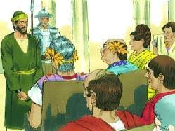
King Agrippa & Bernice visit Festus
Festus wanted Agrippa’s Opinion. Agrippa is excited to listen to Paul.
Agrippa enters in arrogance
Festus is frustrated because the Jewish leaders want Paul dead, Festus finds Paul (a Roman citizen) innocent, Paul appealed to Caesar – what can Festus write to Caesar?

Slide 5
Acts 26 – Paul’s Testimony
“I am fortunate to speak to you Agrippa because you know our Jewish customs and controversies. I beg you to listen to me patiently…”
Paul unloads his testimony: Member of the strictest Jewish group – the Pharisees, was against Christians, sought to imprison or kill them until I met Jesus on my way to Damascus. I am on trial because of my Jewishness!
I am a firm believer in God’s promises to the 12 tribes…it is that HOPE – the fulfilling of His promises, that I am on trial!
V8 Why should any of you find it incredible that God raises the dead?

Slide 6
V10 …”I met Jesus and He said He would rescue me from my own people and send me to the Gentiles so they could receive forgiveness of sins and a place among those who are sanctified by faith in Jesus.”
V22 I am saying what Moses and the prophets have said, ‘the Messiah will suffer and, as the first to rise from the dead, would bring the message of light to His own and to the Gentiles.”
V24 Festus couldn’t take any more and said, “Paul, your intelligence has made you crazy/insane!”
V25 Paul responds, ”I am not insane, Herod knows and these things have not escaped his notice…”

Slide 7
V28 (A sad verse) Agrippa stated, “Do you think that in such a short time you can persuade me to be a Christian?”
V29 Paul says, “I pray to God that not only you Agrippa, but all who are listening to me now would become what I am” … a Christian
V30 Festus, Agrippa, Bernice and listening council stood and left
They said to each other – Paul is innocent, not deserve death or prison!
Agrippa stated, “Paul could have been freed now…if he did not appeal to Caesar…”

Slide 8
Why did Paul appeal to Caesar:
1) Jesus said He would be with Paul in Rome (23:11)
2) Paul knew the Jews were planning to kill him if he returned to Jerusalem

Slide 9

Taking a look…
Festus: Just wanted justice! Confronted with the gospel - panicked with conviction and “ran”
Agrippa: Filled with arrogance that blinded him … ‘Do you (Paul) think you could persuade me to be a Christian?!?’
Paul: Used his personal testimony to share the truth of Jesus Christ. Jesus the suffering Messiah, Who died and rose again to forgive the sins of all who would believe. Jesus – the Hope of God’s word!

Slide 10

Self a Christian!?!
You have a personal testimony
Share the reality and Hope of Jesus in you
Colossians 1: 27

