Slide 1
Paul’s final adventures!
Acts 27 & 28

Slide 2

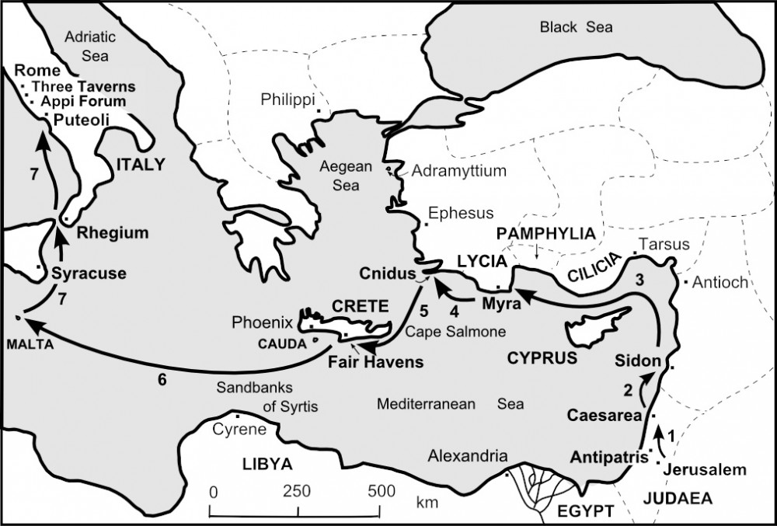
Acts 27 A very bad day Week!
Julius – member of the Imperial Regiment; Roman guards; Luke; Aristarchus; and Paul board a ship going towards Rome.
Landed in Sidon. Julius allows Paul to meet with believers/friends and meet his needs.
Passing Cyprus – winds start; struggling with the winds, they stopped in Myra and changed ship
Landed at Cnidus, pushed on to Fair Haven. Lost a lot of time fighting the wind Paul suggests to winter there…

Slide 3

V 13 The ship’s pilot pushes to continue – the winds seem to calm down
Then suddenly a northeastern hurricane like winds caught the ship and tossed it violently, driven by the storm - no control
Anchors lowered, winds continue to batter the ship, they threw cargo overboard
3rd day of storm the ship’s tackle tossed
V20 After many days, they could not see the sun nor the stars, no time to eat, they started to give up hope…

Slide 4
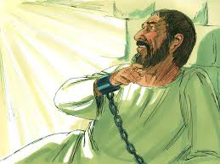
Then Paul said, “I told you to winter in Fair Haven…But I urge you to keep your courage – not one of you will be lost, only the ship. An angel of the Lord – of whose I am and whom I serve stood beside me and said, ’Do not be afraid, Paul, you must stand trial before Caesar, and God has graciously given you the lives of all who sail with you.’ So keep your courage, for I have faith in God that it will happen as he told me…we must run aground on some island.”

Slide 5
V27 On the 14th day of the storm, they dropped 4 anchors and prayed to see daylight. A few sailors tried to escape, Paul warned Julius and the lifeboats were cut loose and drifted away…
Paul encouraged them to eat, none will be lost, then he broke bread and began to eat…they were encouraged and ate
276 onboard
At last daylight was seen, they saw a sandy bay, untied the ropes, set the rudders free, hoisted the main sail guiding the ship to the bay
But the ship hit a sandbar and became grounded and started to break apart

Slide 6
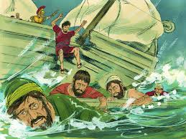
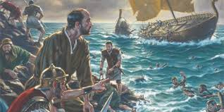
As custom, the soldiers planned to kill the prisoners, but Julius stopped them because he wanted to protect Paul.
Julius ordered, “all who can swim, jump overboard, those who can’t swim, float to shore on the boards broken off the ship…”
V44 As promised, all came ashore safely

Slide 7
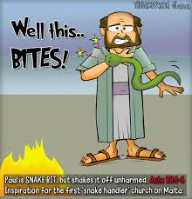
Chapter 28 Just when you think things couldn’t get worse!
They land on Malta, Paul is helping to collect kindling for the fire…a snake bites him!
The islanders thot Paul must really be evil and will drop dead soon!
Paul just shook off the snake into the fire…didn’t get sick or die…he must be a god…(note: he shook it off before the poison could reached his heart)

Slide 8
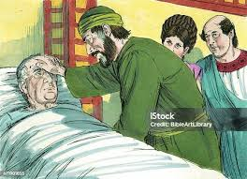
Publius – the Roman Chief Official of Malta – invited Paul and company to his home, showing them 3 days of generous hospitality.
Paul learned Publius’ father was very ill, so he prayed with him and the Lord healed him
Then everyone brought the sick to be prayed for and they were all cured

Slide 9
V10 The whole group (276 people) were honored in many ways and all their needs were met – for 3 months!
V11 Winter passed, now on to Rome with a new ship provided by Malta
Sailed to Syracuse – stayed 3 days
Then Rhegium – overnight
Then Puteoli – stayed 1 week and met with believers
Then finally Rome!

Slide 10
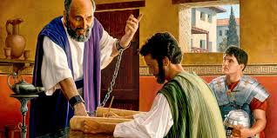
V15 Believers from all over Italy met Paul at the ship and seeing them, he was overwhelmingly encouraged
He was allowed to live in a rented home with a guard and have many visitors
3 days later, he met with the Jewish leaders – he wanted to be clear – he was not bringing charges against them
He shared that Jesus is the Hope of glory the fulfilment of the Laws and Prophets

Slide 11
Some believed and some did not believe…
V 30-31 For 2 years Paul stayed in his own rented home… He proclaimed the Kingdom of God and taught about the Lord Jesus Christ with all boldness and without hinderances

Slide 12
The End

Slide 13

What a life!
What a legacy!
What is your testimony?
What will your life say about Jesus?

