Slide 1
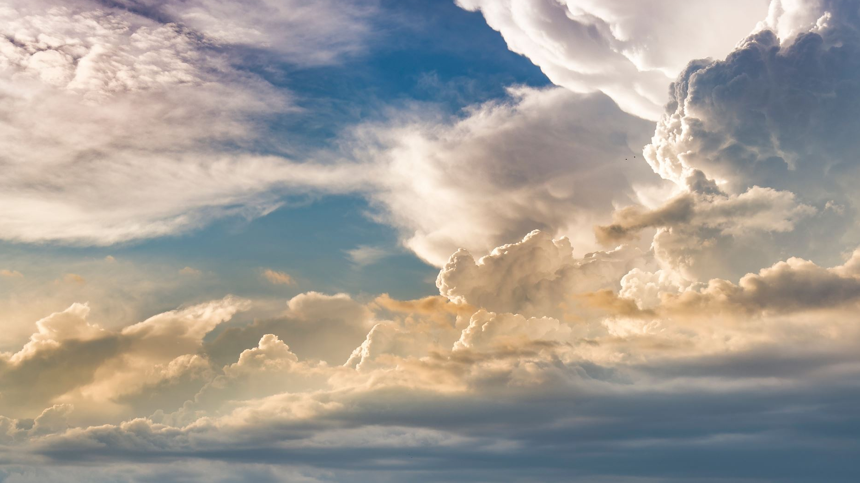
The 12 minor prophets

Slide 2
Introduction
The 12: Hosea, Joel, Amos, Obadiah, Jonah, Micah, Nahum, Habakkuk, Zephaniah, Haggai, Zechariah, and Malachi.
Called “the minor prophets” because the authors wrote brief messages – unlike Isaiah, Jeremiah, Ezekiel, and Daniel (major prophets). Their messages were as important as those written by the major prophets.
The Minor Prophets cover roughly 300 years of history. (the 8th century through the 5th century BC)
The split of the Davidic Kingdom (930 bc) – Rehoboam (Southern Kingdom = Judah and Benjamin - Nation of Judah) and Jeroboam (Northern Kingdom = Israel-the other 10 Tribes/Regions/States).

Slide 3


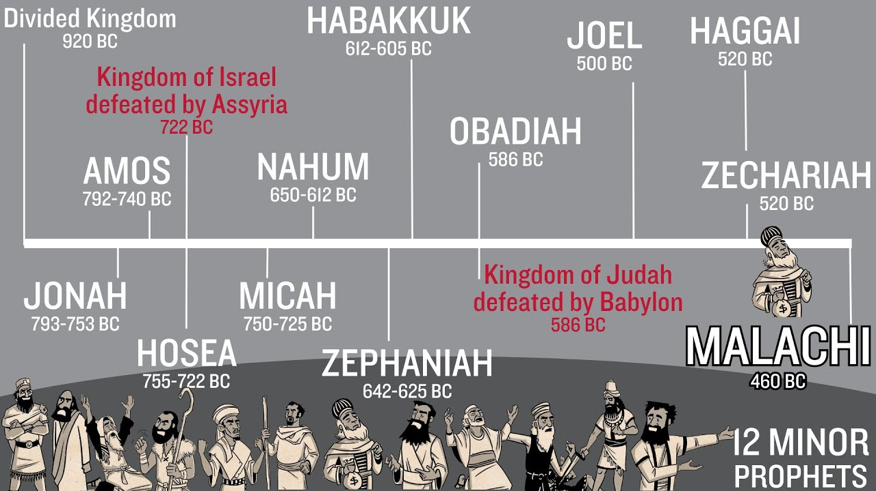




Slide 4
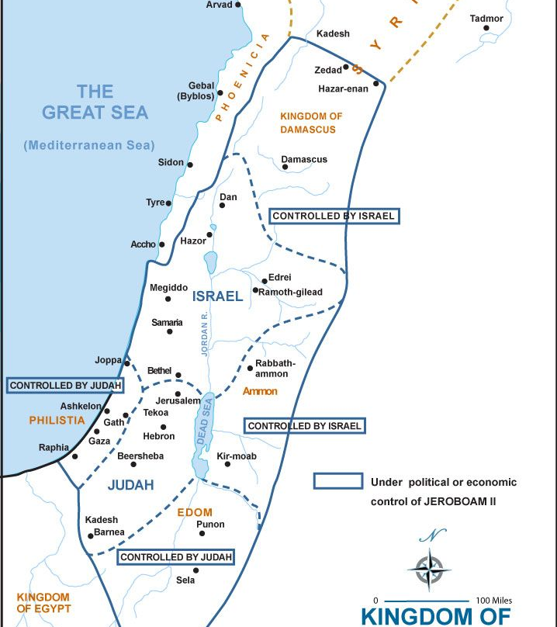
Jeroboam II (793-753 bc) = II Kings 14:25 & 28 – The Nation of Israel expanded its boarders and most likely Syria was a ‘sub-state’ of Israel

Slide 5
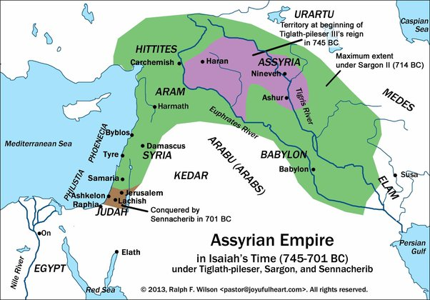
Assyria defeated Syria then eventually Assyria started to decline
It was this time that Jonah was sent to Nineveh (around 780 bc)
Between 780 – 750 bc, Amos and Hosea were called to denounce/ rebuke social injustice and idolatry – the nations were economically prosperous – but morally and spiritually horribly failing in the Northern Kingdom.

Slide 6
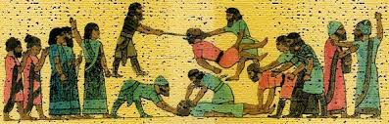
Around 745 bc, Emperor Tiglath-Pileser II became the Assyrian King. He was a very strong ruler, Jeroboam II died (780ish), Israel became unstable filled with turmoil. Part of Hosea’s message addresses this.
722 bc – Israel (Northern Kingdom – 10 former states of David’s kingdom) falls to the Assyrians and are completely assimilated into Assyria.
As Hosea, Amos, and Micah prophesied – Israel was destroyed by Assyria, the capital city of Israel (Samaria) was completely destroyed, and a large number of Israelites were taken into captivity.

Slide 7
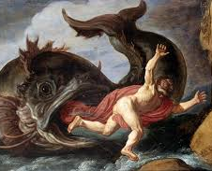
Before we get lost in Biblical history…
Let’s look at Jonah!

Slide 8
Written during King Jeroboam II (790 – 749 bc) – around 780
Jonah was from Gath-hepher – near Nazareth
2 Purposes: Mission to all nations & Messiah’s Resurrection:
  1. God cares for the world not only for the Hebrew soul
  2. Jesus identifies Jonah’s 3 days in the fish with His own 3 days in the tomb – this validates Jonah’s authenticity
Chapter 1 – Jonah’s call & flight
Chapter 2 – Jonah’s prayer
Chapter 3 – Nineveh’s repentance
Chapter 4- God’s Compassion is Sure

Slide 9
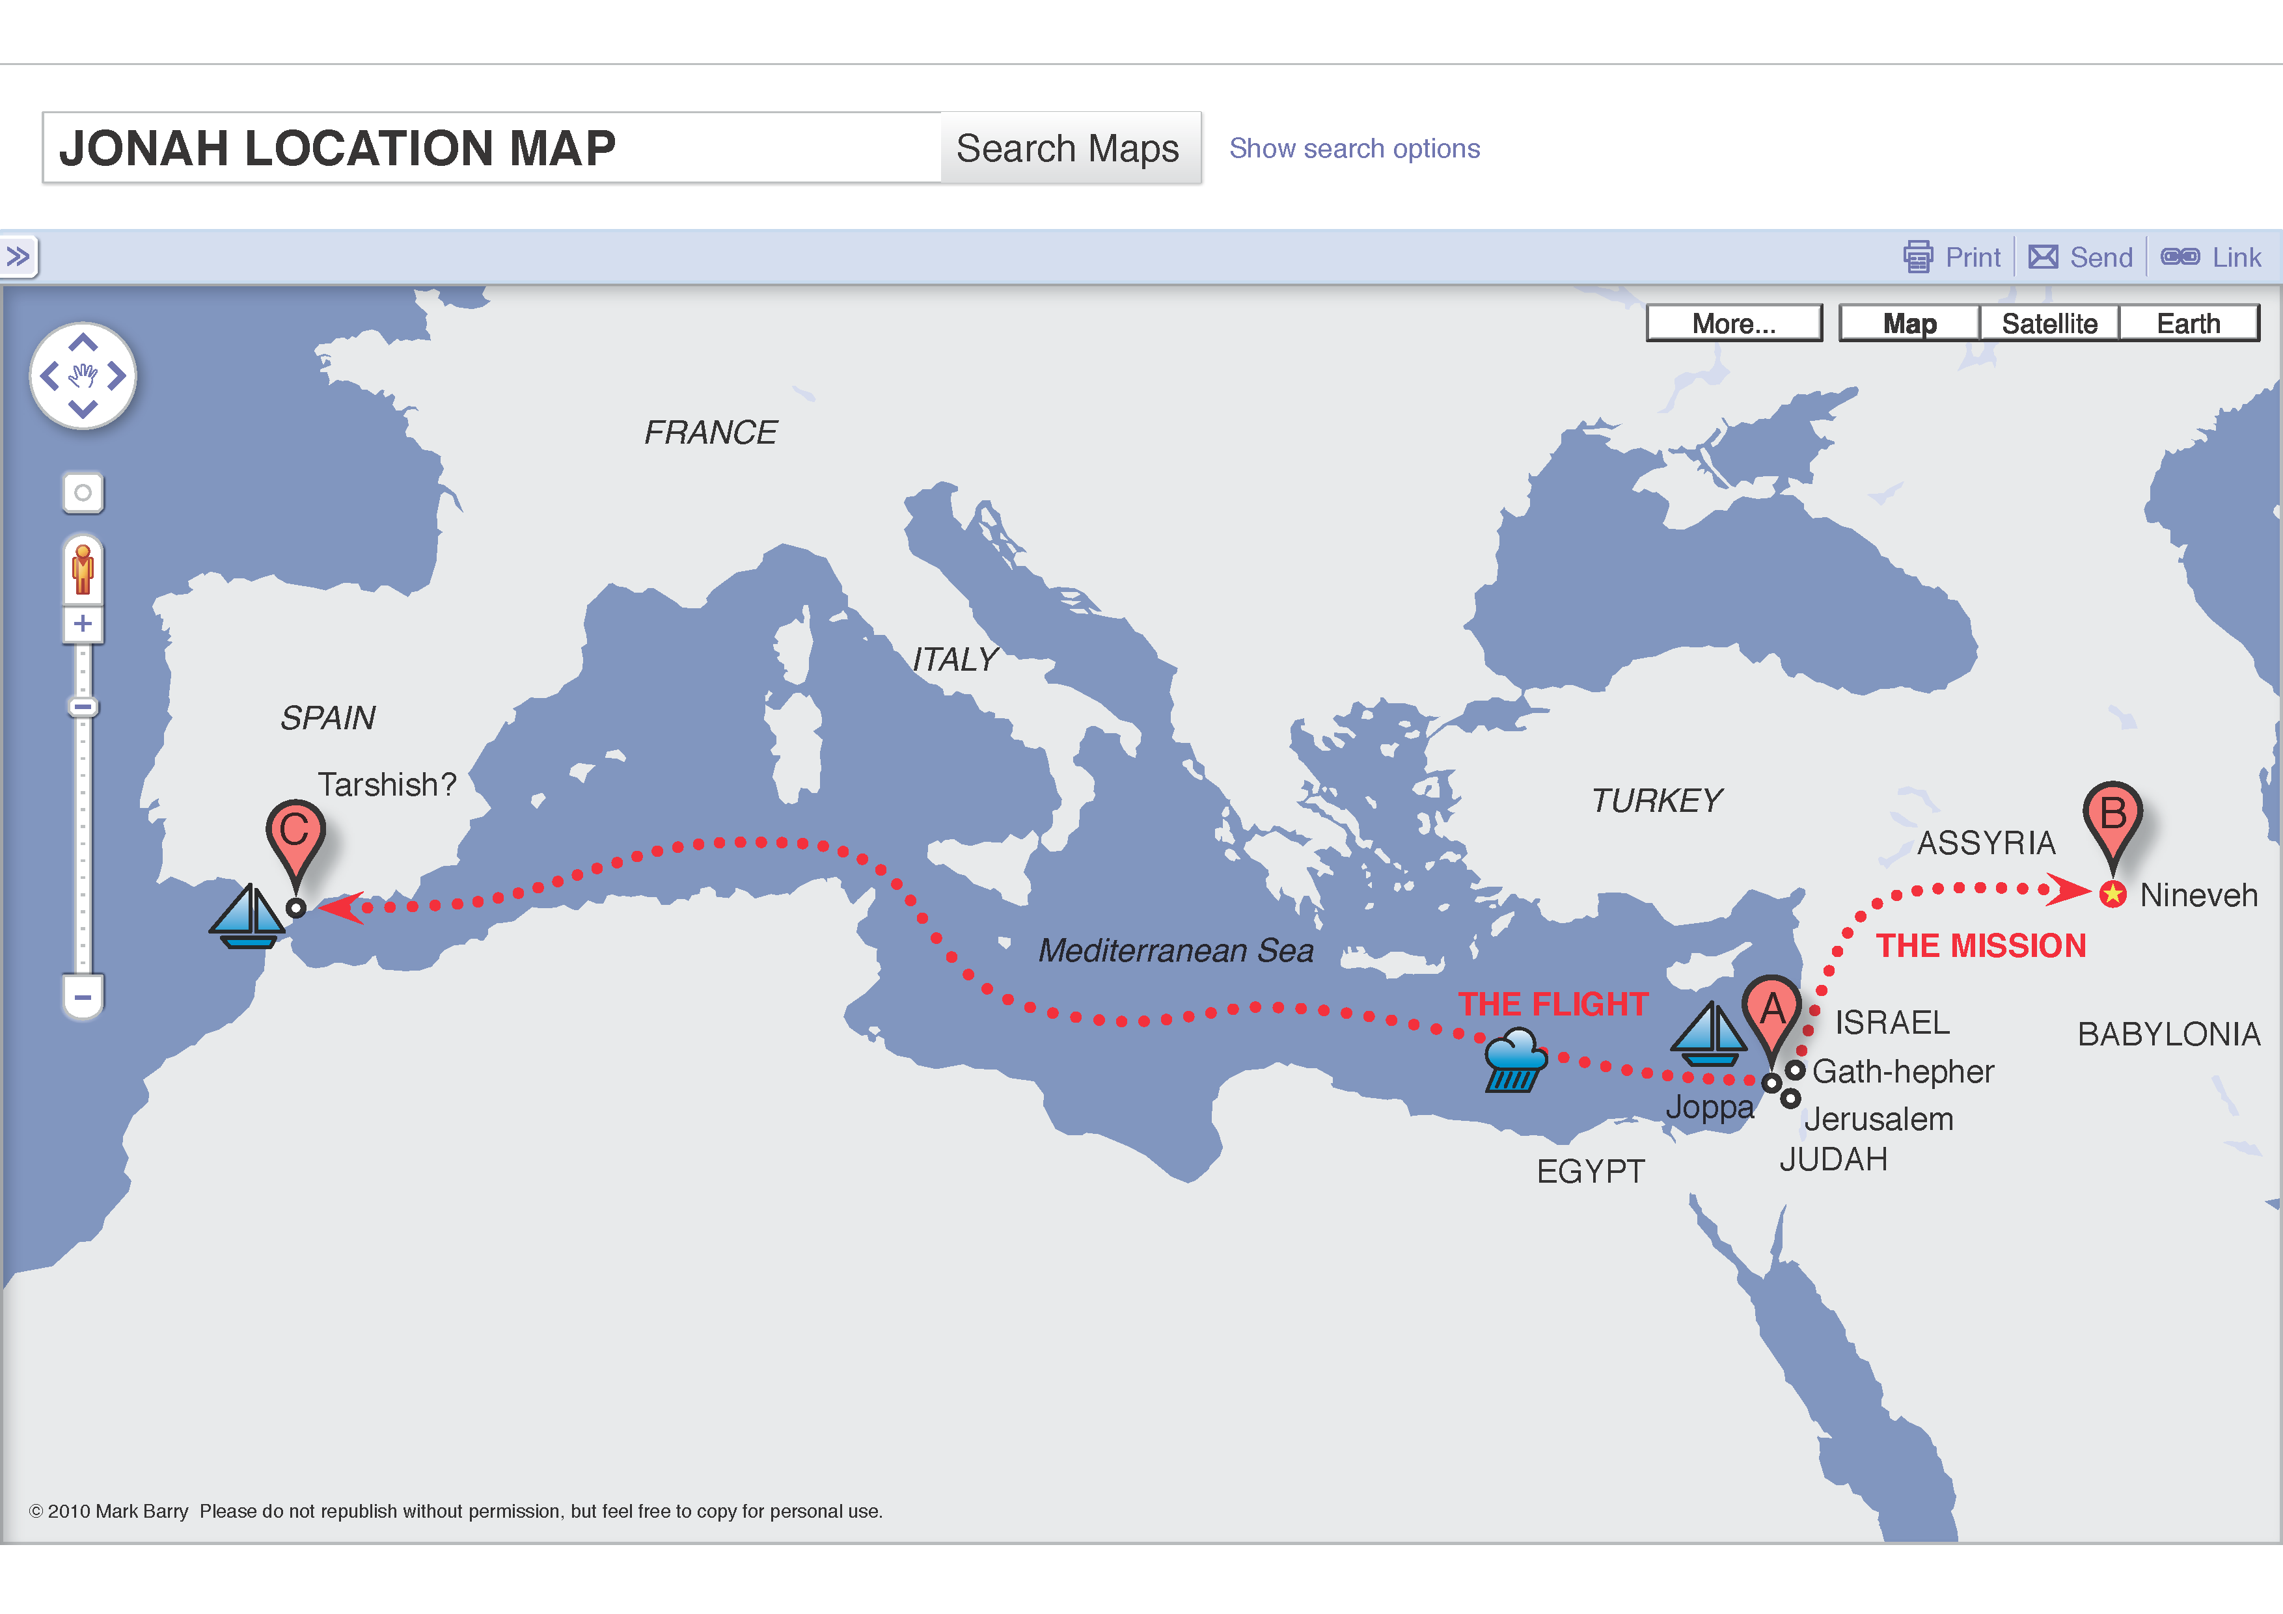
Chapter 1 – Jonah’s call & flight
The Word of the Lord came to Jonah, “Go to Nineveh…”
He ran! Away!
In Joppa, boarded a ship to Spain…opposite way
A great storm hit, Jonah “ko”, they cast lots and it was Jonah! Captain asked, “who are you?”… and “What have you done?”

Slide 10
Jonah said, “I am a Hebrew and I worship the Lord, the God of heaven, Who made the sea and land…throw me into the sea – this is because of me…”
The captain and crew worked hard at throwing cargo overboard…the storm became worse
They prayed they would not be at fault for Jonah’s death and threw Jonah overboard
The Lord provided a huge fish that swallowed Jonah and he stayed in the belly of the fish for 3 days and 3 nights.

Slide 11
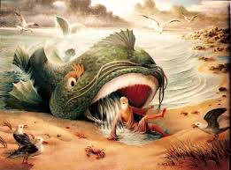
Chapter 2 Jonah’s prayer (from the belly of the fish!)
“…But You, Lord my God, brought my life up from the pit…my prayers rose to you…those who cling to worthless idols forfeit God’s love for them…But I, with shouts of grateful praise, will sacrifice to You…I will say, ‘Salvation comes from the Lord’”
And the Lord commanded the fish and it vomited Jonah on dry ground.

Slide 12
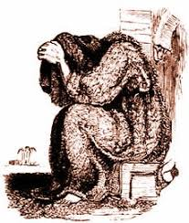
Chapter 3
Jonah Obeys
The Word of the Lord came to Jonah a 2nd time
Took him 3 days to walk thru Nineveh
“In 40 days Nineveh will be overthrown!”
The Ninevites believed and repented
The King dressed in sackcloth, repented, fasted and prayed.

Slide 13
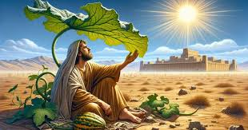
Chapter 4 God’s Compassion is sure!
Jonah became very angry with God
“I told you! This is why I ran!”
”I knew You are a gracious and compassionate God, slow to anger and abounding in love, a God Who relents from sending calamity…now take my life!...”
The Lord said, “Is it right for you to be angry?”
God provided a gourd for shade to comfort Jonah as Jonah watched the city…he was happy…

Slide 14
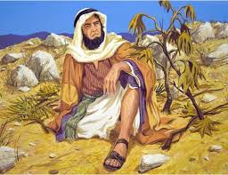
*The next day, God provided a worm to eat the gourd
*The scorching sun came up…so hot Jonah felt faint
*”Is it right for you to be so angry about the gourd when you have done nothing to grow it?”

Slide 15
Jonah said, “YES!”
God said, “You are so concerned about the gourd that came and died in a day’s time – you didn’t even do anything to make it grow…
Shouldn’t I have concern for the 120,000+ people who don’t even know their right hand from their left hand?”

Slide 16
The 12 Minor Prophets and today’s message from Jonah will…
Show us God’s incredible forgiveness – we do not deserve nor can we earn…
God is committed to His promises
God is patient with the nonbeliever as well as with us – the believers
Emphasize His mercy endures forever!

