Slide 1
Judgement against Israel and surrounding nations
The prophesies of Amos
792 bc – 740 bc

Slide 2
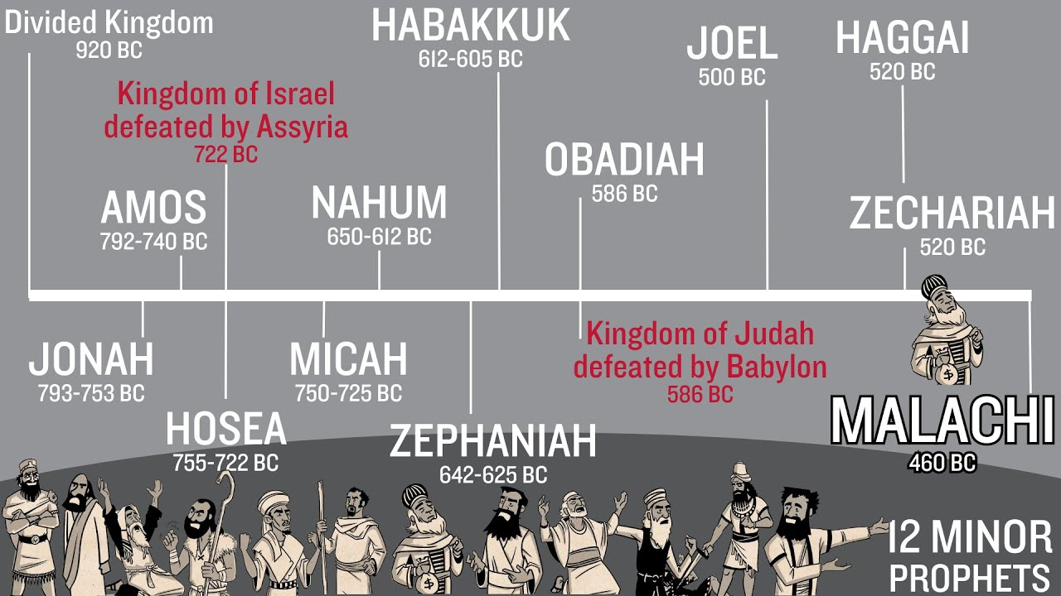

Slide 3
Intro to the book of amos
From city of Tekoa in the country of Judah, 6 miles south of Bethlehem and 11 miles from Jerusalem
He was a farmer of figs and a shepherd
His name means “The Lord comes”
Contemporary of Hosea (love) and Jonah (dove) – Amos focuses on judgement
Sent to Israel but meant for all 12 Tribes
Uzziah was king of Judah (792-740bc) and Jeroboam II (793-753 bc) was king of Israel

Slide 4
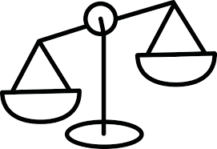
Their religious philosophy: all we have to do is sacrifice to god and we can do whatever we want… sound familiar?
Condemned by God for their disobedience and for making themselves powerful by stepping on others (crab theory?)
Bottom line: Israel needs to remember her commitment to the covenant and remember her obligations to Him
Grace
Mercy
Justice

Slide 5
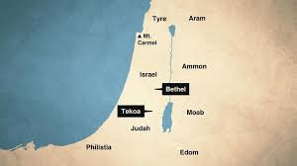
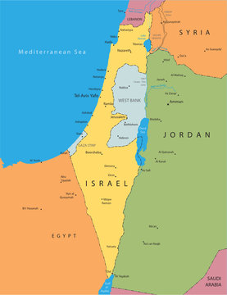
Map today:
Map during Amos’ time:

Slide 6
Chapter 1
The Lion of Judah roars = judgement is for sure! “True business!”
Starts with Damascus (v3-5):
Term used “3 sins – no 4 sins” = “again and again and again”
You will be judged because you “threshed Gilead” breaking the treaty between King Saul and Gilead. Threshing means put hooks in body and drag through town until body parts fall off… cruel torture!
Damascus was described as beautiful as the Garden of Eden… was destroyed when Assyria captured Israel (northern 10 tribes) in 722 bc.

Slide 7
Surrounding Nations:
Gaza (Philistine’s large city), Philistine constantly tormented Judah. Nebuchadnezzar (Babylon) destroyed them in 580’s
Tyre (city in Phoenicia) Sold entire Jewish communities to Edom for slaves. Broke the treaty between David and Hiram (King of the Phoenician area defined in II Sam 5:11)
Edom: “constant anger” against his brother (Esau and Jacob) is constantly at war. Will be destroyed
Ammon (Amman – part of Jordan today) ripped open pregnant women of Gilead, brutal genocide

Slide 8
Surrounding nations continued
Chapter 2
Moab – judged for their cruelty (burnt the bones of Edom’s Kings), they will be a nation of great tumult and war
Judah – rejected the Laws of God, Jerusalem will be consumed, and like other nations, they will experience a loss in their defenses and wealth – they trusted themselves not God
Amorites – tall and strong will be defeated. ‘Amorites’ term used to identify all Canaanites.

Slide 9
Chapters 3 & 4
Israel = “I have chosen you!” Yet you have incest! Fathers and sons have sex with the same girl! Have sex at My altars, sell the innocent for shoes, trample on the poor and denied justice to the oppressed! Can two people walk together unless they agree? I will punish Israel for her sins, destroy the altars at Bethel and the horns of the altar will be cut off and fall to the ground.” Declares the Lord… (722bc became Assyrian slaves)
*You have religiously acted but not heartfully obedient!
Samaria – Bashan and the Cows of Bashan(wealthy women) – they will be taken away with hooks in their nose or lower lip for all to see!

Slide 10
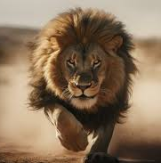
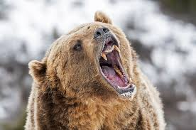
“Prepare to meet your God!” Chapters 5 & 6:
“Hear My lament” – funeral song = Seek Me…you have turned justice into bitterness; you have cast righteousness to the ground; you hate those who upholds justice … seek good, not evil that you might live…hate evil, love good – perhaps then the Lord will have mercy on you!”
The Day of the Lord (Day of Judgement) = you will run away from a lion only to run into a bear; you are a stench to Me because you sacrifice without obedience…

Slide 11
Woe to the Compliant (6: 1-7) = “hands off” “keep to self” “not speak up for right” – you will be the first to be taken into exile - slavery. (The book of James talks about “the sin of omission” – know what is right but ignore – not get involved. To stay silent is a sin)
V8-14 God declares His hate for Israel’s arrogance and pride…punishment is ‘true business’!
7: 1-9 The plum line…God has measured Israel and Israel has failed

Slide 12
A narrative change:
Switch from Amos prophesying to Amaziah (Priest of Bethel) sending a message to King Jeroboam II – telling him that Amos is preaching doom and destruction of Israel
King Jeroboam II tells Amos to get out of Israel – return to his home in Judah
Amos responds, “I was a shepherd and farmer of figs when the Lord brought me here (happy where I was) … Israel will ‘true business’ become slaves!”
Then God showed Amos a basket of ripe/fresh fruit…ready to be picked…judgement is very near.

Slide 13
Redemption promised!
9:8, “Yet, I will not totally destroy the descendants of Jacob!” declares the Lord.
v11-15, “I will restore David’s fallen shelter, they may posses the remnant of Edom and all the nations that bear My name.
I will bring My people Israel back from exile.
I will plant Israel in their own land never again to be uprooted…says the Lord your God!”

Slide 14


What do we see?
God’s grace is in both mercy and justice
Social justice started with God!
Crab Theory is not only a part of the American Deaf Community – it’s a part of our sinful nature
True peace in Israel comes only through Jesus
Two cannot walk together unless they agree – we cannot walk with Jesus without being obedient to His Word
The ’compliant’ will be judged for their silence
The ‘basket of fruit’ is ripe today
“I will restore…” ”I will save those who call on My Name!”

