Slide 1

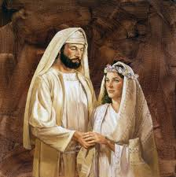
Hosea – God’s Love for Israel

Slide 2
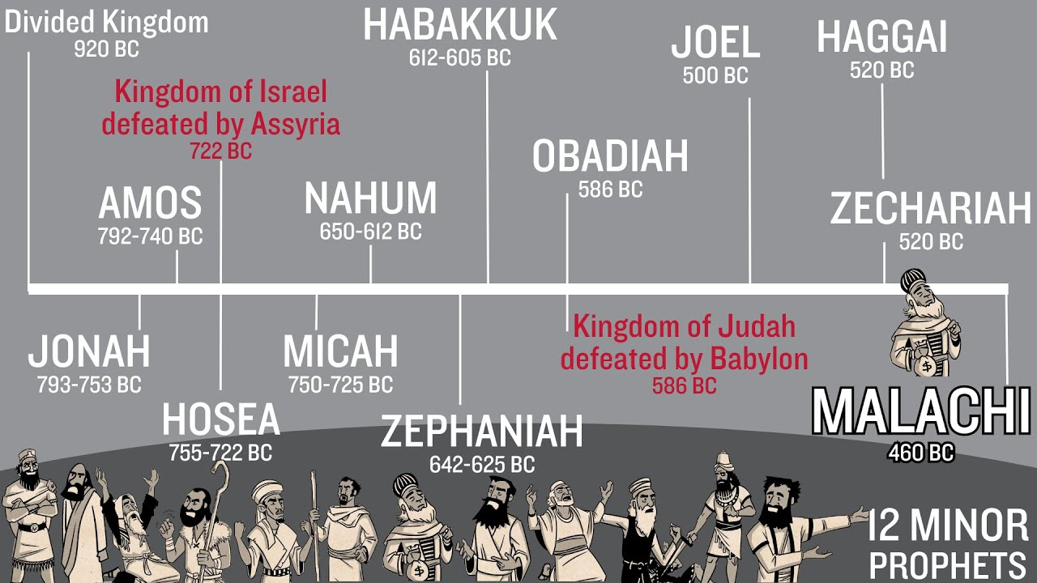

Slide 3
Review:
David’s Kingdom of 12 states divided into:
Northern 10 states = Israel
Southern 2 states = Judah
Jonah: name means “Dove”, symbolic of God’s love
Amos: name means “The Lord Comes”, symbolic of God’s judgement

Slide 4
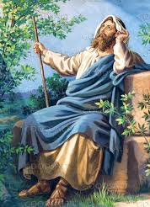
Hosea – name means “Salvation”
The only prophet from Israel (northern kingdom)
Wrote right after Assyria defeated Israel (722 bc)
Ministered 38 years in Israel

Slide 5
Chapter 1
V2 God tells Hosea to marry a ‘promiscuous’ woman – Hosea is the picture of God – God Who pursues His love. The promiscuous woman is Israel… unfaithful!
V3 - 4 He marries Gomer and they have a son named Jezreel. Jezreel has two meanings: scattered or planted by God. In verse 4, Jezreel meant scattered or punished by God. Punished specifically because when Jehu was king of Israel, his family line massacred the reigning king to become king in the Valley of Jezreel (841 bc).
V5 I will break Israel’s bow (military power)

Slide 6
Gomer conceived again, a daughter named Lo Ruhamah. Lo Ruhamah = “not loved”. V7 states, “I will no longer love Israel – but I will love Judah”
The third child (son) was named Lo Ammi which means “not My people” – I am not your God
V11 God’s expressed desire: “Yet they will be called ‘children of the Living God’. Judah and Israel will be united as one, “for great will be the day of Jezreel”

Slide 7
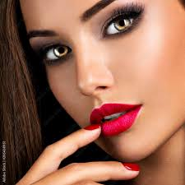
Chapter 2
Note the name changes:
  Jezreel changed from ‘scattered’ to ‘planted by God’
  Lo Ammi changed from ‘not My people’ to ‘My people’
  Lo Ruhamah changed from ‘not loved’ to ‘My loved one’
  V2 Rebuke Gomer! Let her lewdness be exposed! Remove the adulterous look from her face…her roaming eyes. She is determined to run after her ‘lovers’!
  Gomer will be caught in adultery and taken out of their home
  You, Israel, have forgotten Me…

Slide 8
God offers Israel redemption
V14-23 “I will allure her…make the Valley of Achor (Trouble) become a door of hope!”
V16 “You (Israel) will call Me “my Husband” and no longer “my Master”
V19 “I will betroth (marriage promise) you to Me forever. I will betroth you in righteousness, justice, love and compassion

Slide 9
The meanings of the 3 children are emphasized again (v22-23):
Jezreel – I will respond to Jezreel and plant her for Myself
Lo Ruhamah – I will show My love to the one called “not My loved one”
Lo Ammi – I will say to those called “not My people” – “I am your God” and you will say “You are my God”

Slide 10
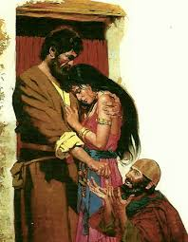
Chapter 3 (v2)
“so, I bought her…Israel will come trembling to the Lord and to His blessings in the last days.”
Chapters 4 “My people are destroyed because of lack of knowledge”
Chapter 5 “I will return to My lair (place of rest) until they have borne their guilt and seek My face – in their misery they will earnestly seek Me”.
Chapter 7 “I long to redeem them but they speak falsely about Me…”

Slide 11
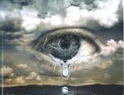
Chapter 8 “How long will they be incapable of purity?...they have forgotten their Maker…”
Chapter 9 “God will reject them because they have not obeyed Him; they will be wanderers”
Chapter 10 “It is time to seek the Lord until He comes and showers His righteousness on you”
“How long?” is answered here…

Slide 12
Chapter 11 God declares His love for Israel
Chapter 12 Israel is reminded of God’s love for Jacob…
Chapter 13 “I care for you”, “I am your helper”, “I will deliver them from the power of the grave; I will redeem them from death, Where O death are your plagues? Where O grave is your destruction?” (I Cor 15)
Chapter 14 Conclusion: “The ways of the Lord are right; the righteous walk in them, but the rebellious stumble in them.”

Slide 13





What do we see?
*God still pursues Israel and He still pursues us
*God intimately loves us
*Our sins deeply grieves Him
*He bought us back thru Christ’s sacrifice
*Will you pursue Him – chase after Him?

