Slide 1
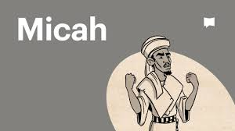
Micah
“Who is Like God?”

Slide 2
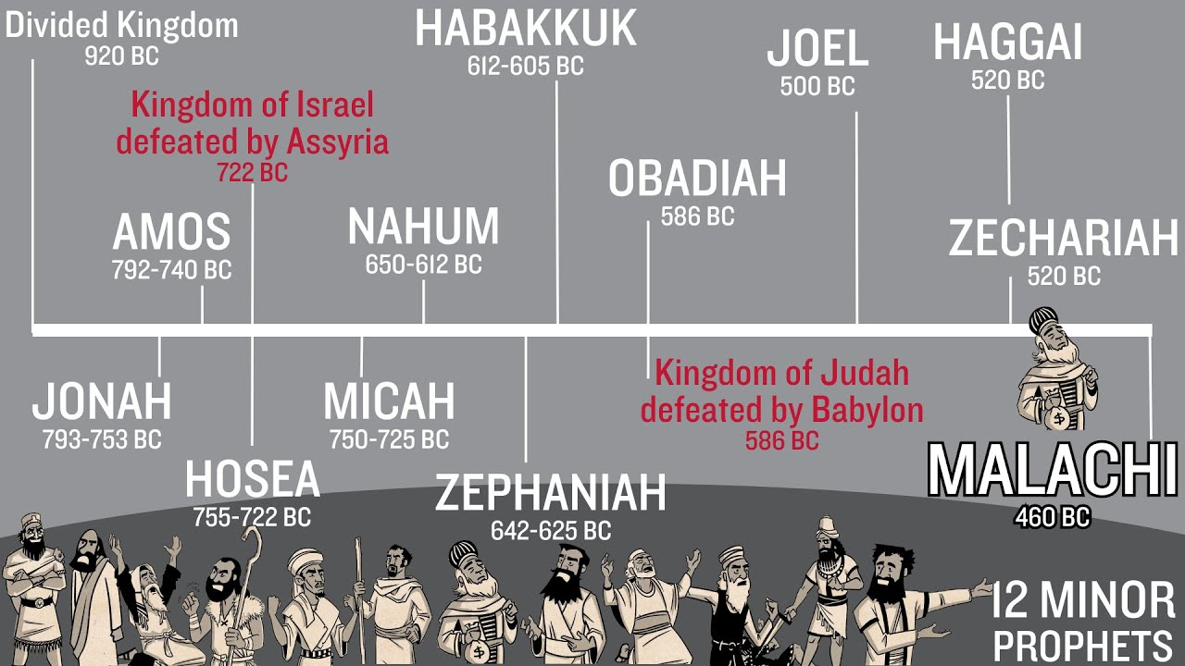

Slide 3
Review:
David’s Kingdom of 12 states divided into:
Northern 10 states = Israel Southern 2 states = Judah
Jonah: name means “Dove”, symbolic of God’s love
Amos: name means “The Lord Comes”, symbolic of God’s judgement
Hosea: name means “Salvation”
Micah: name means “Who is like God?”

Slide 4
3 Cycles Alternating Between God’s Justice and Mercy
OVERVIEW OF MICAH: WHO IS LIKE JEHOVAH? Micah 7:18
RETRIBUTION Micah 1:1-2:13 |  | KINGDOM Micah 3:1-5:15 |  | WORSHIP Micah 6:1-7:20
First Message: Judgment Will Come |  | Second Message: Blessing will follow Judgment |  | Third Message: An Indictment of Sin & A Promise of Blessing
Judgment Micah 1:1-2:11 | Promise Micah 2:12-13 | Judgment Micah 3:1-12 | Promise Micah 4:1-5:15 | Judgment Micah 6:1-7:10 | Promise Micah 7:11-20
Sin and Judgment |  | Hope and Comfort |  | Controversy and Pardon
Sin & It's Outcome Incurable |  | The King & His Kingdom Inevitable First Coming - Mic 5:2-3 Second Coming - Mic 5:4-15 |  | The Lord & His Justice Inescapable
Message of Destruction for Samaria & Judah |  | Message of Doom & Deliverance |  | Message of Denunciation
God Gathers to Judge and Deliver |  | God Judges Rulers and Comes to Deliver |  | God Brings Indictments and Ultimate Deliverance

Slide 5
Chapter 1 He judges
The Lord Himself will judge Samaria (722bc) and Jerusalem (586bc)
The Lord grieves… (vv8-16)
Chapter 2 He Delivers
Vv12 & 13 “I will surely gather all of you, Jacob; I will surely bring together the remnant of Israel. I will bring them together like sheep in a pen, like a flock in its pasture; the One Who breaks open the way will go up before them; Their king will pass through before them, the Lord at their head.”
Rabbinic Note: “The One”, “Their King”, and “The Lord” = The Messiah

Slide 6
Cycle #2 Chapters 3 to 5:15
3:1-4, Israel was like “social cannibals” – they hated good and loved evil
Their sins separated them so far from God, when they cried – God would not hear them…
Vv 5-8, False prophets will declare peace (“all is well”) – they will be shamed; “but as for me (Micah), I am filled with power, with the Spirit of the Lord, and with justice and might, to declare to Jacob his transgressions (choices to sin), to Israel his sin.”

Slide 7
Cycle #2 continued
Chapter 4
Vv1-5, “In the last days”… New Temple will be established grander than ever – become the worship learning center for all nations. No more war, and all will walk in the Name of the Lord
Vv6-9 , “In that day”… the lame and broken will be my strong remnant…Kingship will come to Jerusalem
V10, But until then… “Babylon will be Judah’s captures”… (586bc)

Slide 8
Cycle #2 continued
Chapter 5 Restoration
V2, “But you, Bethlehem Ephrathah, though you are small among your clan of Judah, out of you will come for Me One Whose origins are from old, from ancient times”… (Hebrew idiom = come from God – from eternity)
Vv4-5, He will stand and shepherd His flock in the strength of the Lord and in the majesty of the name of the Lord His God…and He will be our peace
Vv10-15, “I will uproot you from among the Asherah poles!”

Slide 9
Cycle #3 Chapters 6-7
6:1-16 Set up as a Courtroom scene
The Lord’s case against His people:
What have I done to you?
What have I burdened you with?
V8, He has shown all you people what is good! This is what He requires of you:
      Act justly
      Love mercy
      Walk humbly before your God

Slide 10
Cycle #3 continues
Chapter 7: 1-17
V2, The righteous have been swept from the land; not one upright person remains
V7, “As for me (Micha), I watch in hope for the Lord, I wait for God my Savior, my God will hear me…”
Vv8-13,
  An expression of trust – “the Lord will be my light”
  Declaration of promised restoration - “You will build again!”
  A prayer – “The Lord answers…”

Slide 11
Micah concludes – vv18 – 20
“Who is a God like You Who pardons sin and forgives the transgressions of the remnant of His inheritance?”
“You do not stay angry forever, but delights to show mercy”
“You will again have compassion on us: You will tread our sins underfoot and hurl all our iniquities into the depths of the sea”
“You will be faithful to Jacob, and show love to Abraham, as You pledged on oath to our ancestors in days long ago”

Slide 12


Who is like our God? And what does He require of us?
Micah 6: 8 … “the Lord requires you…
To act justly and to love mercy and to walk humbly with your God.”

